Slide 1
The Environmental Laboratory Informatics and Management System
Team LabRats
Julian Bell, Remy Brandriff, Blake Lawton Team Mentor: Ana Steinmacher
Design Review III
11 April 2019
Notes:
Julian: we are team labrats, our capstone project is ELIMS, and this is our third design review for the capstone sequence. Introduce each person

Slide 2
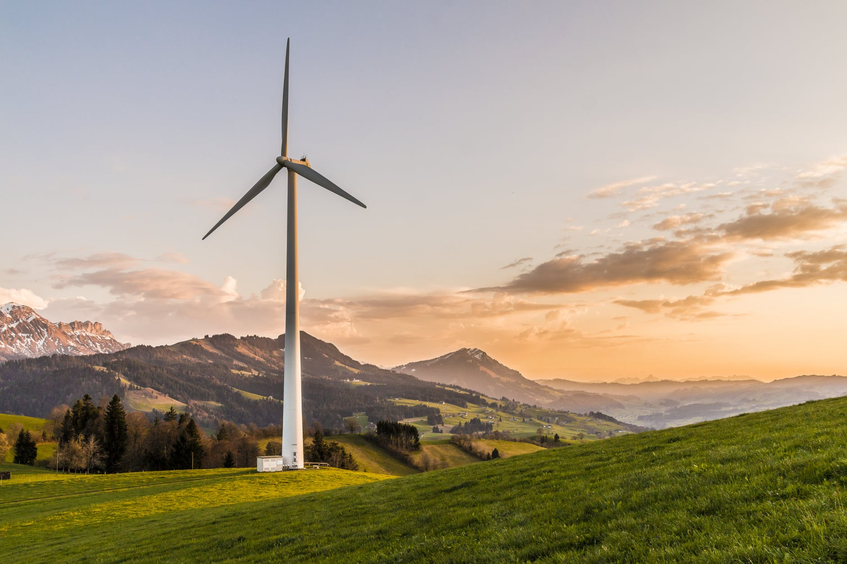
The Field of Environmental Engineering
Environmental engineering is the combination of fields and specialties with the goal of creating solutions to environmental problems, like acid rain, global warming, and pollution
Improving and protecting the environment protects human and animal health, protects nature’s beneficial ecosystems, and improves environmental-related quality of life
Recycling and waste disposal
Public health
Water and air pollution
Sustainable and renewable energy
Notes:
Chemistry, biology, ecology, geology, hydraulics, microbiology, mathematics
Addressing issues like acid rain, global warming, ozone depletion, water and air pollution -- Blake

Slide 3
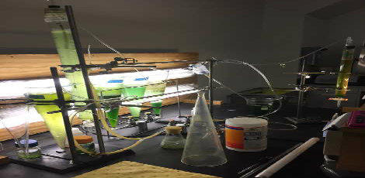
About the ENE Lab
The Environmental Engineering (ENE) Lab at NAU supports state-of-the-art research into pollution, soil, water, hazardous waste, and natural resources for students and faculty, and industry professionals.
Why is that important?
Research performed here at the ENE Lab has wider applications solving problems in the global environment to help ensure the safety and health of our planet
Notes:
ENE Lab: Student work, professional research. Studying pollution, soil samples, water, etc. Research done here supports global efforts
Blake. Start at global environ. Eng. scope and why it’s important, THEN into ENE Lab The overview of the entire project

Slide 4
Clients
Terry Baxter, PhD
Main project client
Professor in the ENE program
Lab Director, oversees labs with other managers
Also supervises student research
Mick Kelly
Lab and Safety manager for ENE department
Professor Terry Baxter
Notes:
Main sponsor is Terry, lab manager and professor who is our main point of contact, along w/ Mick who is the lab and safety manager. Julian

Slide 5
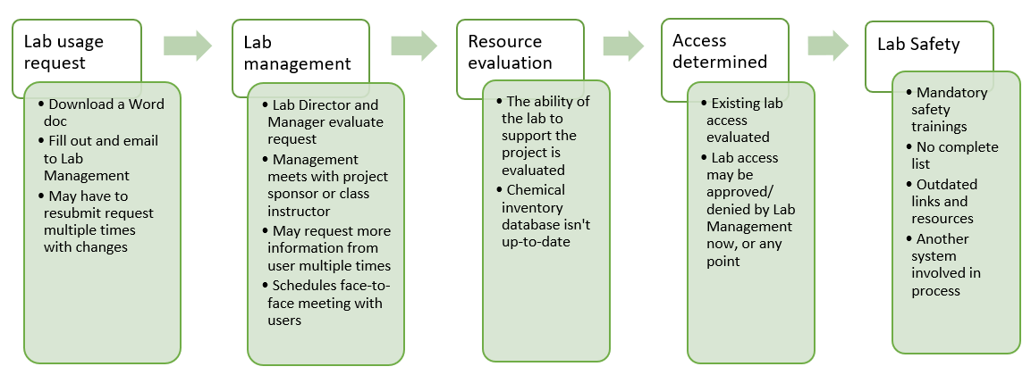
Current Lab Management Procedures
Main components: 1) Lab usage request process, 2) communication with lab management, 3) lab inventory, and 4) lab safety tracking
Notes:
Inventory, lab requests, contacting, and safety trainings spread over different platforms. Lab usage request example: People wanting to use lab downloads a document to fill out, submit via email, lab management meets to review, emails back and forth, face-to-face meeting, safety trainings, final approval or denial. restructure graphic, bullet out points. Add new slide to bullet main points, summarize the problems, 3-4 main problems (decentralized,), next slide
Remy
Current system is too lacking in structure and organization
ENE and labs lack a single, central location to handle these processes
Increasingly critical to safe, efficient lab operations
Failures in safety can lead to many unintended risks

Slide 6
4 Key Problem Areas
Inefficient
Decentralized
Unsustainable
Disorganized
Notes:
3-4 main problems, buzzwords we’ll keep coming back to
Remy

Slide 7
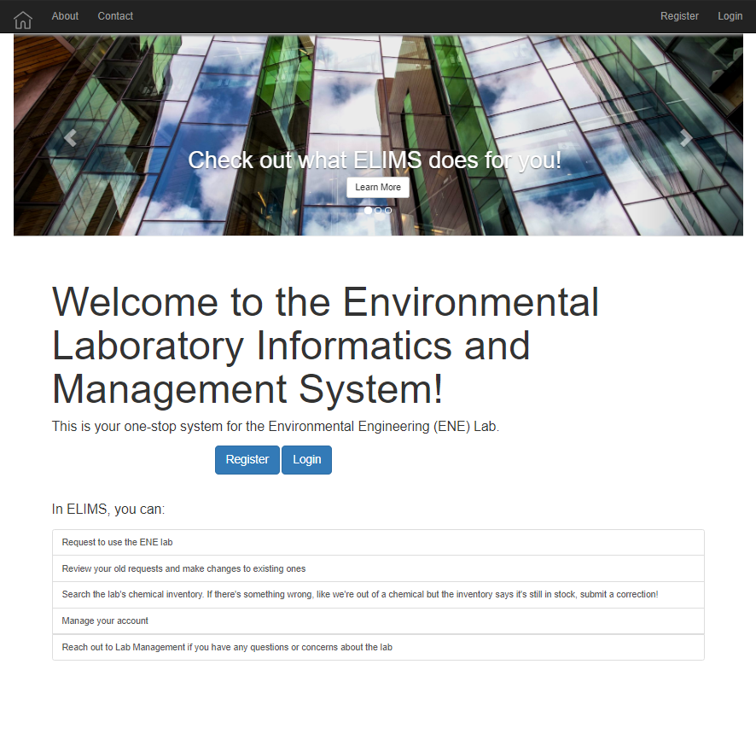
The Solution
A robust, dynamic web app centralizing the operations for the ENE Lab and streamlining the lab usage request process into one convenient system that is:
Efficient
Centralized
Sustainable
Organized
Notes:
Remy, instead of these bullets, have problem bullets written in positive way. Decentralized -> Centralized, etc.

Slide 8
Requirements Overview
Users need to be able to make lab usage requests and administrators must be able to approve/deny requests
Lab administrators must be able to review safety trainings
The lab inventory must be accessible and easy to manage
The system must be maintainable by ITS for deployment
Notes:
Briefly summarize previous semester. Julian

Slide 9
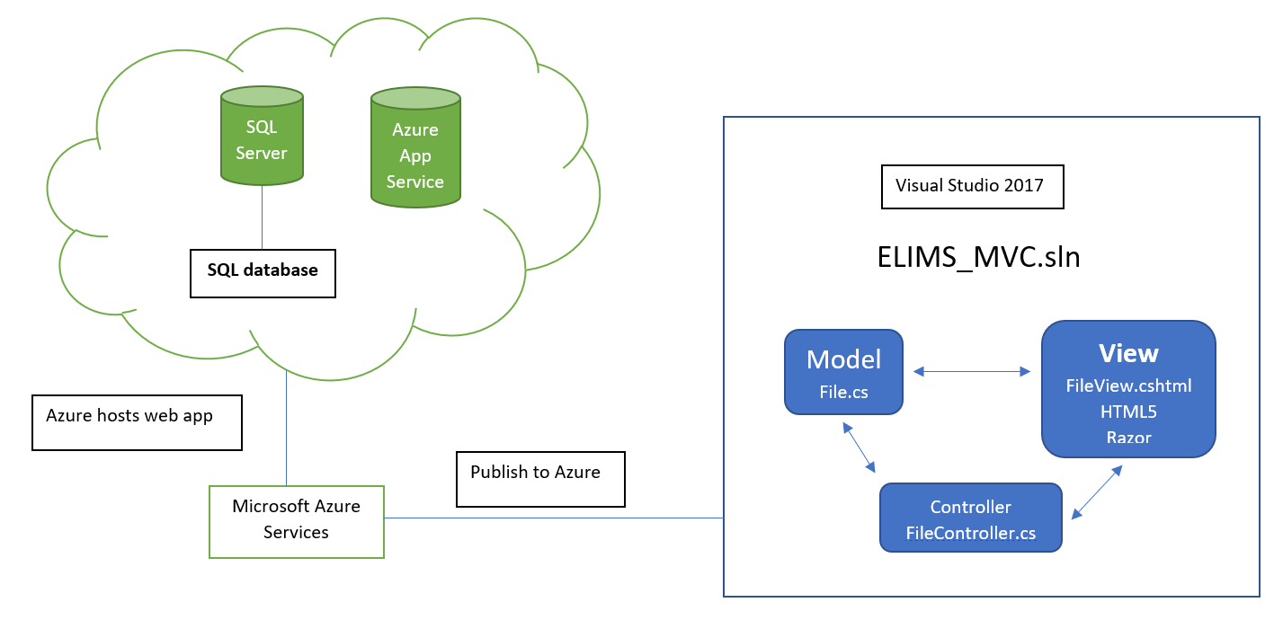
ELIMS Structure & Architecture
Notes:
Remy

Slide 10
Architecture
Front end
Bootstrap & JavaScript
LINQ/SQL
C#
Back end
C#
LINQ/SQL
Hosting
Microsoft Azure web server and SQL server
Frameworks & Tools
ASP.NET Core 2.1 framework
Visual Studio 2017 Community
Microsoft Azure for Students services
Notes:
Remy

Slide 11
Implementation
A contact page that enables users to get in touch with lab instructors and lab managers
Online lab request forms that can be approved or denied by lab management
Inventory tracking system for chemicals
Organized informational page for safety trainings
Notes:
Blake. Main goal of DR is to show HOW we’re fixing our problems

Slide 12
Notes:
Blake

Slide 13
Challenges
Challenge 1: Azure credit running out
Solution: Created free app service and migrated things over
Challenge 2: Separate development created some integration issues
Solution: Troubleshooting and brainstorming as a group
Challenge 3: Difficulty running Microsoft Azure servers
Solution: Use localhost, push to GitHub for server owner to run
Notes:
Progress has been largely very smooth, with some setbacks here and there. Explain/reword each problem and talk about steps we took to overcome it -- self explanatory. Julian

Slide 14
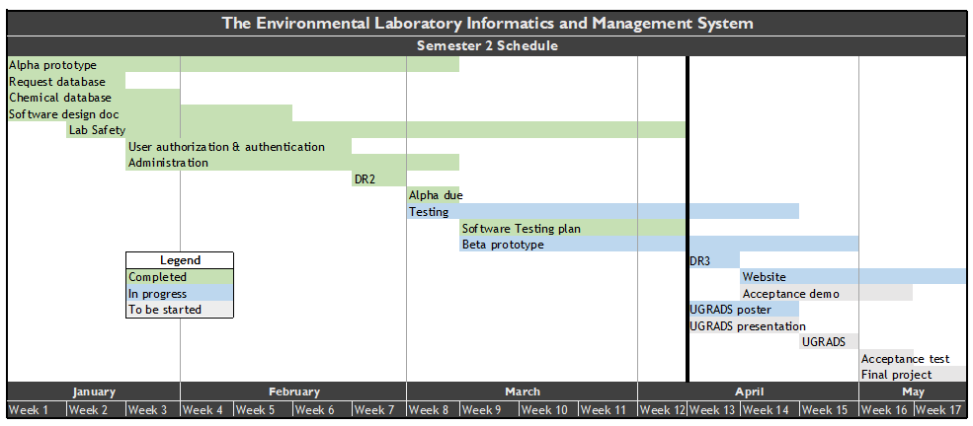
Schedule
Currently conducting our testing
Creating UGRADS poster and presentation
Writing documentation (user manual, project report, reflection document)
Updating team website
Fine-tuning the beta prototype into the final ELIMS product
Notes:
As mentioned, progress is smooth and swift, and we are largely on schedule if not ahead in some areas. Julian

Slide 15
Testing Plan
Collaborative, team-based debugging
Unit Testing
Not much formal unit testing will occur, if any
Instead:
Go through each critical section of ELIMS
Evaluate each subcomponent, i.e., does filtering work, adding items, etc?
Factor in non-functioning segments and work on them
Integration Testing
4 major modules in testing
10 workflow tests
Usability Testing
Login
Contact
Request
Inventory
Notes:
Blake - add stats, like X units reflected in functionality across X modules, same for integration

Slide 16
Usability Testing
To test the UI and UX of ELIMS, we’ve selected several different user groups
CS students
ENE students
Lab Director & Lab Manager
Student managers
Miscellaneous
Users will receive the link to the ELIMS web app.
While using it, the users will record their thoughts and ideas. They will also be asked a series of questions, such as:
“Did you find ELIMS easy to start using? Was it easy to use or were some things confusing or difficult to understand?”
User feedback will be used to improve the ELIMS UI and user experience
Notes:
Remy, summarize 14-15-16, keep this one standalone

Slide 17
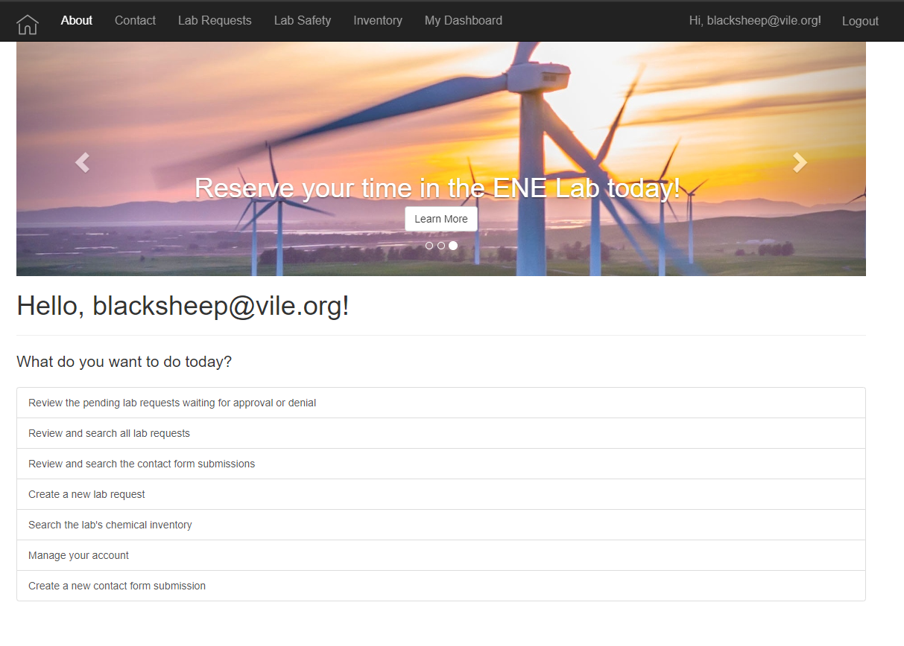
Conclusion
ELIMS is:
Efficient
Centralized
Sustainable
Organized
System functionality is 90% in place; requirements fulfilled, some minor work left
Front end
Finetune processes
NAU’s ENE Lab needs a robust system to continue its effective operation with scaling population and needs, and we are confident ELIMS will fulfill this need
Notes:
Julian- replace bullets with the buzzwords from earlier

Slide 18
Questions / Comments ?

