Slide 1

The Environmental Laboratory Informatics and Management System
Team LabRats
Design Review II
28 February 2019
Notes:
Julian: we are team labrats, our capstone project is ELIMS, and this is our second design review for the capstone sequence

Slide 2


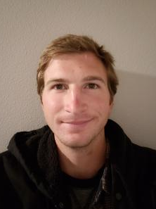
Team Intro
Remy Brandriff
Architect
Webmaster
Front end
Julian Bell
Team Leader
Communications
Back end
Blake Lawton
Developer
Email system
Back end
Notes:
Intro each member with roles

Slide 3
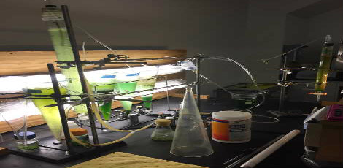
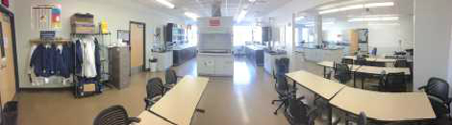
Context of Problem
The Environmental Engineering (ENE) Lab at NAU supports state-of-the-art research into pollution, soil, water, hazardous waste, and natural resources for students and faculty, and industry professionals.
Why is that important?
Research performed here at the ENE Lab has wider applications solving problems in the global environment to help ensure the safety and health of our planet.
Notes:
ENE Lab: Student work, professional research. Studying pollution, soil samples, water, etc. Research done here supports global efforts

Slide 4

Sponsors
Terry Baxter, PhD
  Main project sponsor
  Professor in the ENE program
  Oversees labs with other managers
  Also supervises student research
Mick Kelly
  Lab and Safety manager for ENE department
Notes:
Main sponsor is Terry, lab manager and professor who is our main point of contact, along w/ Mick who is the lab and safety manager

Slide 5
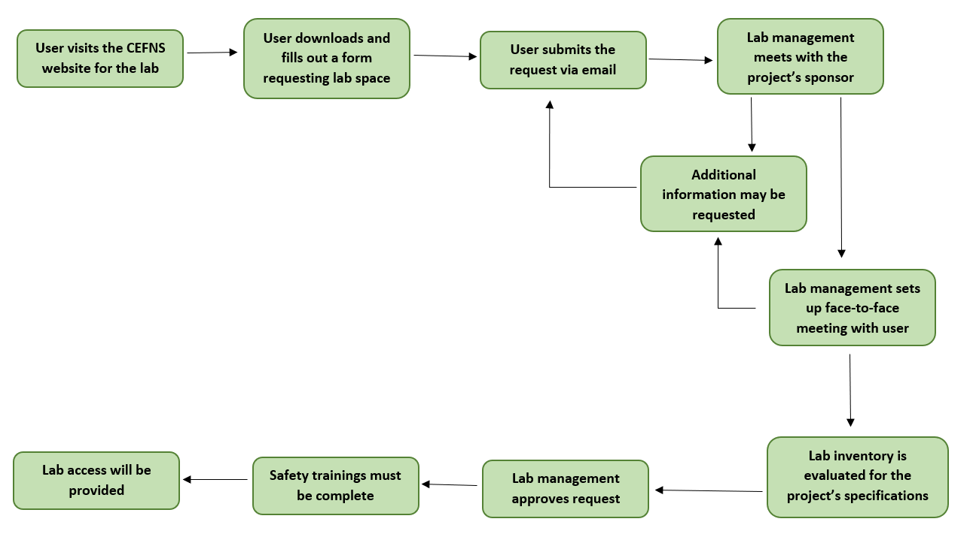
Current
ENE Laboratory Usage Request Process
Notes:
Inventory, lab requests, contacting, and safety trainings spread over different platforms. Lab usage request example: People wanting to use lab downloads a document to fill out, submit via email, lab management meets to review, emails back and forth, face-to-face meeting, safety trainings, final approval or denial.

Slide 6
The Problem
Current system is too lacking in structure and organization
ENE and labs lack a single, central location to handle these processes
Increasingly critical to safe, efficient lab operations
Failures in safety can lead to many unintended risks

Slide 7
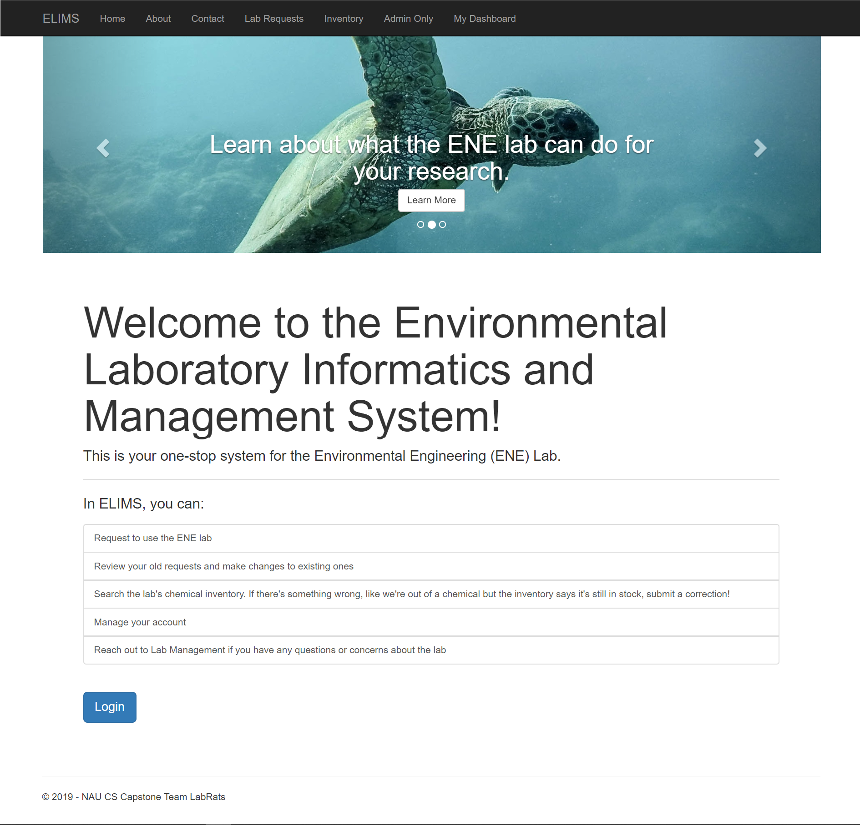
The Solution
A robust, dynamic web app centralizing the operations for the ENE Lab and streamlining the lab usage request process into one convenient system
Standard users
  Make requests for lab access
  Contact lab administrators
  Search lab inventory
  Manage their requests in a dashboard
Lab administration
  Approve/deny lab access requests
  Review safety trainings
  Manage the lab inventory and users

Slide 8
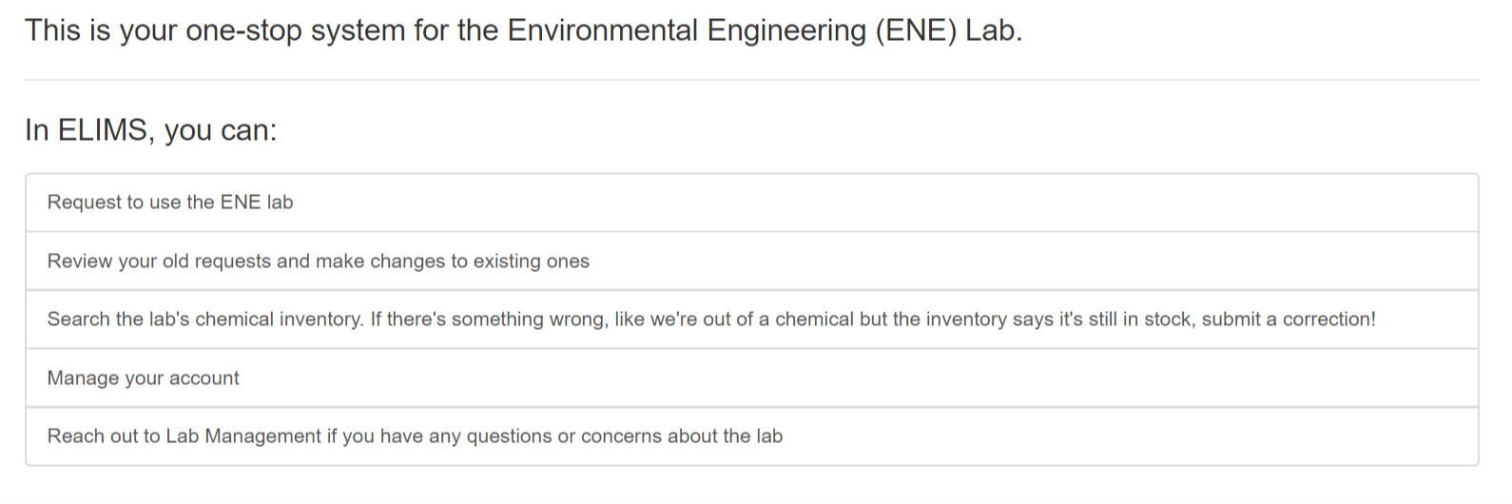
Requirements Overview
Users need to be able to make lab usage requests and administrators must be able to approve/deny requests
Lab administrators must be able to review safety trainings
The lab inventory must be accessible and easy to manage
The system must be maintainable by ITS for deployment
Notes:
Briefly summarize previous semester

Slide 9
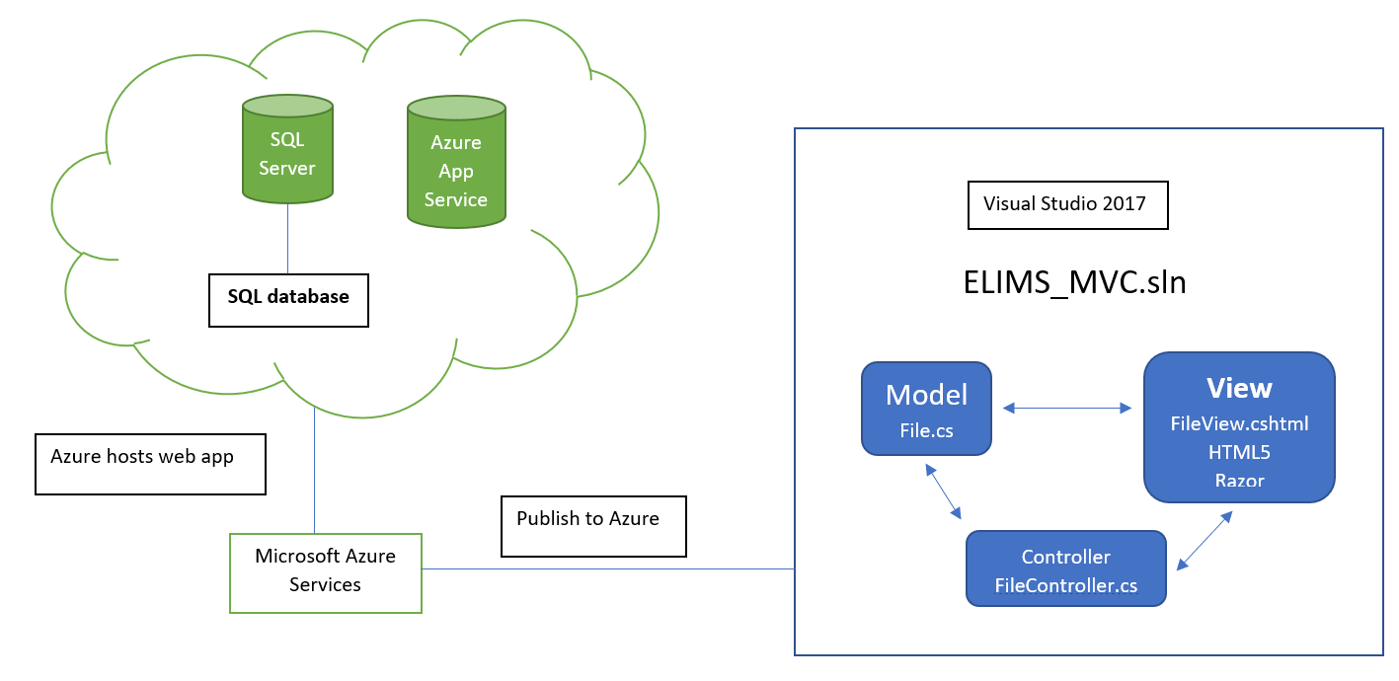
ELIMS Structure & Implementation
Notes:
Describe how our solution is implemented (developed in Visual Studio using C#, JavaScript, HTML, CSS, Bootstrap, LINQ; hosted on Microsoft Azure servers. Same as ITS. Also same as ITS, we use CAS authentication using NAU CAS servers). Implementation of different components spread out between us (I’ve done the front end, including setting up the contact and request forms, and user authentication/authorization, deployment; Julian has done the inventory; Blake has done the automated internal email service)

Slide 10
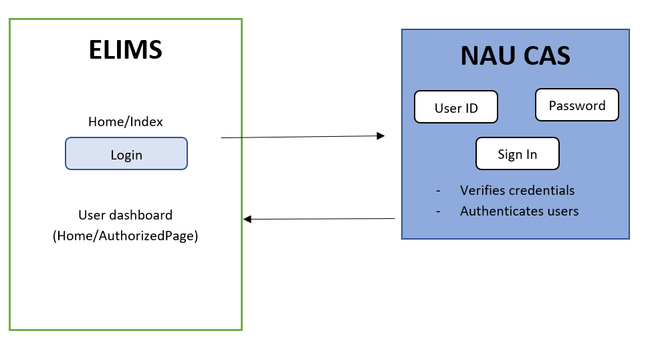
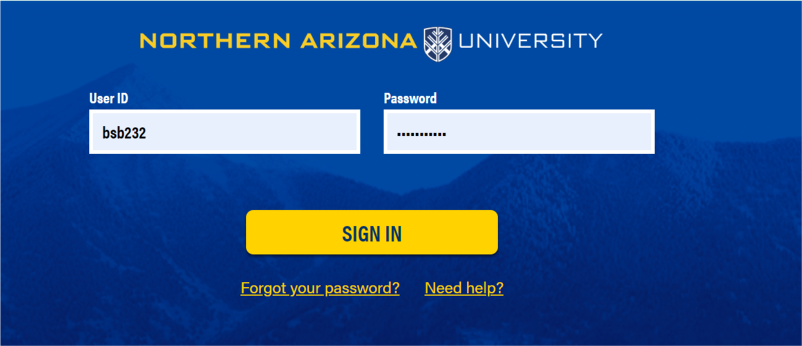
User Authentication

Slide 11
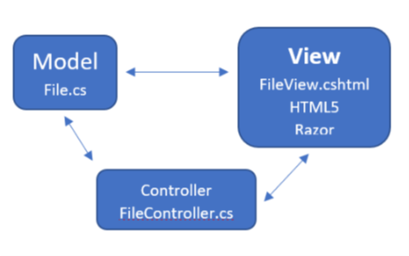
Framework Architecture
Model
View
Control

Slide 12
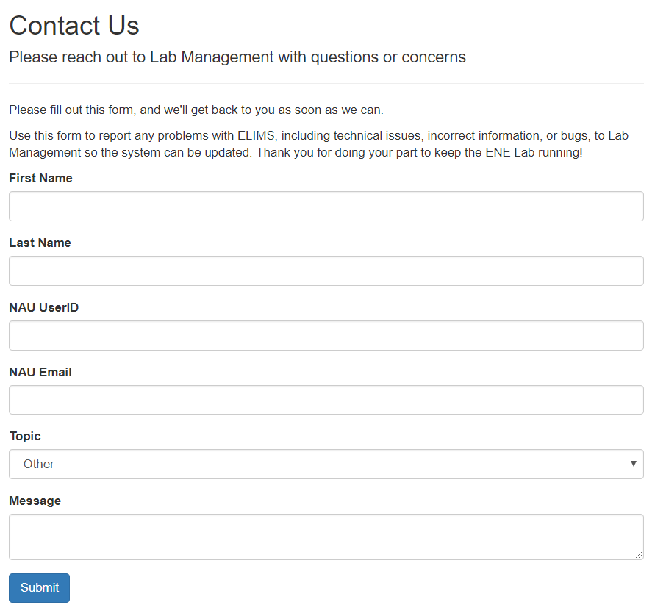
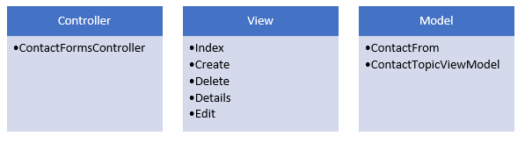
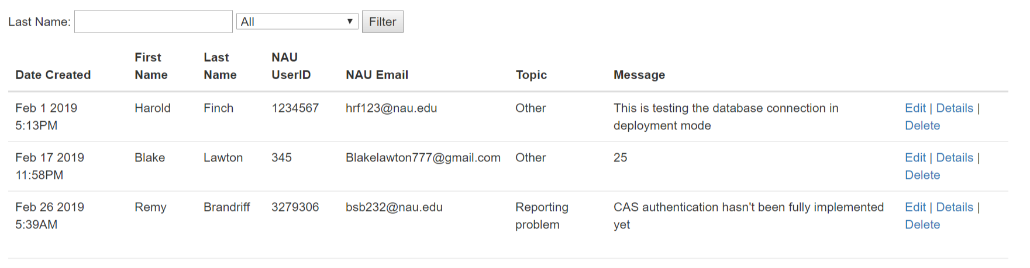
Architecture of Contact Us Page

Slide 13
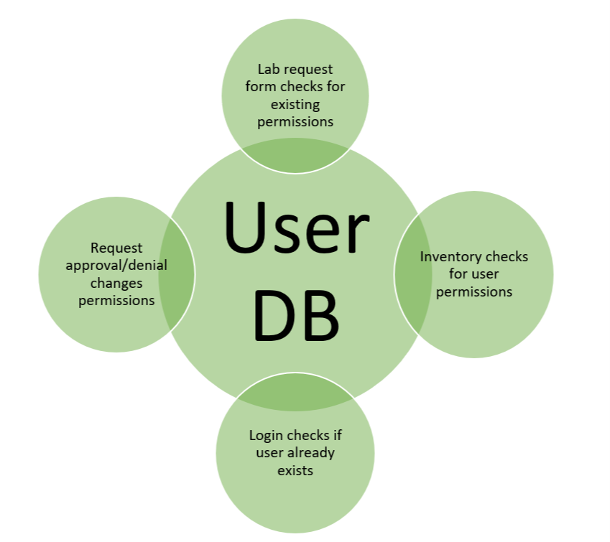
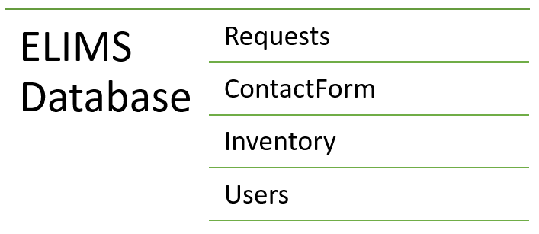
Database Architecture
Lab request will check permissions for approval/denial
Login system
Inventory only accessed by administrative user
Logged in for any lab request or contact us submits

Slide 14
Challenges
Problem 1: Implementing NAU CAS server
Solution: Communicating with ITS to troubleshoot
Problem 2: Difficulty running Microsoft Azure servers
Solution: Using localhost and pushing to GitHub for server owner to run
Problem 3: Separate development has led to rocky integration
Solution: Troubleshooting and brainstorming as a group
Notes:
Progress has been largely very smooth, with some setbacks here and there. Explain/reword each problem and talk about steps we took to overcome it -- self explanatory

Slide 15
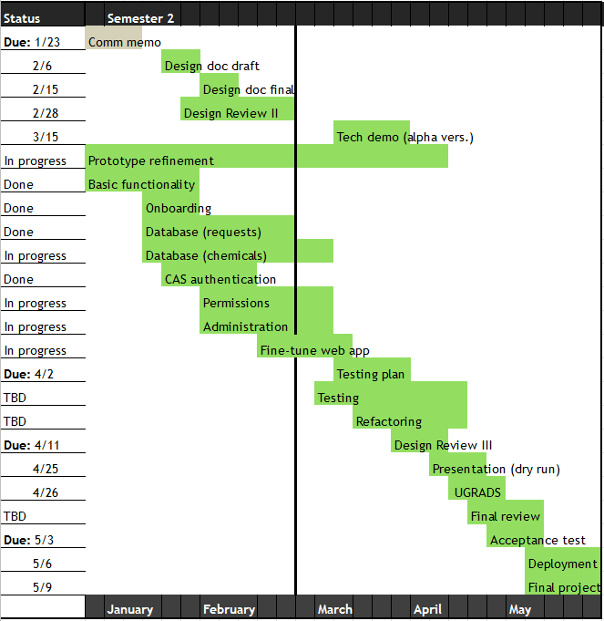
Schedule
Most front-end / server work done
  Back end still in progress
Last pre-alpha tasks coming up:
  Permissions
  Inventories
  Safety modules
Bar occasional setbacks, project going smoothly
Notes:
As mentioned, progress is smooth and swift, and we are largely on schedule if not ahead in some areas. Front end and server setup is mostly done, will have to update as back end progresses, which is our main focus now.
Talk briefly about each of the main three tasks left

Slide 16
Conclusion
NAU’s ENE Lab needs a robust system to continue its effective operation with scaling population and needs
Our work can:
  Handle requests for use of lab
  Process all inventory information in a central location
  Do all of this in a safe, secure manner which ITS can build on in the future
System is well on its way to fulfilling our requirements and our sponsor’s needs to best serve the ENE Lab

Slide 17
Questions / Comments

