Slide 1
BioNetFit
Web Access and GUI Design
Team U.I. Fit
Charles Chatwin, Matthew Burns, Joshua Gutman, Tanner Brelje
Mentor: Dr. Abolfazl Razi
Notes:
First quickly intro the team, the name of the project you are working on, and your CS faculty mentor

Slide 2
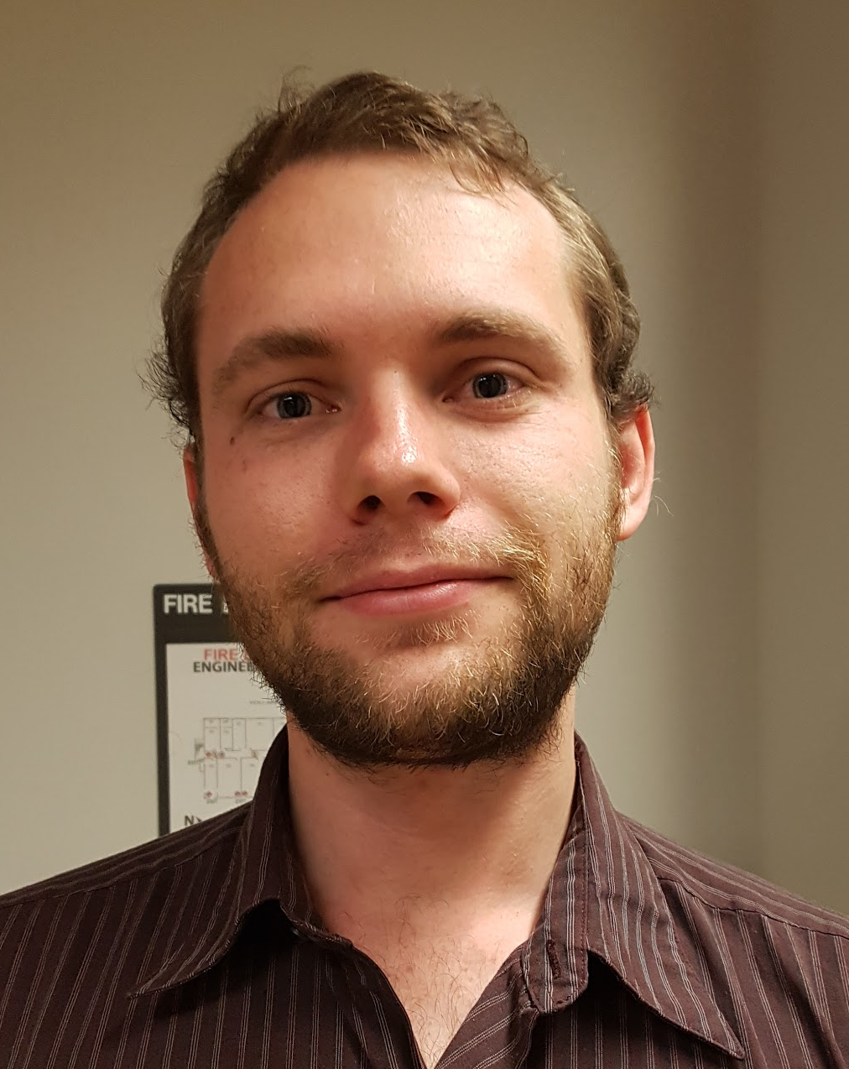
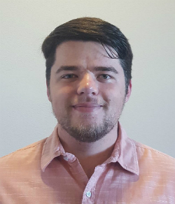
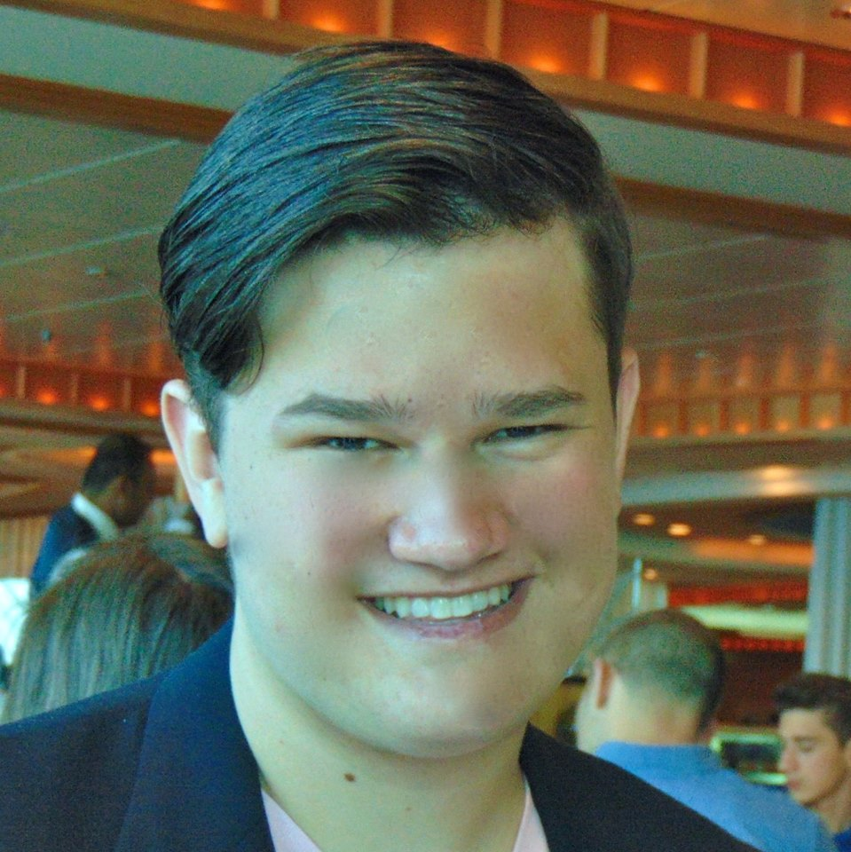
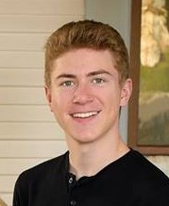
Team U.I. Fit
Charles Chatwin
Team Leader
Tanner Brelje
Coordinator
Matthew Burns
Web Designer
Joshua Gutman
Release Manager
Notes:
First quickly intro the team, the name of the project you are working on, and your CS faculty mentor

Slide 3
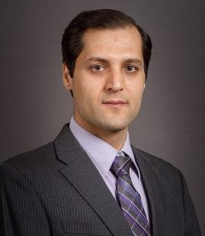
Mentor and Client:
Dr. Abolfazl Razi
Assistant Professor of Electrical Engineering in the School of Informatics, Computing and Cyber Security (SICCS) at Northern Arizona University.
Has a B.Sc., M.Sc., and Ph.D. in EE.
Quantifiable work for the biological process.
Notes:
Our client’s company is generally in the business of making quantifiable work for the biological process.
He also has a team that is even looking for people to fill positions in his team currently.
Our role in the company is with the integration of online viability and user access.

Slide 4
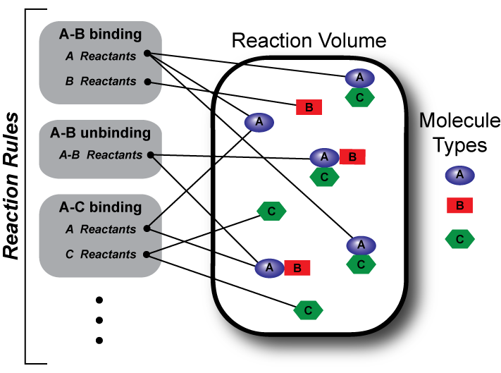
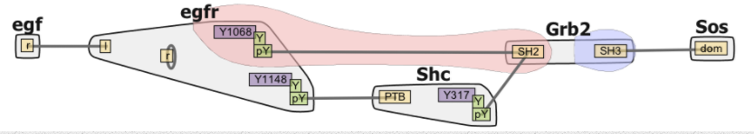
Client’s Business
Researching remote sensing and predictive modeling with focus on health related applications.
Developing integrative computational frameworks to integrate conceptual information in molecular biology.
BioNetFit is a tool that allows researchers to run iterative molecular simulations.
  Created by NAU researchers in conjunction with Los Alamos National Laboratory.

Slide 5

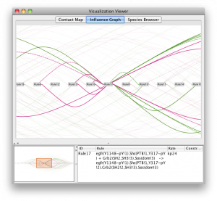
State of BioNetFit
BioNetGen allows researchers to run one molecular simulation at a time.
Researchers want to run the same molecular simulation over and over with varying parameters.
BioNetFit takes in a configuration file that defines the desired values for each parameter of the simulation.
  Then BioNetGen is run multiple times according to those values.
  Exists only as a command-line tool.

Slide 6
Problems
BioNetFit is a useful tool for researchers who want to speed up or reduce the cost of their work.
Currently, only available as a command-line program.
Many researchers aren’t technically savvy enough to comfortably and effectively use command-line programs.
Notes:
Ok, now you have hopefully given a clear explanation of the client's business. Now explain what is broken/wrong/deficient...what is it that made your client wish for some new/better software? Again, an effective technique would be to explain the general problem first, then follow up with a concrete example of badness.

Slide 7
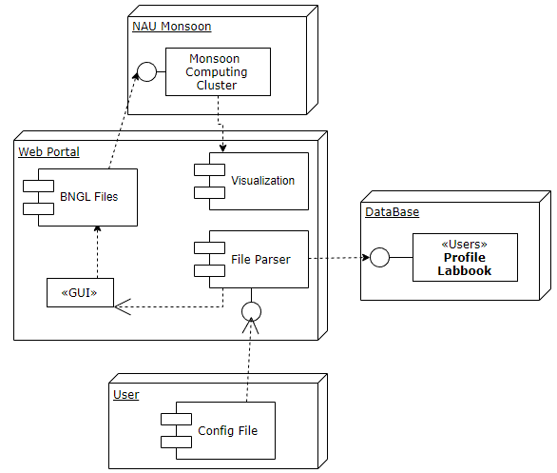
Solution
Simple GUI on website hosted by NAU
  User uploads .bngl file to website
  Website creates GUI based on .bngl file
  Website creates BioNetFit configuration file based on user input
  Website either outputs configuration file, or runs BioNetFit on a computer cluster specified by the user.
Website keeps track of users’ previous runs if they are logged in
Notes:
Now intro your solution, overall. Describe the solution in broad outline, e.g., "At this early stage of our understanding, we envision solving this problem with a sophisticated WebApp that handles the <whatever for the client>. In this app, users could log in securely, then do <x y and z>". Again, follow that overall intro through with your concrete example. If you do this right, it will be obvious to the whole room that your solution very clearly does brilliantly solve the problem/deficiency you just described.

Slide 8
Initial Development
Bi-Weekly client meetings, covering programming languages, knowledge of chemistry, and implementation of GUI.
  Team task reports signify important developments from the previous work weeks.
  Present sketches and diagrams that outline ideas for GUI implementation.
Develop a clear list of objectives, both self-informational and design oriented, to be executed over the next 2 work weeks.
Notes:
Last, sketch us your "Plan for development" for your project. This is just a few bullet points saying how you will progress on:
Requirements acquisition/refinement. What is you plan for building and fleshing out requirements? Weekly client meetings? Do what? For instance, maybe each week you'll have draft of the requirements doc and/or sketches of the process data flow, the data model, whatever -- and then you'll go over that and try to refine it iteratively? What is you PLAN? Just random conversations isn't going to be very effective.
Technical Investigation. What are the main pieces of the project (e.g. Web2.0 front end, database backend, desktop application, mobile app, whatever)? And for each, what are the things that you are going to need to figure out (platforms, implementation language to use, whatever), and what is your PLAN for investigating these things.
Other issues. You might have issues that you will need to investigate as part of the requirements/design process. In some projects, for instance, it is critical to do an investigation on competing products to clearly see what they provide and where you can beat them. Or maybe there are legal issues to investigate and consider.
Remember: your task here is to impress us with your insightful analysis of the problem, and confidence-inspiring plan for tackling it. This will force you to (a) really focus your initial meetings/inquiries with client; and (b) to think very carefully about what your plan/tasks are in the next months.

Slide 9
Implementation
Features:
Web GUI allowing for the manipulation and creation of BioNetFit files.
Database to store files created by the user.
Project will be run on a network of computers in order to process large amounts of files at once.
Result:
When fully operational, the project will simulate high-maintenance experiments, saving the client time and money.

Slide 10
Conclusions
BioNetFit provides a way to take out the costs of running expensive real lab experiments for automated results.
Currently exists only as a command-line program.
  Many researchers aren’t technically savvy enough to use the command line effectively.
Our client, Dr. Razi, wants a web based GUI for BioNetFit, which would allow researchers to better utilize it.
Notes:
Closing. This is an often-botched area. You can't sell something if you just end abruptly with a whimper. Always have a conclusion slide where you summarize things briefly and create a sense of confidence and excitement about your team. So maybe "In summary, we are Team Foobar, and we are working to create a sophisticated web-based assett manager for our client, John Doe who is head of <whatever> for the <whatever> division of Company X. They have some real challenges in the area of <whatever> but we are confident that we on track to provide them with a very effective solution. Whereas before it took them <x> long and cost <y> money to do <whatever their main task is>, our solution should be able to cut this to <z> dollars and <t> time. Of course, Joe Doe and Company X aren't the only ones moving to cloud-based systems; we suspect that literally thousands of companies are facing the same problem, and <explain how your product could have broad impact/makes millions, etc>"
Note the key pieces in the above: summarize what you are doing, try to place a *value* on that for the client, and try to speculate on broader applications (if applicable).

