Slide 1
BioNetFit
Design Review 2
Team U.I. Fit
Charles Chatwin, Matthew Burns, Joshua Gutman, Tanner Brelje
Mentor & Client: Dr. Abolfazl Razi
Notes:
Tanner’s notes: Slide 2 - Give credit to Dr. P and the Los Alamos team
Slide 3 - more visualizations. More overall
NEED PAGE NUMBERS ON THE SLIDES, who is speaking during the slide
Thank god, he likes the new feasibility report
More info on BioNetFit, as it is not clear, more pictures
Point out specifics of the config file to highlight how long the process is
Add to the visualization slide, in order to make the process more understandable.
Add points from what Josh talked about to the slide
Speed up the security risks
ADD A LOOOOOOT OF VISUALIZATIONS

Slide 2
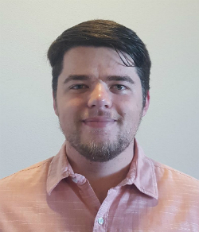
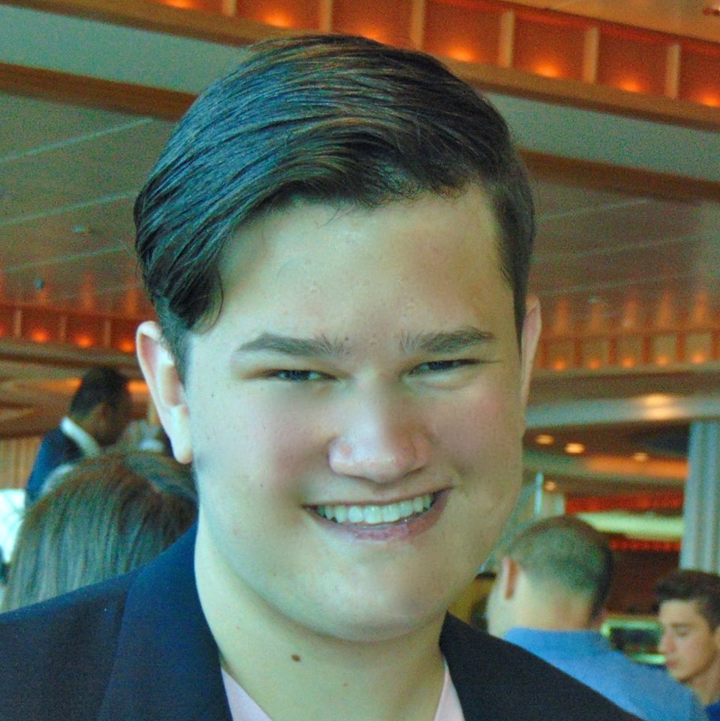
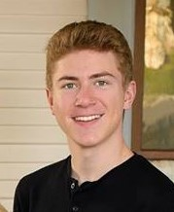
Team U.I. Fit
Charles Chatwin
Team Leader
Tanner Brelje
Database Designer
Matthew Burns
Web Designer
Joshua Gutman
Release Manager
Notes:
Slide 1&2 should take 30 seconds max.
Each team will have a total of 15 minutes for their presentation, including some time for questions. Plan to talk
for about 12 minutes, to leave a few minutes for questions and critique

Slide 3
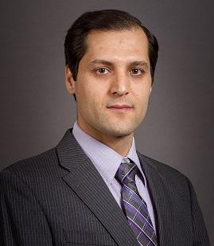
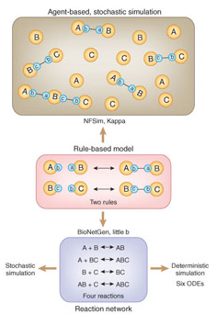
Mentor and Client:
Dr. Abolfazl Razi
Assistant Professor of Electrical Engineering in the School of Informatics, Computing and Cyber Security (SICCS) at Northern Arizona University.
B.Sc., M.Sc., and Ph.D. in Electrical Engineering.
Accomplished work to quantify the biological process along with researchers at Los Alamos and Dr. Posner.
Notes:
Posner and his group created BioNetFit
Molecular Biology is used in medical fields and other important research What do they produce, how does it fit into that larger sector, and what is the volume/importance/user base of their part? What it the process by which your client produces whatever data/product that they are producing?

Slide 4
Molecular Biology
Molecular Biology is an ever-advancing scientific field that finds a main focus in the experimentation and testing of molecular combinations.
In order to make computations and develop headway in the field, researchers are required to test the interactions of molecules in a laboratory setting.
These experiments consume a heavy amount of time and resources, and may not even yield palpable results.
Notes:
30 - 45 seconds to introduce the problem in a grand scope Posner and his group created BioNetFit
Molecular Biology is used in medical fields and other important research

Slide 5
BioNetFit
Simulates large scale experiments; Runs similar experiments multiple times with configurable parameters.
Implements BioNetGen and NFSim to simulate reactions.
User uploads a experimental-results file, which is used by BioNetFit to measure how close it is to reality and choose the next set of parameters.
Uses genetic algorithms, simulated annealing, and others methods to choose the best parameters, and the next set of parameters.
Notes:
About 45 sec to talk about the current uses of BioNetFit

Slide 6
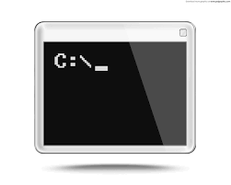
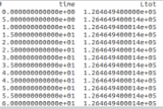
The Problem
BioNetFit suffers from poor usability.
Only exists as a command-line tool.
Results are not easily interpreted.
No visual representation of the data.
Cannot run large experiments in a reasonable timeframe.
Works accurately, but very
slowly on a single machine.
Notes:
BioNetFit suffers from poor usability.
Only exists as a command-line tool.
Requires the user to create a complicated and long configuration file.
Results are not easily interpreted.
Output data complicated and messy.
No visual representation of the data.
Cannot run large experiments in a reasonable timeframe.
BioNetFit uses MPI to parallelize its simulations.
Works accurately, but very slowly on a single machine.
Not optimized for clusters.

Slide 7
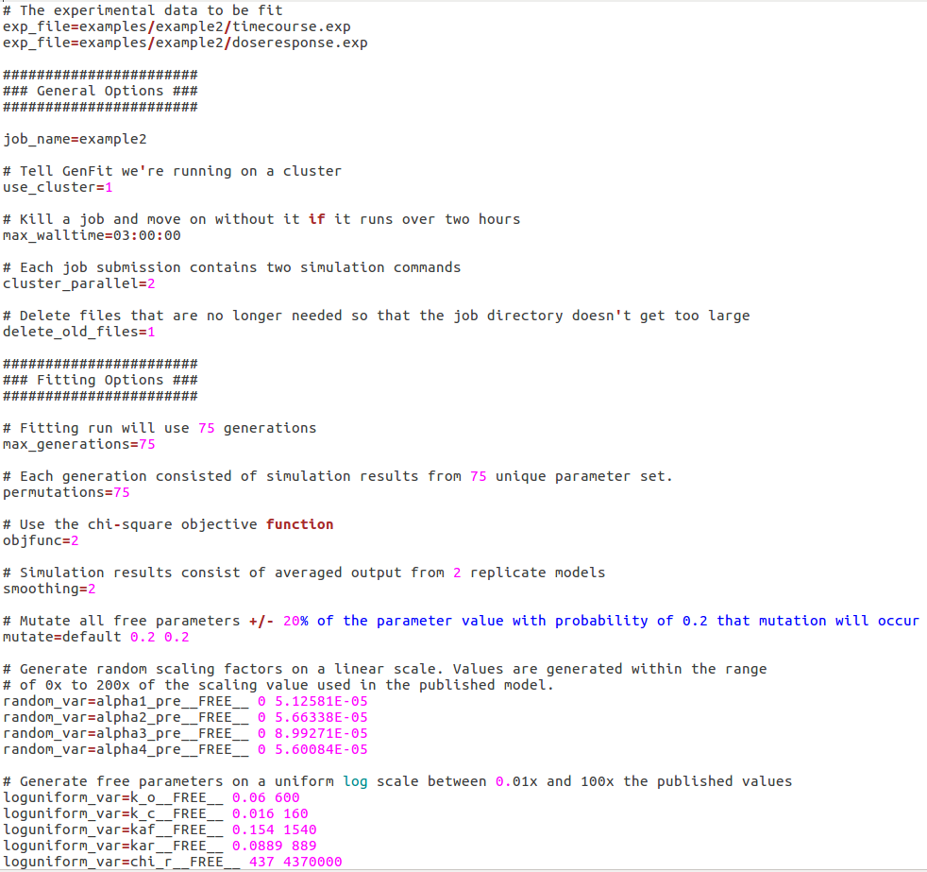
Image of bionetfit on cmd line
Example output
Example config file
Notes:
Take a few moments to show examples of the program in its current state.

Slide 8
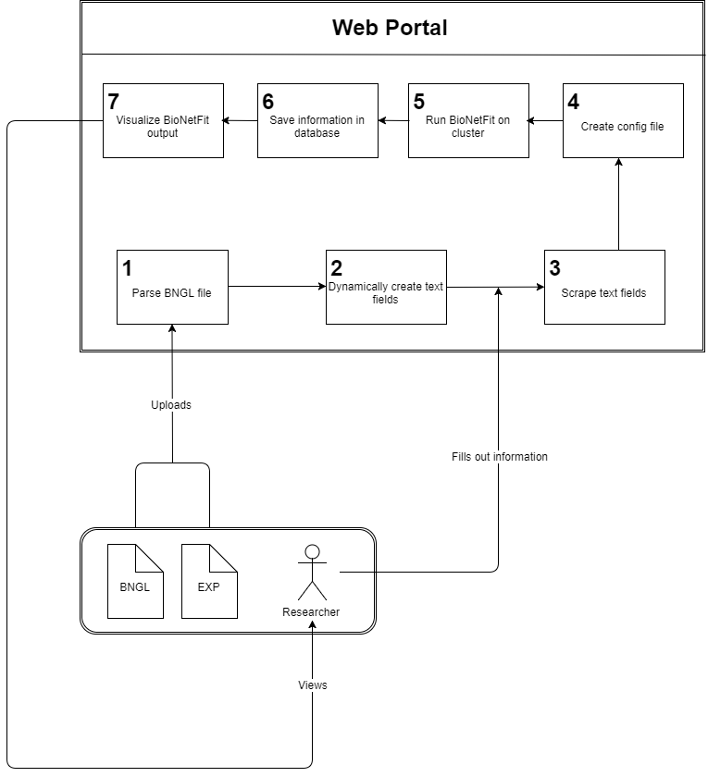
Our Solution
Our solution is a Web 2.0 Graphical User Interface that will drastically increase the usability of BioNetFit.
Automatically generate necessary files.
Visualize results to increase ease-of-interpretation for users.
Increase workflow via NAU Monsoon cluster in order to increase processing speed.
Notes:
Talk for 2-4 minutes on this, going into details (but not too much) on each.

Slide 9
Key User Requirements
The user must be able to:
Generate configuration files.
Visualize the results of BioNetFit
Save all information related to BioNetFit in a database.
Repeat past experiments with small alterations.
Download any and all files related to BioNetFit.
Notes:
Need to take about 4 minutes on this. Talk about 3 main requirements and some others here, and then delve into the main 3 in the following slides.

Slide 10
Key Technical Requirements
Dynamic HTML generation
Text fields are created from user-uploaded file
Scraping text fields
Text fields are scraped to get user-inputted information
Creating files from user-inputted information
A configuration file is created from user-inputted information
Storing information in a database
All input and output files are stored in a database for each user
Visualizing data
Plot BioNetFit output

Slide 11
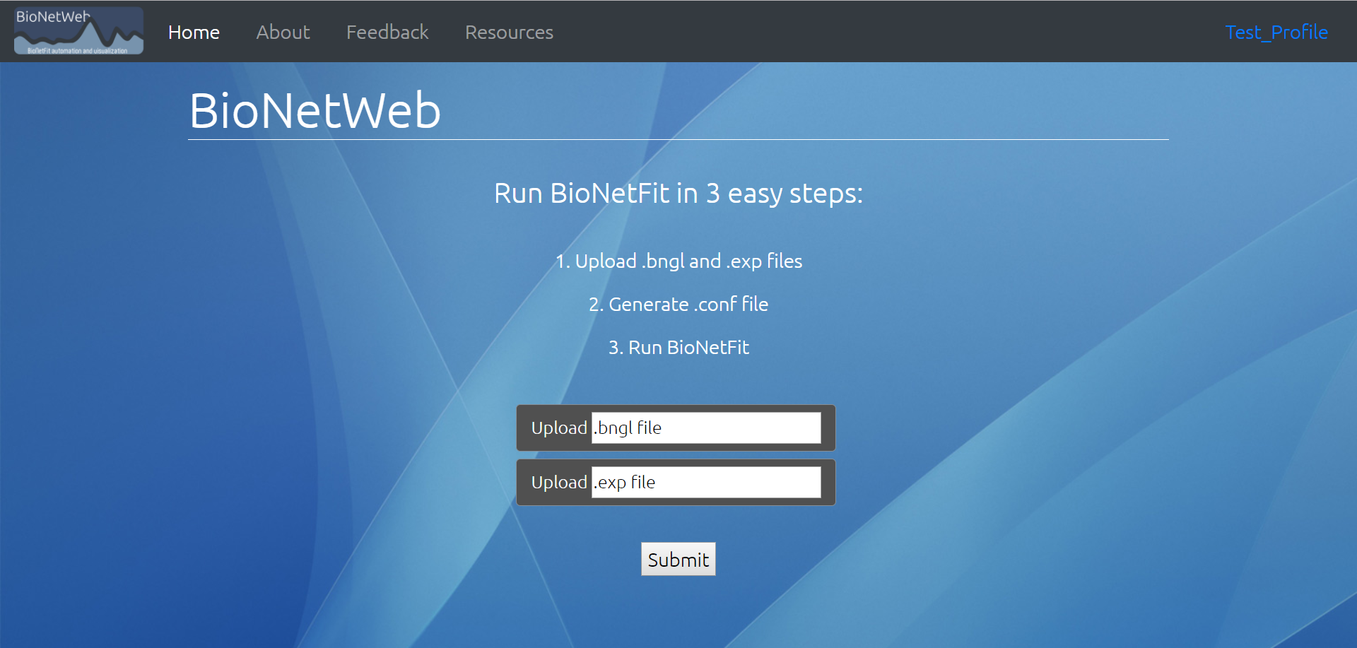
File entry

Slide 12
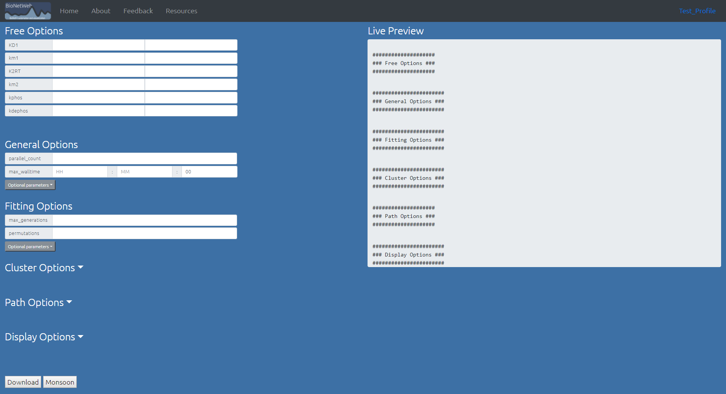
File Generation

Slide 13
Variable Entry

Slide 14
User Page

Slide 15
Image of bionetfit on cmd line
Example output
Example config file
Notes:
Take a few moments to show examples of the program in its current state.

Slide 17
Python Framework
Requirement | Fulfilled by | Python?
Dynamic HTML generation | Django | Yes
Scraping Text fields | Django | Yes
Creating files | Vanilla Python | Yes
SSH from server to server | Paramiko | Yes
Database | MongoDB | Partial
Visualizing Data | D3 | No
Notes:
Hey i think this slide should go before our screenshots. It feels out of place here

Slide 18
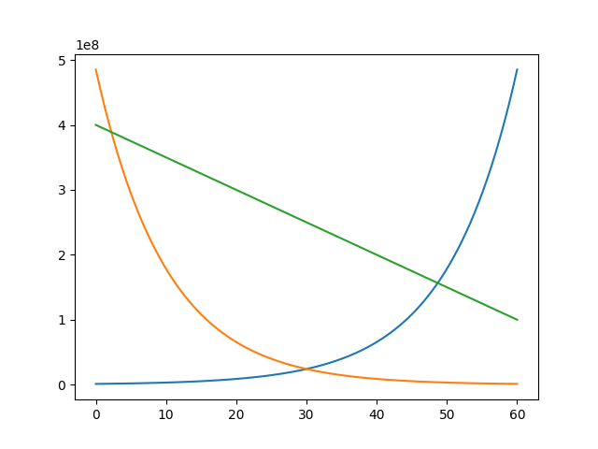
Visualizing Data
D3
Read output of BioNetFit
Write each data point to a CSV file
Create plot using D3
Other methods of visualization could be added

Slide 19
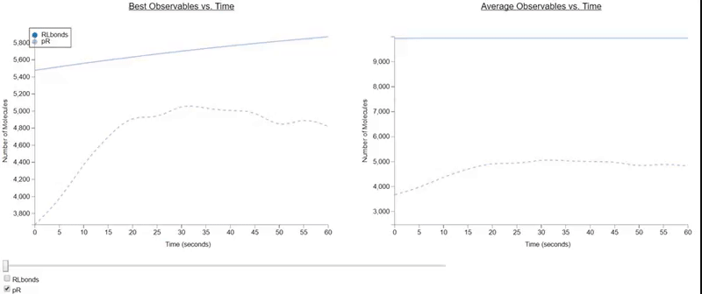
Interactive Visualization

Slide 20
Risks and Feasibility
Possible Risks | Importance | Steps Towards Mitigation
Unable to access NAU Monsoon Cluster. | Fail | Currently in contact with Monsoon coordinator; access will be granted for a secure system.
Insecure storage and usage of Monsoon login details. | High | Looking into methods to securely store and use login information on unix systems.
Securing a Domain to host the BioNetFit GUI. | Medium | Host using NAU web services; use Amazon web services for backup/testing.
Database leaks personal data of the user. | Low | Assure that no privately held data will be stored within the user database; Name, Password, Files.
Notes:
Challenges and Resolutions
(about 2 minutes) -- replaces risks and feasibility Now you are in the thick of implementation, so you
should focus on coding challenges here. Briefly introduce a few of the challenging questions or problems that have come up in your implementation (e.g. “Computing spatial layout of nodes in our graphical state view”), briefly describe the problem, then present your solution...or ideas you’re working on to address it (maybe someone in the audience has some input or help for you, who knows). In any case, your goal here is to show that you have recognized some key implementation challenges and are well into solving them.

Slide 21
Successes and Failures
Successes:
Database successfully implemented without use of personal data.
Full pythonic implementation of website as well as additional features.
Dynamic creation of files, upload and download functionality.
Failures:
Access to the Monsoon servers has been denied due to possible security risks.
Preliminary visualization methods deemed inadequate.
Notes:
Change risks to challenges
Now you are in the thick of implementation, so you
should focus on coding challenges here. Briefly introduce a few of the challenging questions or problems that have come up in your implementation (e.g. “Computing spatial layout of nodes in our graphical state view”), briefly describe the problem, then present your solution...or ideas you’re working on to address it (maybe someone in the audience has some input or help for you, who knows). In any case, your goal here is to show that you have recognized some key implementation challenges and are well into solving them.

Slide 22
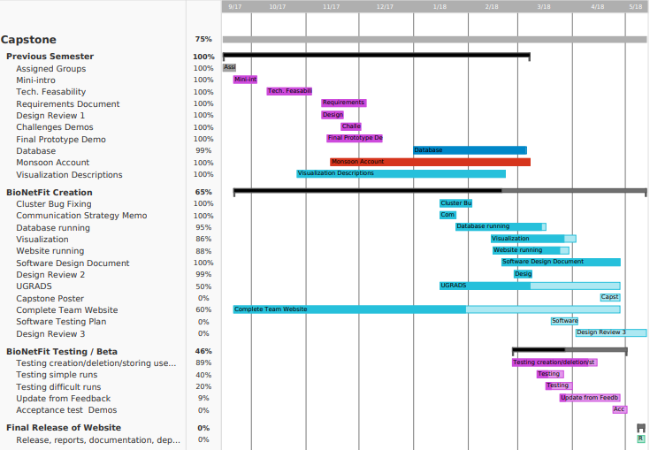
Schedule
Notes:
As usual, offer a short discussion of your project
plan, as it stands right now. A Gantt chart is highly recommended, with a “now” line running through it.
Go over your main functional milestones...which ones you’re through and what’s
coming. Close with some summary statement of where you are “going well”, “somewhat behind, but we think we can catch up”, whatever.

Slide 23
Conclusion
The Problem: BioNetFit is not easy to use, requires a lot of time to process huge experiments, and gives outputs that are hard for researchers to digest.
Our Solution: A Web 2.0 GUI that will increase ease-of-use, implemented with parallelization on the Monsoon cluster, and clear visualizations of outputs.
Implementation via Python Framework
Django, Paramiko, vanilla Python, etc.
Risks to design can be overcome via feasible options.
Notes:
Conclusion (about 1 minute)
Finish your talk by providing a solid summary of your presentation: This
is where you wrap it all up nicely and bring it all together. Start by briefly restating the importance of the domain, your client’s business and processes and what was
inefficient about them. Then review your solution vision, and go on to review what key topics you’ve discussed in this
Design Review; do NOT review the details of those topics (you did that already in the middle part), just review what you
talked about and the overall outcomes: Requirements acquisition, development of detailed Functional, Performance,
Environmental requirements, and risks/feasibility. End your conclusion with a sentence or two about what’s coming up for you, what you’ll be focusing on in the next
development phase. End the presentation with an energetic note that conveys professionalism and
confidence that you’ll be able to solve the problems and satisfy your client.

