Slide 1

Design Review II
Team Hindsight

Slide 2
Intro Statement
Hunter Rainen - Team Lead, Documents/Research
Alexanderia Nelson - Release Manager, Documents/Research
Adam Paquette - Architect , Coder
Charles Beck - Recorder, Coder
Client: Iona Brockie NASA\JPL - Caltech
Faculty: Dr. Doerry
Mentor: Austin Sanders
Notes:
*Add more slides as needed for this section
Time: about 2-5 minutes (our domain is complex)
Description:
Begin by talking about the overall business area that client is in: introduce the area, explain briefly how it works, and try to give some motivating info on how big/active/important the sector is. How many people are involved, how much data is transacted, etc. If it’s a complex area, graphics that help you explain processes, entities or data flow can help support you.
THEN introduce your sponsor and the organization they’re attached to, and say how they and their organization contribute within the larger picture of the sector you intro’d. What do they produce, how does it fit into that larger sector, and what’s the volume/importance/user base of their part? What is the process by which your client produces whatever data/product that they are producing?
Ok, now the audience hopefully fully understands what your client does and how it matters. Now you can go on to describe what’s broken, why you were hired. This should be easy if you’ve already described the workflow/dynamics of how your client’s production/business process works: you then just have to explain what’s bad/inefficient about it. Describe the problem in overall terms briefly, then get down to bulleting out a few specific things that are not satisfactory. By the end of this, your audience should be really clear on what needs fixing.

Slide 3

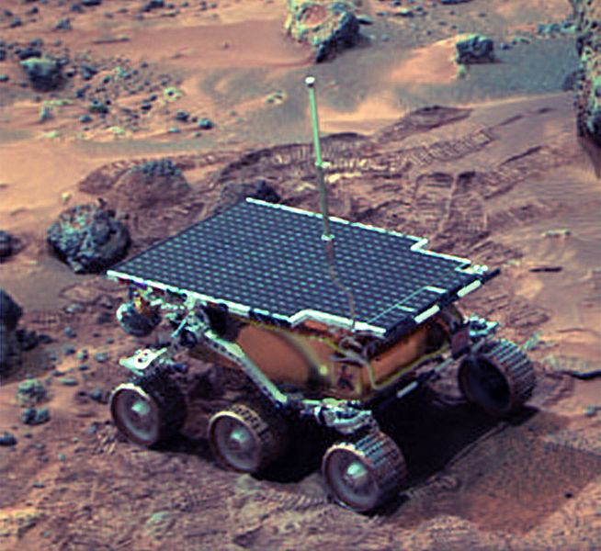
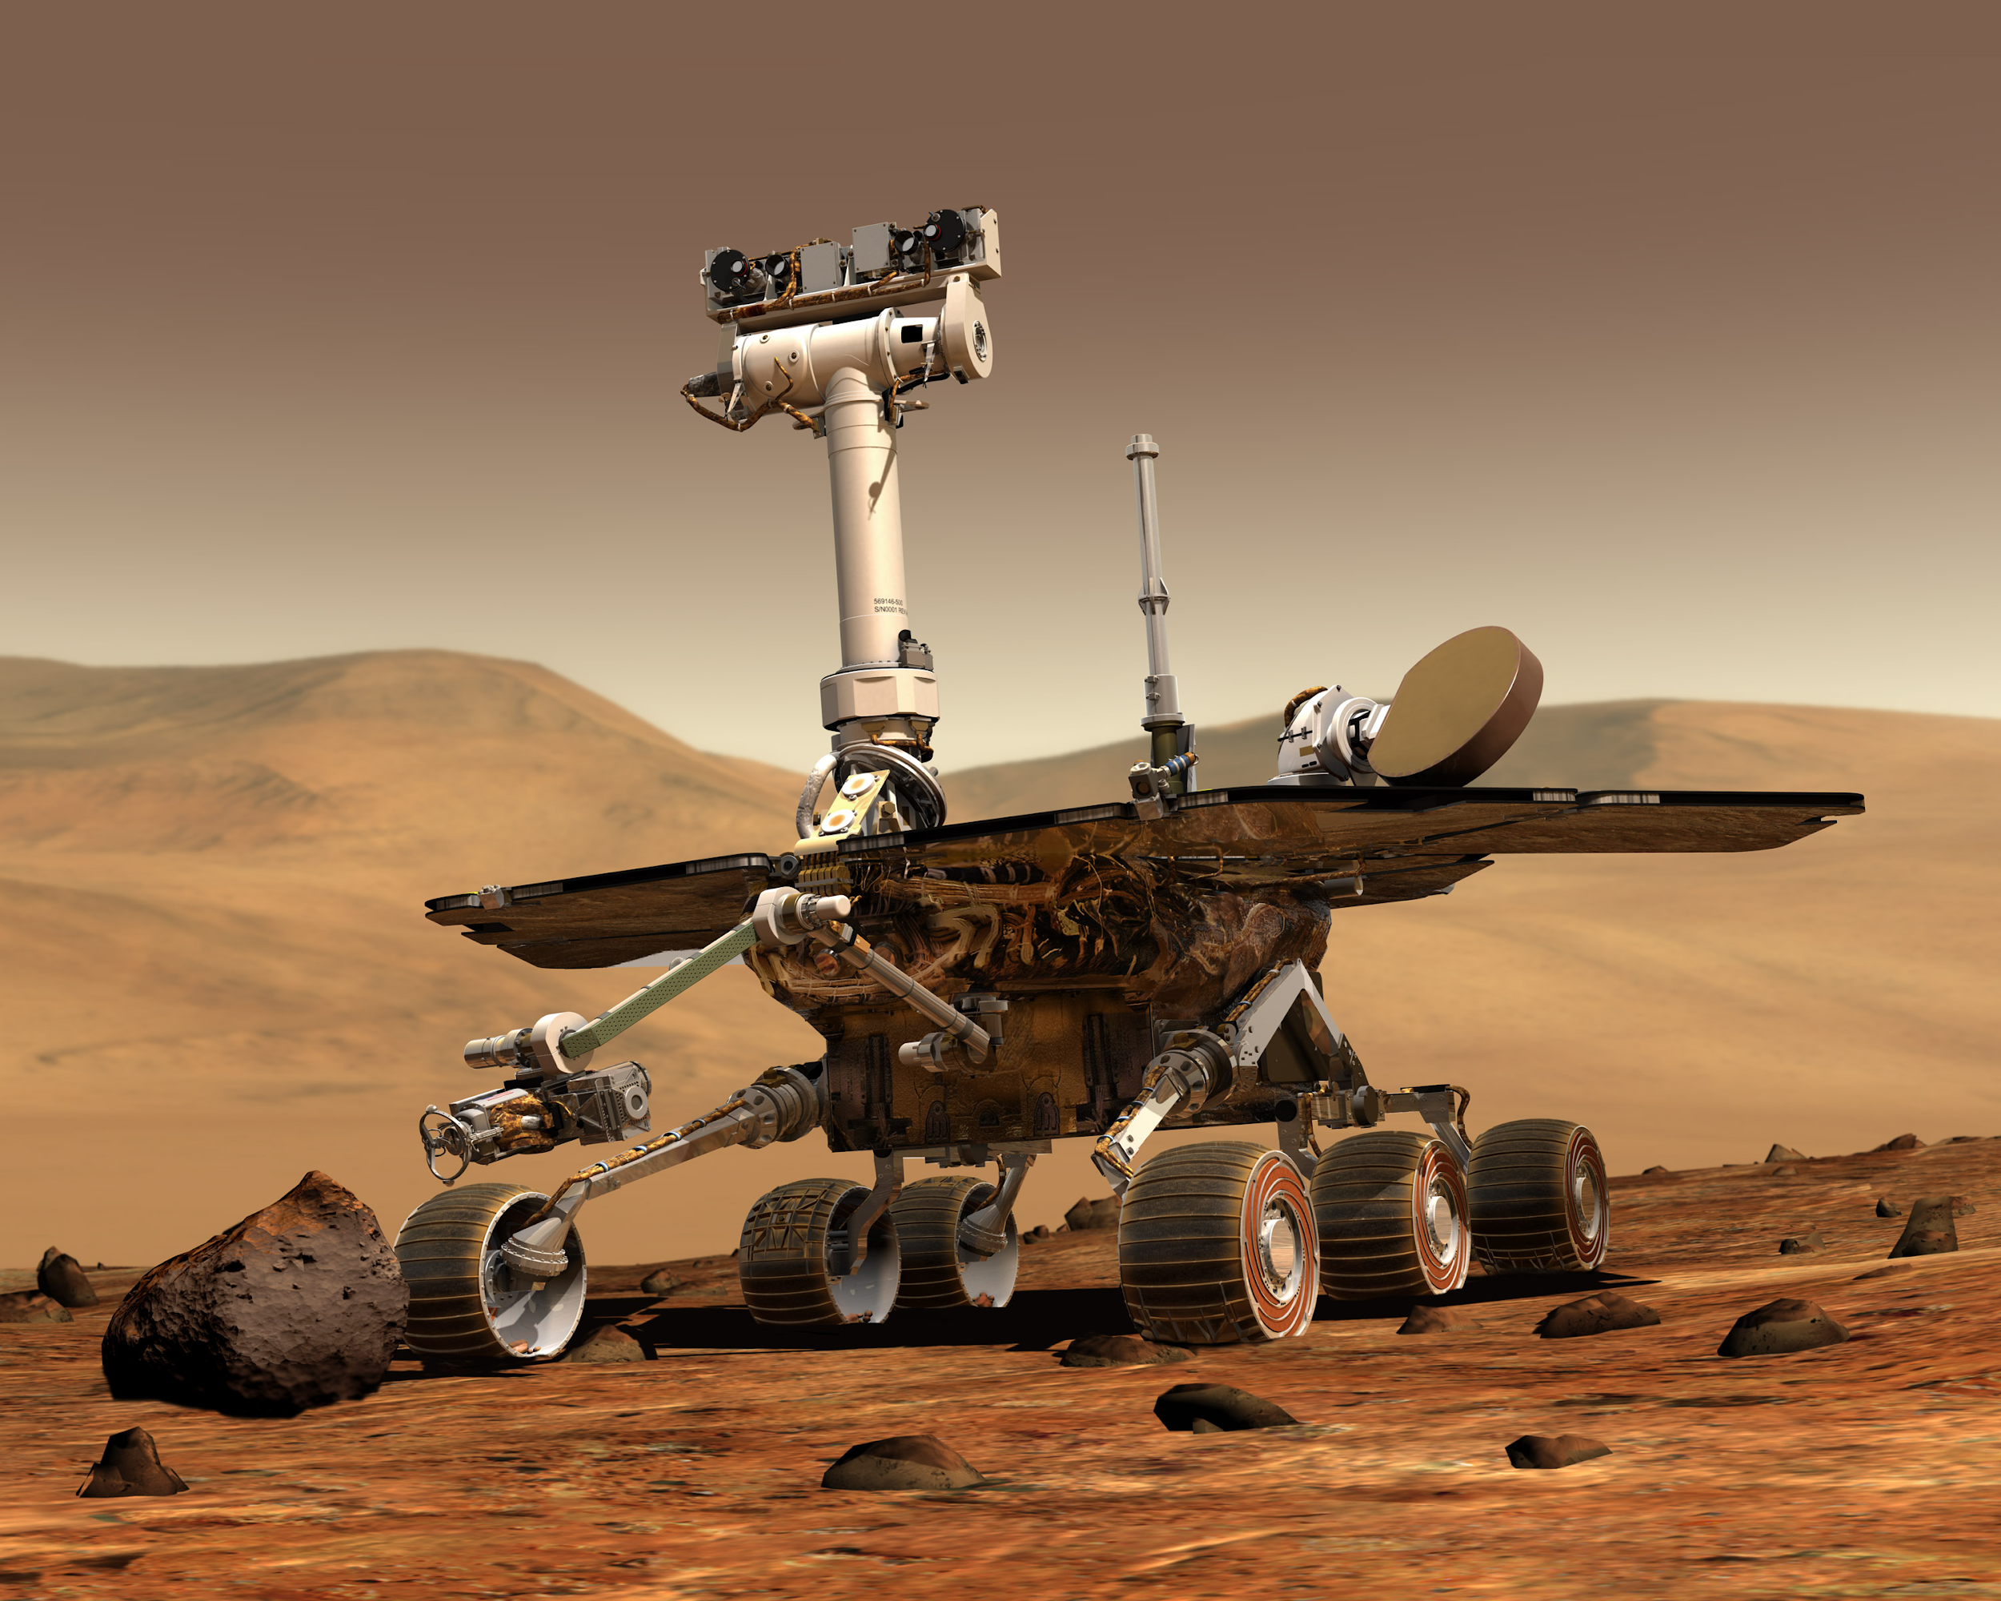
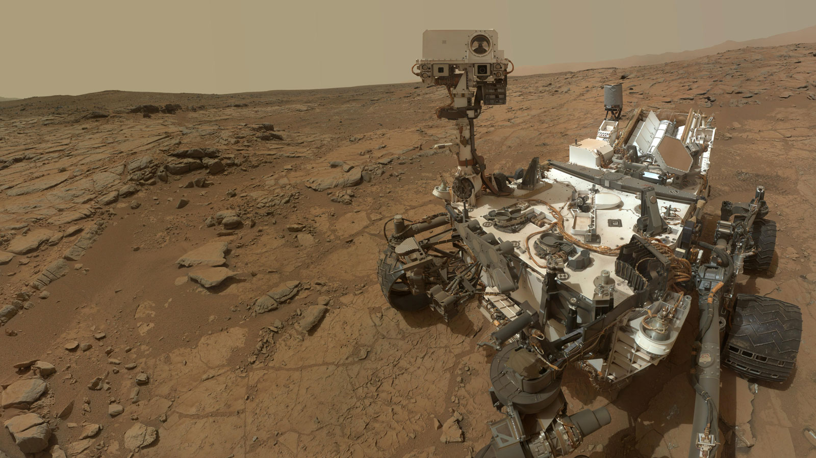
JPL’s Mission to Understand Mars
JPL is a federally funded NASA research and development center whose primary role is to construct and operate planetary robotic spacecraft. With the help of JPL, the scientific community have been looking to answer whether or not we are alone in the universe. Mars is a good place to start looking for answers for a few reasons. JPL has sent many missions to Mars with the goal of looking for evidence that Mars once had the conditions necessary to support life.
Figure 1.0. Pathfinder
Figure 1.1. Spirit and Opportunity
Figure 1.2. Curiosity
Notes:
Pathfinder: Main goal was to show it was possible to get to Mars (with scientific instruments) and do it cheaper than previous missions (Viking) ~ Given 250 million dollars
Main scientific goal: do geological surveys to understand weather/ atmosphere
Spirit and Opportunity: characterize a wide range of rocks and soils that hold clues to past water activity on Mars, Dust is magnetic (titanium)
Curiosity: Long list, but important few are: basic chemical components for life (carbon, hydrogen, oxygen, phosphorus, etc), organic carbon found in rocks, Methane found (can be produced by living beings), Radiation (poses risk for human exploration)
But there is only so much science we can do remotely on another planet.
Time: about 2-5 minutes (our domain is complex)
Description:
Begin by talking about the overall business area that client is in: introduce the area, explain briefly how it works, and try to give some motivating info on how big/active/important the sector is. How many people are involved, how much data is transacted, etc. If it’s a complex area, graphics that help you explain processes, entities or data flow can help support you.
THEN introduce your sponsor and the organization they’re attached to, and say how they and their organization contribute within the larger picture of the sector you intro’d. What do they produce, how does it fit into that larger sector, and what’s the volume/importance/user base of their part? What is the process by which your client produces whatever data/product that they are producing?
Ok, now the audience hopefully fully understands what your client does and how it matters. Now you can go on to describe what’s broken, why you were hired. This should be easy if you’ve already described the workflow/dynamics of how your client’s production/business process works: you then just have to explain what’s bad/inefficient about it. Describe the problem in overall terms briefly, then get down to bulleting out a few specific things that are not satisfactory. By the end of this, your audience should be really clear on what needs fixing.

Slide 4
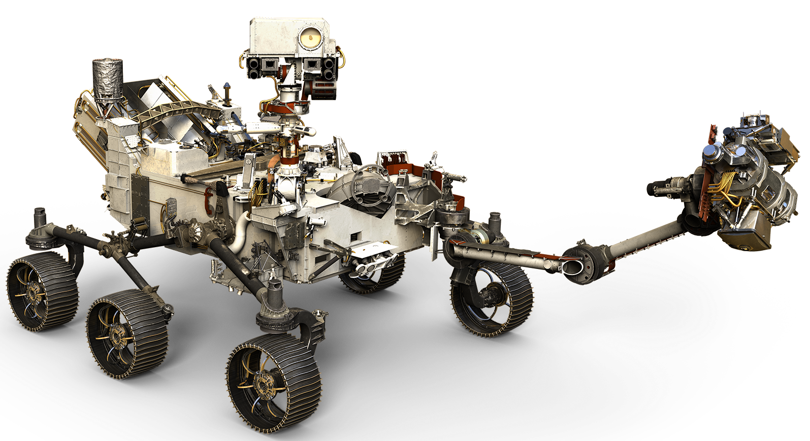
Mars 2020 (M2020)
JPL’s latest rover, M2020 will aim to further deepen our understanding of whether or not the red planet was once habitable. Specifically, the primary goal of M2020 will be to look for evidence of past life on Mars by analyzing and collecting samples of the Martian surface which will then be picked up, and returned to Earth by a future mission.
Figure 2.0. Mars 2020
Notes:
In its quest to find evidence of past life, the M2020 rover will use a suite of tools including an onboard drill with a set of drill bits to take measurements of the soil/rock and potentially collect samples from the Martian surface to return to Earth later. To identify what samples to take, the rover is equipped with a Planetary Instrument for X-ray Lithochemistry (PIXL) camera. The PIXL camera looks at a particular region and analyzes it for chemical compounds and elemental makeup. However, before instruments like PIXL can analyze samples, the rover needs to overcome a problem inherent to drilling. When the rover drills into a rock, it creates a lot of dust, obscuring the hole.

Slide 5
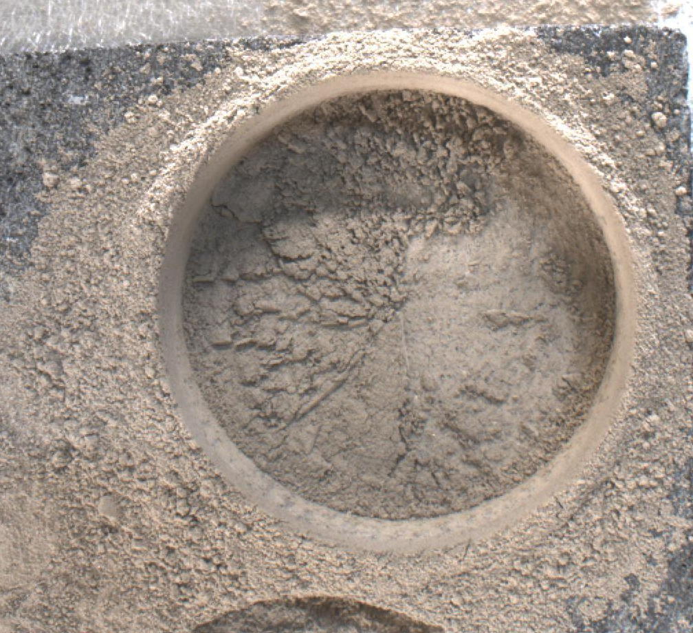
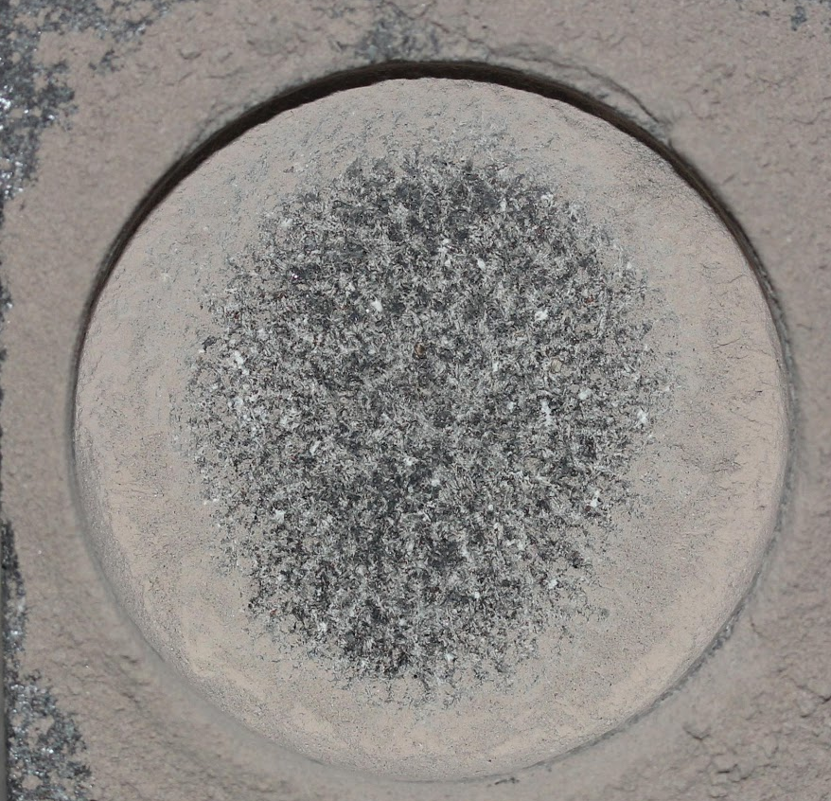
Challenge facing JPL
When the rover drills it creates dust that obscures the hole. JPL’s solution is to use compressed gas to blow dust out of the hole.
Figure 3.0. Before dust removal
Figure 3.1. After dust removal
Notes:
When they find something they are interested in analyzing, they will drill into it, but ..

Slide 6
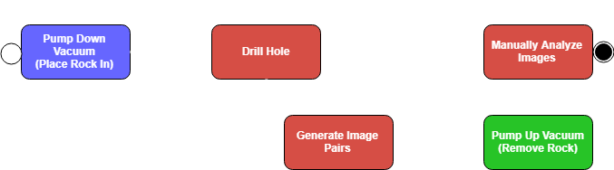

Why JPL’s testing method is a problem:
Figure 4.0. JPL Testing process
Slow
Inconsistent
Could be better
Notes:
In order to get their tools ready for drilling on Mars, they simulate Martian atmosphere in a vacuum chamber.
This means when they want to test drilling into a rock, they place a piece of that rock into a vacuum chamber, pump down to Martian atmospheric pressure.
Then they drill, pump the chamber back up to Earth’s atmospheric pressure, analyze the rock by hand, put it back in the chamber, and pump back down to Martian atmospheric pressure.
Slow: They simulate Martian atmosphere in a vacuum chamber. Currently rock has to be analyzed by hand which means taking the rock out of the pressurized vacuum chamber, for every drilled hole. This is costly as it takes around 40 min (for small chamber) Afternoon for large chamber to pressurize and depressurize.
Inconsistent: Humans are deciding on what dust looks like, and the bigger risk is that by removing the rock from the vacuum chamber, may disturb where the dust has settled, invalidating the results
Could be better, It could be automated
Stop here - Hunter

Slide 7
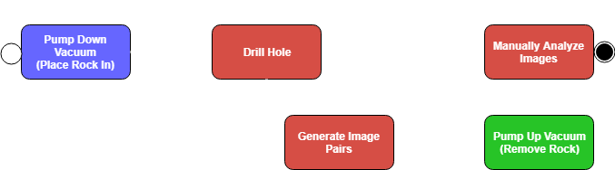
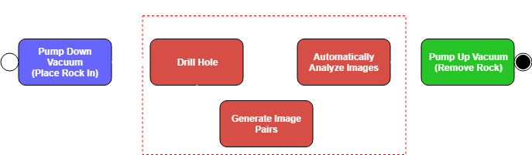
Solution Overview
Figure 5.0. Old process from JPL
Figure 5.1. New process from our solution
Notes:
New method automates analysis by analyzing images taken inside chamber while it is pressurized.
Now, they can pump down to Mars atmosphere, drill, take before picture, blow dust, take after picture, analyze images, and repeat until their testing is finished. No pumping back up to Earth’s atmosphere required. Much less manual analysis.
Description:
So now you need to outline your plan for fixing the problems you just outlined. Again, this is easy if you’ve done a good job of describing the business workflow, and then pointing out specific problems with it: you just connect your solution right into this discussion. Again, begin with a broad statement of your overall solution, e.g., “The solution that we envision to address the client needs just outlined is to transition the entire workflow to a secure, highly reactive web application that…”. This is a great place to have process- or data-flow graphics you used to describe the clients business re-appear, with the elements you are fixing/adding clearly highlighted. Then present a list of bulleted specific features of your solution; choose them so that it’s pretty clear to listeners that your solution features will certainly address the problem issues bulleted out earlier. Explain as much as needed (e.g. walk us through figures, whatever) to make it clear.

Slide 8
Our Solution
Our software includes the following to the process:
Faster :
  No longer need to depressurize vacuum chamber
  Image analysis speeds up to less than 5 minutes (from one hour)
More consistent:
  For all images per rock type
  less prone to human error
Further improvements and flexibility
  Can be parallelized
  Algorithms added or changed
Notes:
By automatically analyzing the images taken inside the chamber, we solve these problems.
There are future improvements to be made, after we have hit the core requirements.

Slide 9
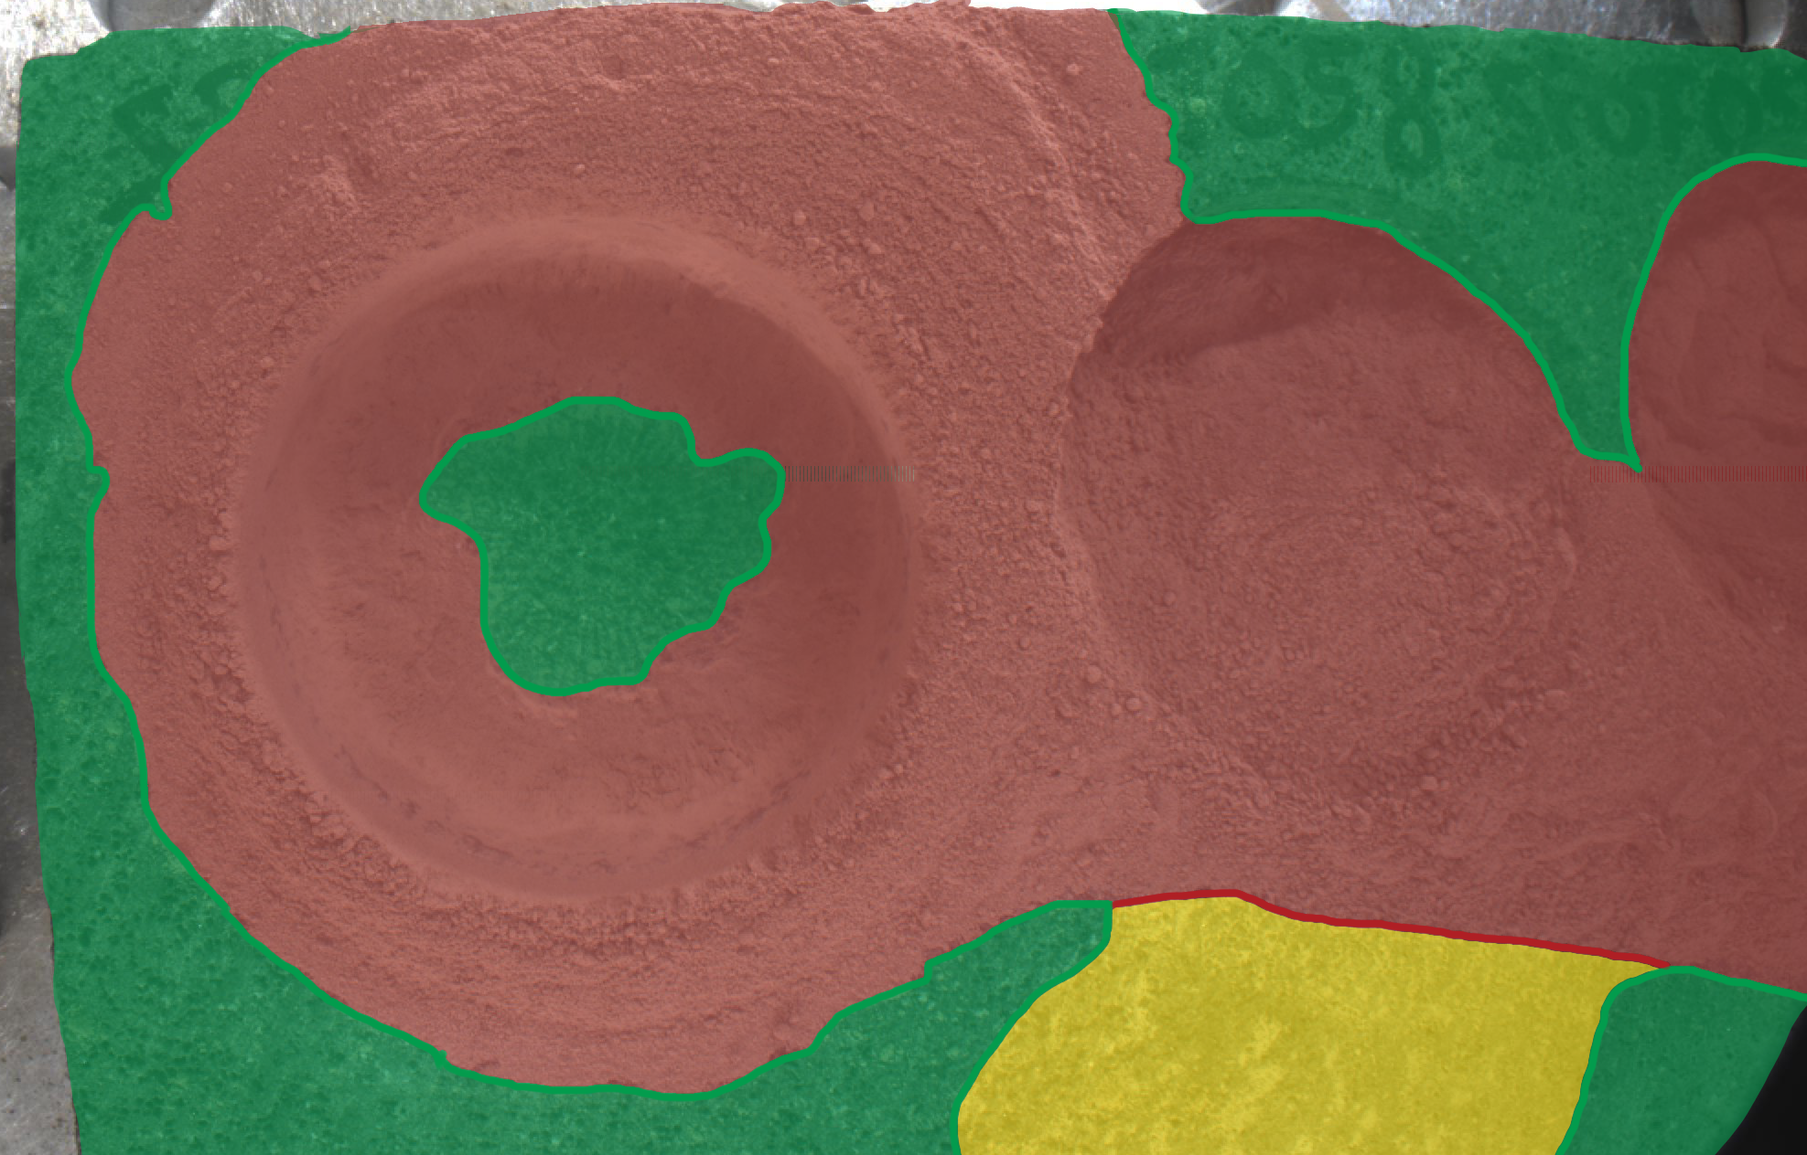
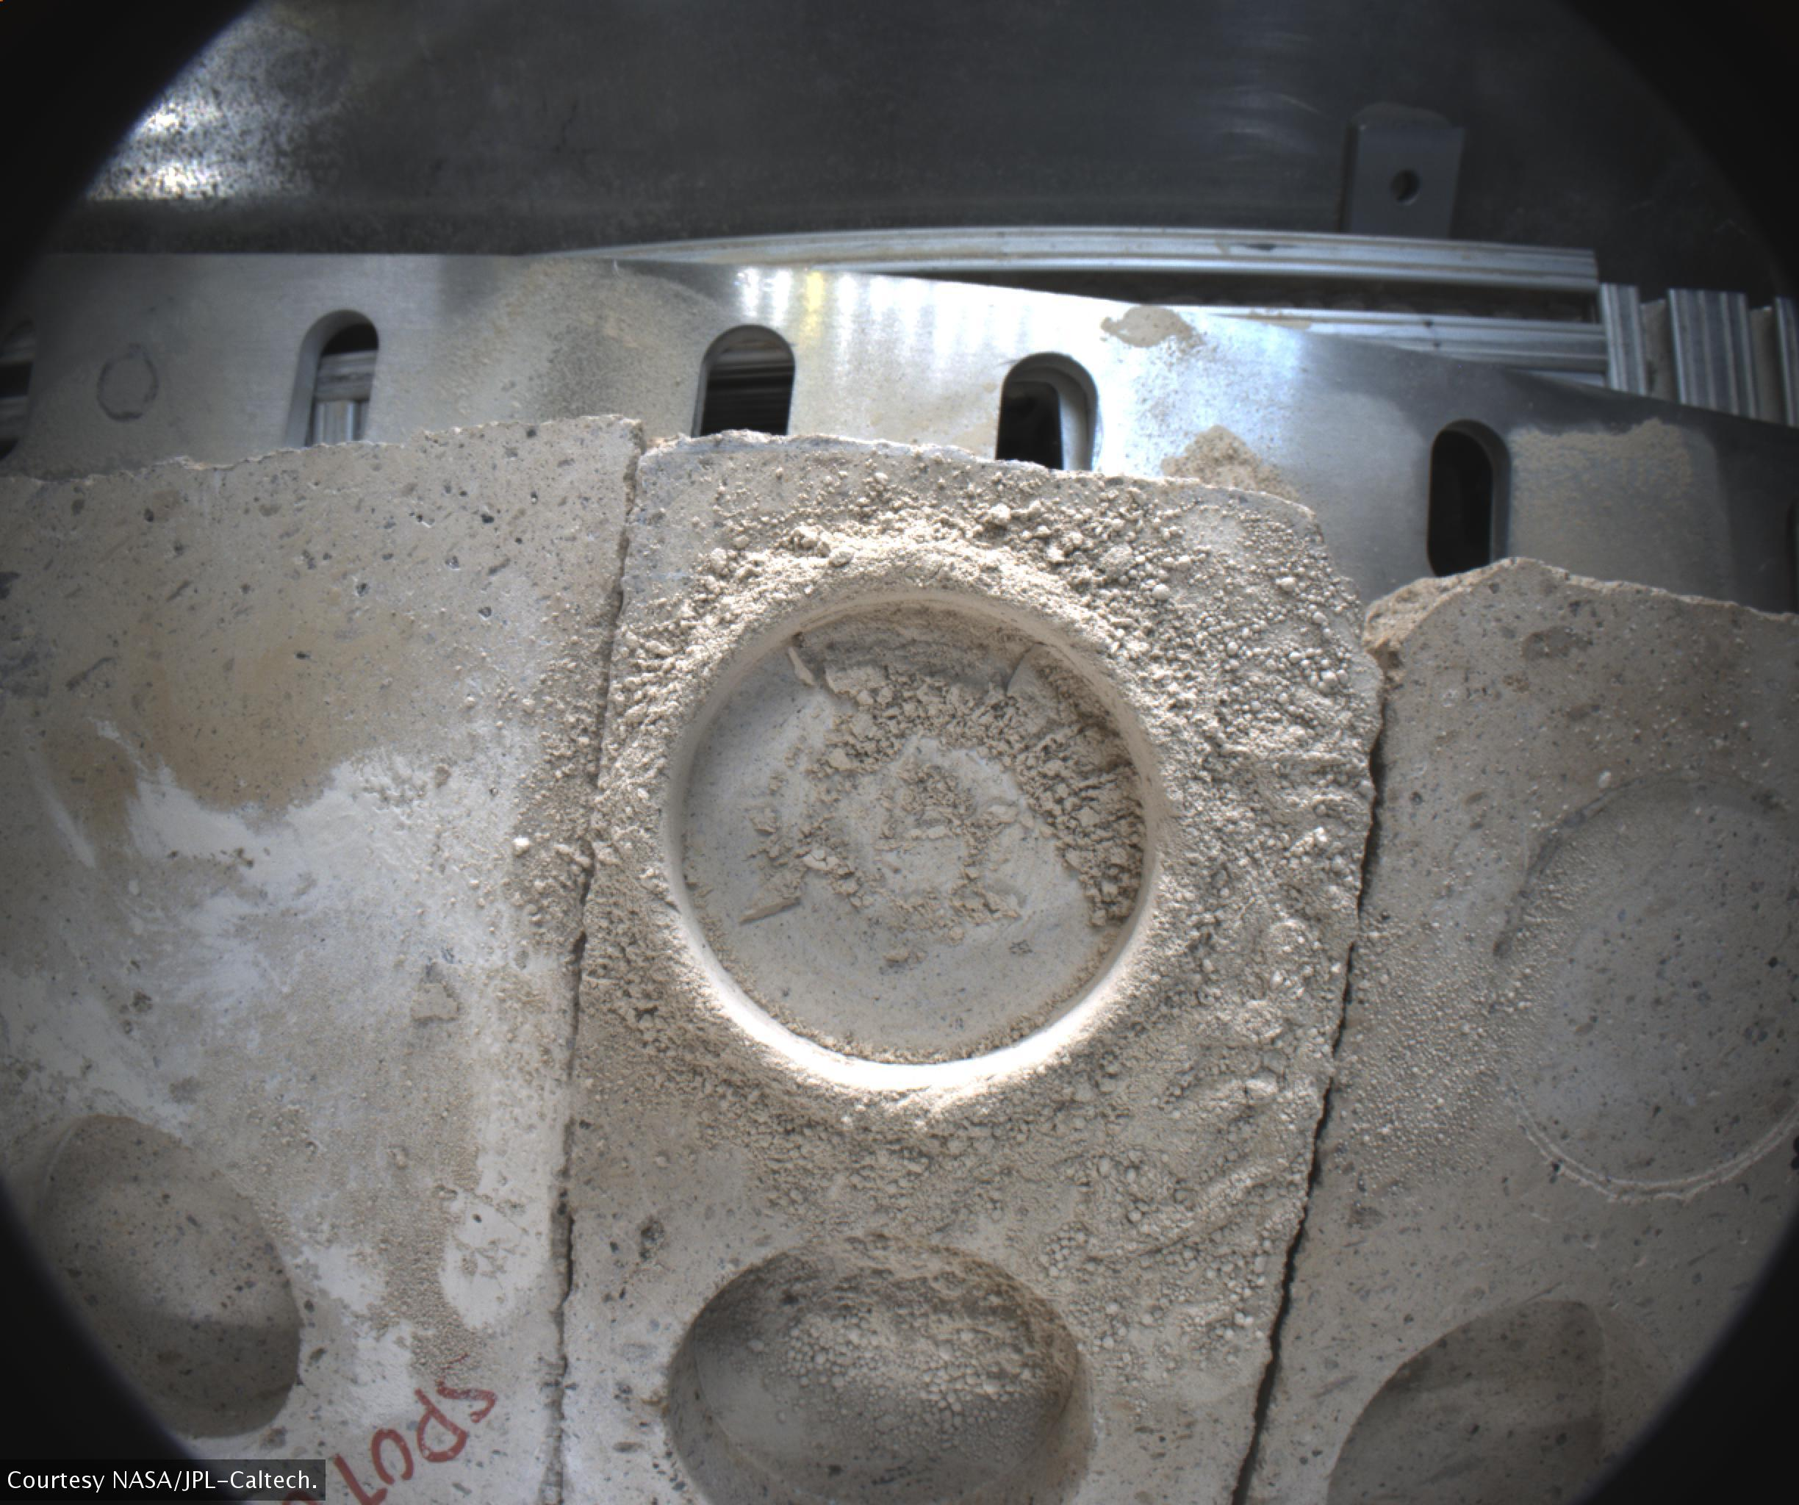
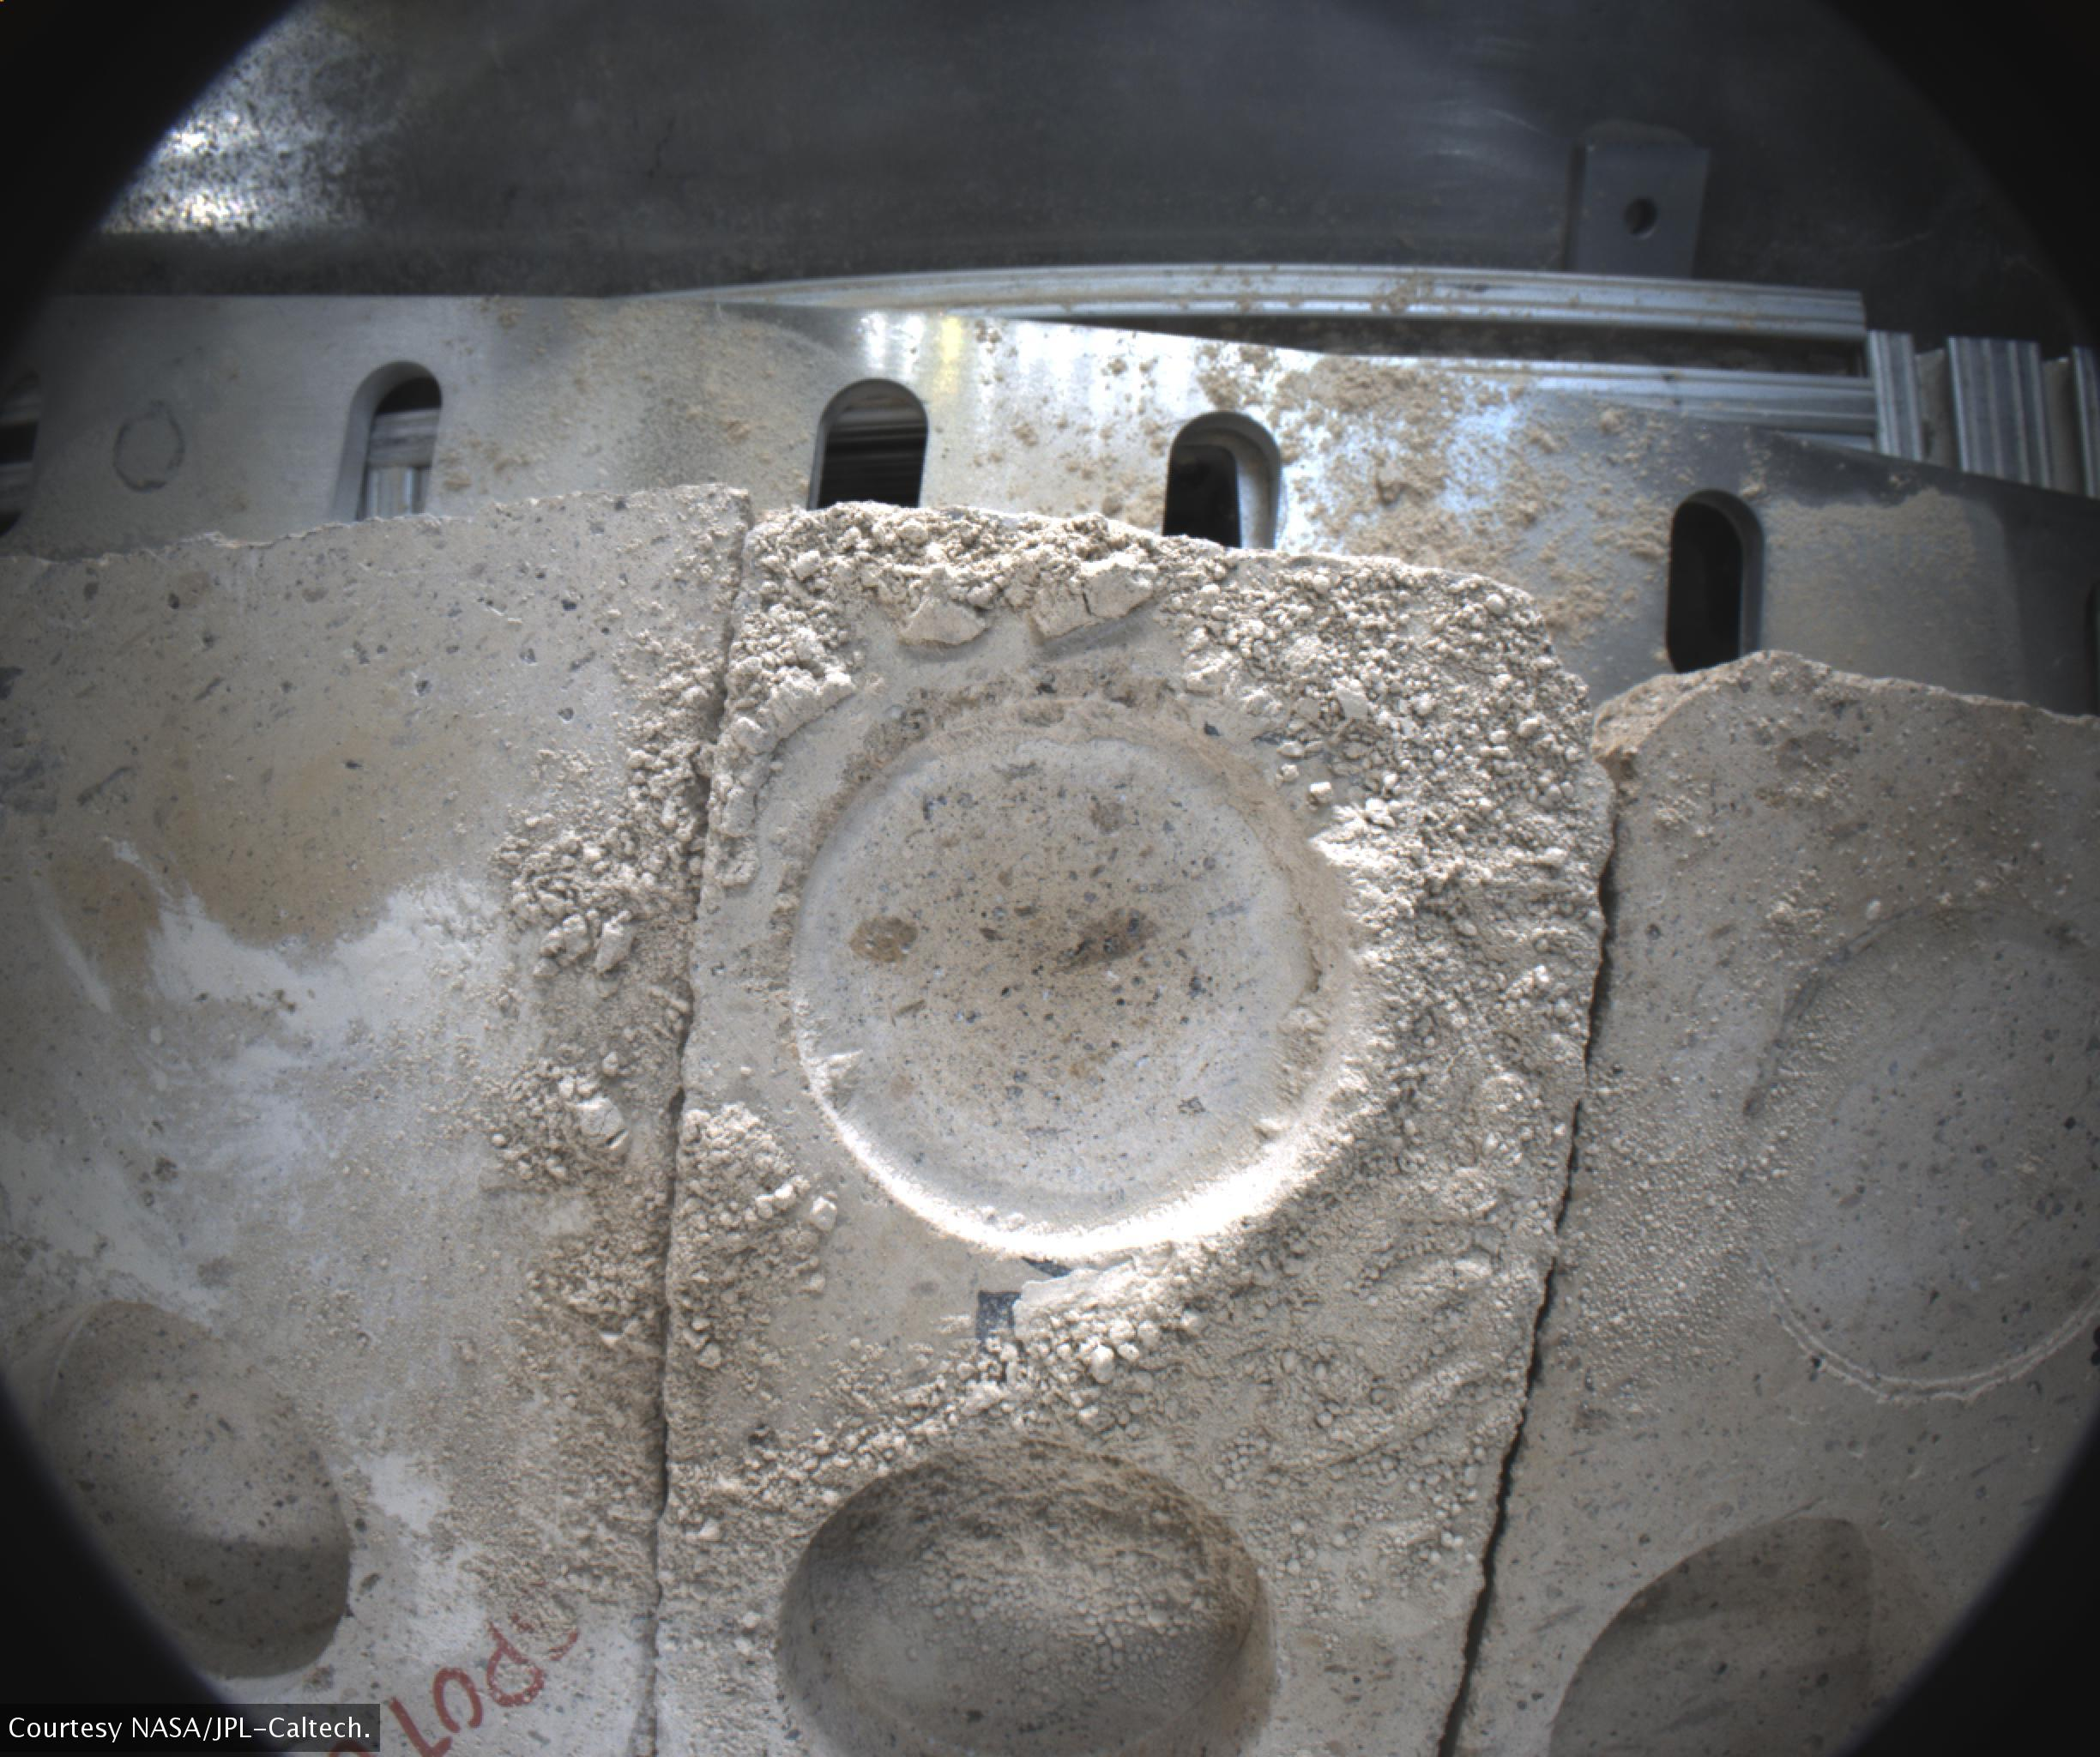
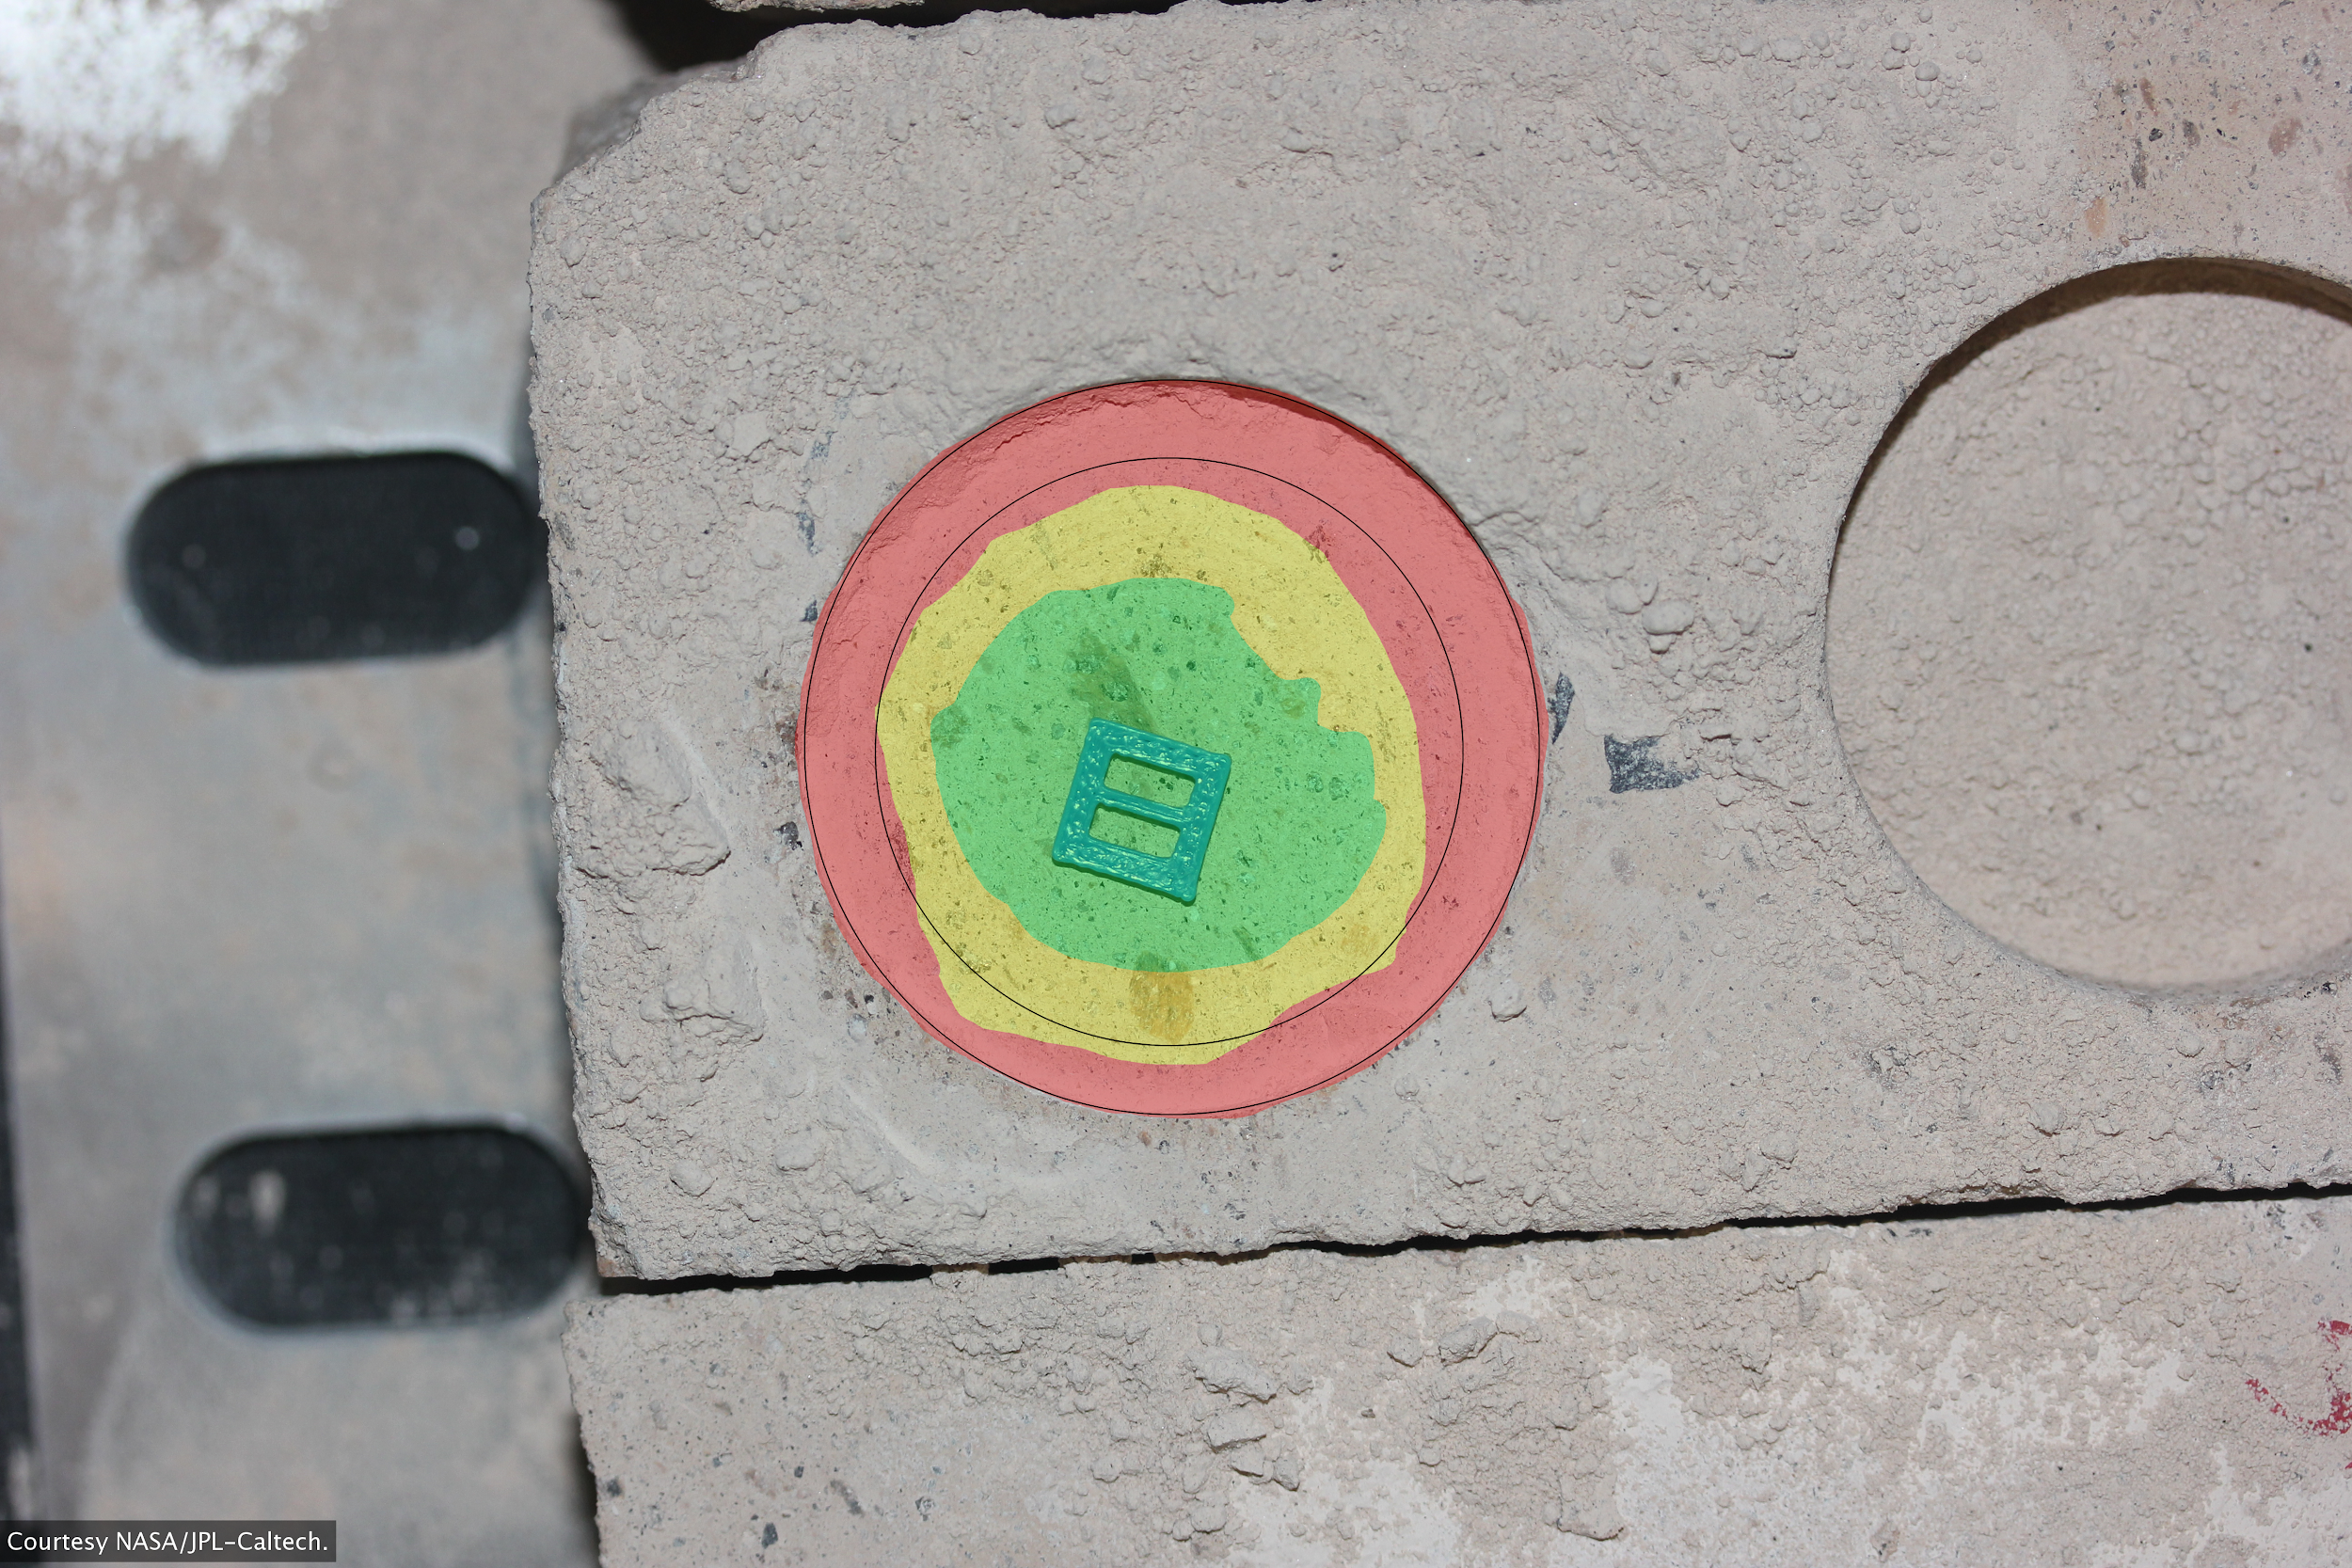
Requirements
Functional
  Handle batch of images
  Analyze image(s) for dust
  Allow user to adjust parameters
  Mark areas of dust coverage
Non-Functional
  Display percentage of areas cleared
  Display before air blast, after air blast, and analyzed images in a GUI
  Should take no longer than a minute per image pair
BEFORE
AFTER
ANALYZED
Figure 6.0. Example abrasion analysis
Figure 6.1. Examples of a before, after, and JPL analyzed image
Notes:
Time: about 30 seconds
From our requirements acquisition in the fall, we obtained both functional and non-functional requirements from our client. For functional requirements, we need to be able to take in a batch of images, analyze each image for dust, allow our users to modify the parameters of the image analysis, and mark the dust covered areas.
For the non-functional requirements, we need to display the percentage of areas cleared, display the before, after and analyzed image, and the overall process for one pair of image should take no longer than one minute.

Slide 10
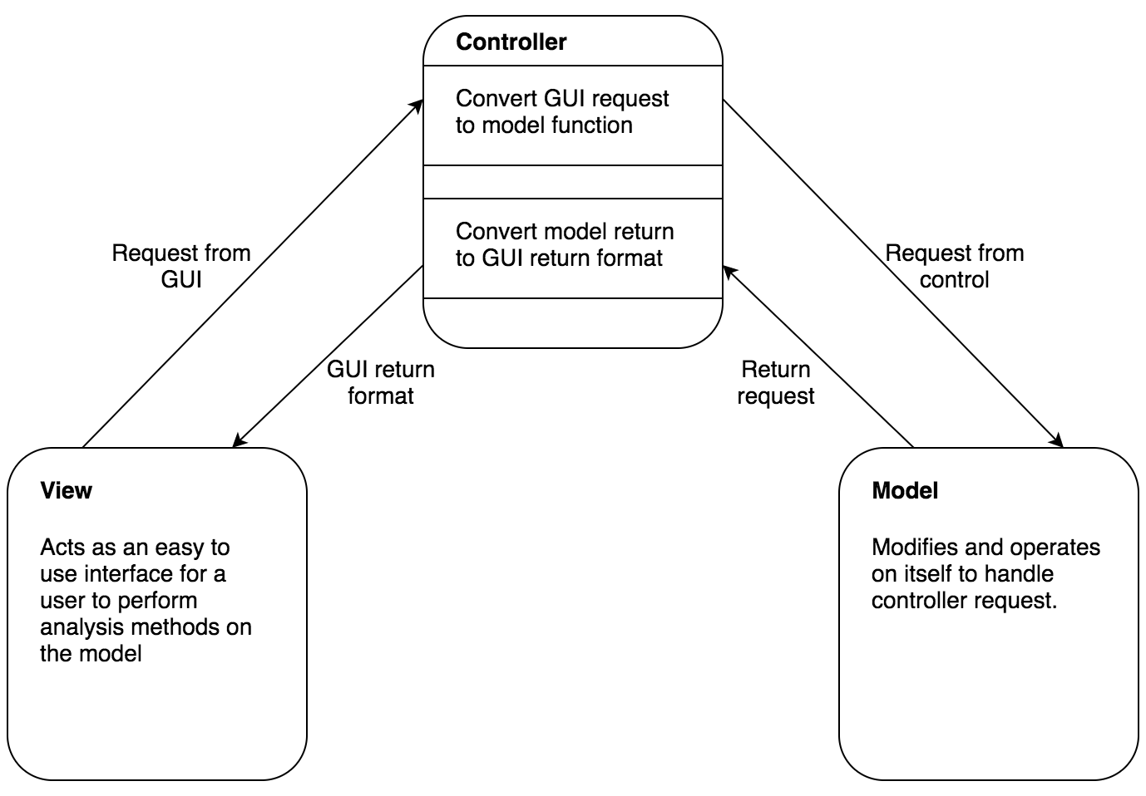
Architecture Overview
Model View Controller (MVC)
  Graphical User Interface integration
  Logic Separation
  Parallel Development
Figure 7.0. High level architecture of the processing pipeline
Notes:
Time: about 30 seconds
From the requirements we gathered, we determined that we will be performing analysis operations on images and we need to have some type of gui so the user can perform those image operations. Thus, to keep things clean, we wanted to separate the logic of our image operations and the operations of the gui. As such, we decided to use a Model View Controller or MVC software architecture pattern. The MVC pattern is defined by three pieces, a Model, a View, and a Controller where the Controller interfaces with the Model and View communicating between the two so that the View and the Model never have to know about each other. In our case the Model would be an image represented as an object, the View would be the gui, and the controller would communicate between the two as defined in the pattern. This pattern makes for both a separation of logic for the view and the model, and also allows for parallel development for image analysis operations and the gui as the two do not directly depend on each other.

Slide 11
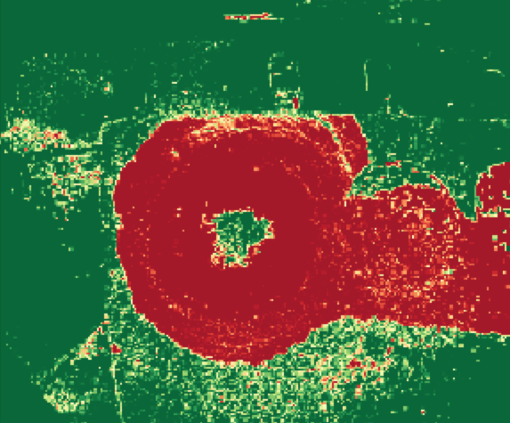
Implementation Overview
Model:
Image
Communicates with Controller through return values
Uses third party libraries
  Numpy
  OpenCV
Figure 8.0. Before image data
Figure 8.1. After image data
Figure 8.2. Analyzed image data
Notes:
*Add more slides if deemed necessary
Time: about 2-3 minutes
Description:
Now that everyone understands what the overall architectural nature of your implementation is, it’s time to give a little more implementation detail. This is the part where you can get detailed, technical, and geeky. After a nice transition, dive us down for a look at the more detailed architecture within each of the main functional elements that you introduced in the last section. For instance, what are the main modules that make up the front end (e.g. User Profiles, Authentication, etc.)... and how do they interact to produce the behavior of the front end. You don’t have time or need to get really low level details like UML diagrams of all classes --- at most you could show the key classes, or maybe just “modules” that contain multiple classes. What you are trying to achieve here is an overview of the key functional modules within each main part of the system. As you introduce each one, you would talk about what it does, what particular quandaries or challenges there were associated with its implementation, and how you thought about and addressed each of them.
By the end of this part, the technically savvy in the audience should have a clear idea of key implementation pieces, the implementation challenges you faced, and your reasoning to solve them. This will allow them to ask specific questions and give specific technical input on your project.
What you will NOT do here is to go into incredible code-level detail --- UML, internal class structure, method headers. It would just break your momentum, put you over the time limit, and be boring to all. Your Design Document should have all of this detail; a nice touch is to just invite the audience to have a look at your Software Design document for more detailed info on code structure.

Slide 12
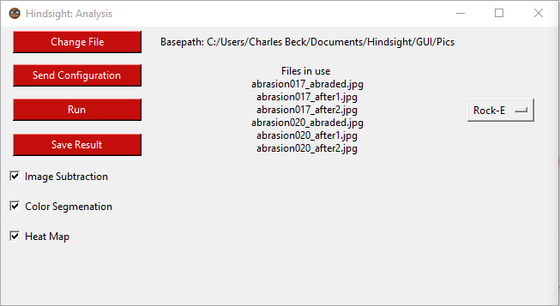

Implementation Overview
View:
Window Class
Analysis Window Class
Communicates with Controller using Config Class
Uses tkinter
Figure 9.0. Window
Figure 9.1. Analysis Window
Notes:
*Add more slides if deemed necessary
Time: about 2-3 minutes
Description:
Now that everyone understands what the overall architectural nature of your implementation is, it’s time to give a little more implementation detail. This is the part where you can get detailed, technical, and geeky. After a nice transition, dive us down for a look at the more detailed architecture within each of the main functional elements that you introduced in the last section. For instance, what are the main modules that make up the front end (e.g. User Profiles, Authentication, etc.)... and how do they interact to produce the behavior of the front end. You don’t have time or need to get really low level details like UML diagrams of all classes --- at most you could show the key classes, or maybe just “modules” that contain multiple classes. What you are trying to achieve here is an overview of the key functional modules within each main part of the system. As you introduce each one, you would talk about what it does, what particular quandaries or challenges there were associated with its implementation, and how you thought about and addressed each of them.
By the end of this part, the technically savvy in the audience should have a clear idea of key implementation pieces, the implementation challenges you faced, and your reasoning to solve them. This will allow them to ask specific questions and give specific technical input on your project.
What you will NOT do here is to go into incredible code-level detail --- UML, internal class structure, method headers. It would just break your momentum, put you over the time limit, and be boring to all. Your Design Document should have all of this detail; a nice touch is to just invite the audience to have a look at your Software Design document for more detailed info on code structure.

Slide 13
Implementation Overview
Controller:
Control Class
control_funcs
Sends returns from Model to View
Applys Config functions to Model
Uses Pandas Dataframe
Figure 10.0. Controller Pandas Dataframe
See our Software Design Document for more details on our implementation .
Notes:
*Add more slides if deemed necessary
Time: about 2-3 minutes
Description:
Now that everyone understands what the overall architectural nature of your implementation is, it’s time to give a little more implementation detail. This is the part where you can get detailed, technical, and geeky. After a nice transition, dive us down for a look at the more detailed architecture within each of the main functional elements that you introduced in the last section. For instance, what are the main modules that make up the front end (e.g. User Profiles, Authentication, etc.)... and how do they interact to produce the behavior of the front end. You don’t have time or need to get really low level details like UML diagrams of all classes --- at most you could show the key classes, or maybe just “modules” that contain multiple classes. What you are trying to achieve here is an overview of the key functional modules within each main part of the system. As you introduce each one, you would talk about what it does, what particular quandaries or challenges there were associated with its implementation, and how you thought about and addressed each of them.
By the end of this part, the technically savvy in the audience should have a clear idea of key implementation pieces, the implementation challenges you faced, and your reasoning to solve them. This will allow them to ask specific questions and give specific technical input on your project.
What you will NOT do here is to go into incredible code-level detail --- UML, internal class structure, method headers. It would just break your momentum, put you over the time limit, and be boring to all. Your Design Document should have all of this detail; a nice touch is to just invite the audience to have a look at your Software Design document for more detailed info on code structure.

Slide 14
Challenges and Resolutions
Edge detection
  After applying multiple algorithms and methods for detecting the edge, we found they led to a dead end
  Resolution: Client suggested we do it ad-hoc (based on camera parameters)
    Another team at JPL is working on same problem (so they may solve it before we do)
      Better to focus our efforts on dust detection/ analysis
Color segmentation for other rock types
  What we currently have for Rock Type E doesn’t work/may not work for other rock types
  Resolution: Each rock type will have a customized algorithm
Notes:
Time: about 2 minutes
Dead end for a few reasons, there is true edge, and pseudo edge (edge created by dust covering abrasion)
Dust is dust not farm hard edges, it clumps, and breaks apart, issue of shadows and inconsistent lighting.
The major challenge we have been facing is being able to detect the edge of the abrasion, which was one of the requirements we gathered last semester. Due to the nature of the dust created from the drill and the rock, the multiple algorithms we tried to apply like Canny Edge detection, ending up leading to dead ends for both the raw images and dust density maps. We discussed this issue with our client, who suggested we use the camera parameters, which are the pixel-to-mm scale and diameter of the abrasion, to find the abrasion in the image. JPL has another team working on the same problem so we will be focusing our efforts more on dust detection and analysis.
Another challenge is applying color segmentation to the other rock types that JPL is testing. The color segmentation we have for the Rock Type E analysis can't be applied to the other rock types because of how the dust and rock look differently compared to this rock type. For example, the second rock type we are analyzing, Rock Type B, has white dust and we're having issues with having it detect the dust correctly. To solve this, each rock type will have its own customized color segmentation according to how the dust and rock look.

Slide 15
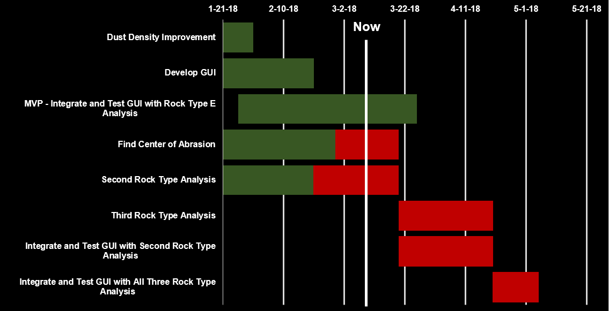
Schedule
Figure 11.0. Current Implementation Schedule
Notes:
Time: about 1 minute
On our development schedule, these are the main tasks we are doing or planning to do this semester. The dark green bars indicate how much progress has been made in implementing the task. The bars that are completely dark green mean that they have been completed like the first two tasks. Red indicates that we have started the task and the dark green bars show how much progress has been made on them. Our minimal viable product, which was to integrate and test our GUI with the Rock Type E analysis we implemented, is highlighted by this blue bar. The final three tasks are ones we have not started yet so they are colored a dark gray to indicate that status and will turn red when we have started them.

Slide 16
Hand
analyzed:
Automatically analyzed:
Figure 12.0. Example abrasion analysis
Figure 12.1. Current abrasion analysis
Notes:
Mention that the above is the same image, the left is
This slide shows how much progress we have made in analyzing an image. The left image was done in photoshop to illustrate what an example of an analysis of the abrasion could look like and the right image is an actual analysis done by our program. As you can see, there still is work to be done in correctly detecting the dust as this area should be marked red instead of green.

Slide 17
Conclusion
Client and Problem
Solution Vision
  Take in batch of images
  Automatically apply computer vision algorithms to detect dust
  JPL can then run multiple tests in a single vacuum chamber pump down session
    And get feedback on how effective their gas Dust Removal Tool is
Overview of:
  Requirements
  Architecture
  Implementation
Challenges and Resolutions
What’s Coming Up for Team Hindsight
Notes:
Time: about 1 minute
In conclusion, we are Team Hindsight and our client is Iona Brockie, a mechatronics engineer at JPL and one of the people working on the Mars 2020 rover mission to discover if there was past life on Mars. To solve their problem of testing the effectiveness of their gas Dust Removal tool and speed up the testing process, our program will be able to take in a batch of images, automatically apply computer vision algorithms, and allow JPL to run multiple tests in a single vacuum chamber pump down session and get feedback on how effective their tool is.
In this talk, we reviewed what requirements we gathered, such as handling a batch of images to analyze for dust and mark the areas with dust and displaying the before, after and analyzed images in a GUI, the architecture we have chosen, which was a MVC model, and how we plan to implement the architecture with our chosen libraries and languages. We also talked about the challenge of detecting the edge of the abrasion and using color segmentation on the othe rock types and how we plan to solve them using customized algorithms for the color segmentation and using camera parameters to find the abrasion. We were able to achieve a minimal viable product for our client and will improve the accuracy of the dust detection analysis and improve the design of the GUI. We are working on a second rock type analysis and finding the abrasion which will be implemented into the GUI once they are completed. This tool will save JPL a lot of time testing their gas Dust Removal tool on their Mars 2020 rover so that it can succeed at its goal of detecting whether there was past life on Mars. Thank you. Are there any questions?

Slide 18
Sources
https://mars.nasa.gov/programmissions/missions/present/2003/
https://en.wikipedia.org/wiki/Mars_Pathfinder
https://www.jpl.nasa.gov
https://mars.nasa.gov/mars2020/mission/rover/

