Slide 1

Team Lasso
Greg Andolshek
Alex Koch
Michael McCormick

Slide 2
Team Lasso
Group Members
  Greg Andolshek - Architect, Release Manager, Documenter
  Alex Koch - Graphic Designer, Database Manager
  Michael McCormick - Team Leader, Communicator
Mentor
  Dr. Eck Doerry

Slide 3



Groups
Types of organizations:
Common grouping challenges:
  Manage members
  Define groups manually and automatically
  Analyze members and groups
  Facilitate group communication

Slide 4
Grouping Example – Little League
Manage members | Define Groups | Analyze Members and Groups | Facilitate Group Communication
Little League Division
Coach 1
Name: Mike Age: 35 Position: Coach BA: --
Player 1
Name: Bob Age: 9 Position: 1B BA: .500
Player 2
Name: Stu Age: 10 Position: SS BA: .432
Player 3
Name: Dan Age: 12 Position: SS BA: .547
Player 4
Name: P.J. Age: 11 Position: P BA: .235
Coach 2
Name: Tom Age: 41 Position: Coach BA: --
Player 5
Name: Phil Age: 10 Position: 2B BA: .346
Player 6
Name: Ron Age: 9 Position: SS BA: .564
Player 7
Name: Pat Age: 12 Position: SS BA: .445
Player 8
Name: Joe Age: 12 Position: 3B BA: .367

Slide 5
Grouping Example – Little League
Manage members | Define Groups | Analyze Members and Groups | Facilitate Group Communication
Team 1
Coach 1
Name: Mike Age: 35 Position: Coach BA: --
Player 1
Name: Bob Age: 9 Position: 1B BA: .500
Player 2
Name: Stu Age: 10 Position: SS BA: .432
Player 3
Name: Dan Age: 12 Position: SS BA: .547
Player 4
Name: P.J. Age: 11 Position: P BA: .235
Coach 2
Name: Tom Age: 41 Position: Coach BA: --
Player 5
Name: Phil Age: 10 Position: 2B BA: .346
Player 6
Name: Ron Age: 9 Position: SS BA: .564
Player 7
Name: Pat Age: 12 Position: SS BA: .445
Player 8
Name: Joe Age: 12 Position: 3B BA: .367
Team 2

Slide 6
Grouping Example – Little League
Manage members | Define Groups | Analyze Members and Groups | Facilitate Group Communication
Age 9-10 Group
Age 11-12 Group
Coach 1
Name: Mike Age: 35 Position: Coach BA: --
Player 1
Name: Bob Age: 9 Position: 1B BA: .500
Player 2
Name: Stu Age: 10 Position: SS BA: .432
Player 3
Name: Dan Age: 12 Position: SS BA: .547
Player 4
Name: P.J. Age: 11 Position: P BA: .235
Coach 2
Name: Tom Age: 41 Position: Coach BA: --
Player 5
Name: Phil Age: 10 Position: 2B BA: .346
Player 6
Name: Ron Age: 9 Position: SS BA: .564
Player 7
Name: Pat Age: 12 Position: SS BA: .445
Player 8
Name: Joe Age: 12 Position: 3B BA: .367

Slide 7
Grouping Example – Little League
Manage members | Define Groups | Analyze Members and Groups | Facilitate Group Communication
Shortstop Group
Coach 1
Name: Mike Age: 35 Position: Coach BA: --
Player 1
Name: Bob Age: 9 Position: 1B BA: .500
Player 2
Name: Stu Age: 10 Position: SS BA: .432
Player 3
Name: Dan Age: 12 Position: SS BA: .547
Player 4
Name: P.J. Age: 11 Position: P BA: .235
Coach 2
Name: Tom Age: 41 Position: Coach BA: --
Player 5
Name: Phil Age: 10 Position: 2B BA: .346
Player 6
Name: Ron Age: 9 Position: SS BA: .564
Player 7
Name: Pat Age: 12 Position: SS BA: .445
Player 8
Name: Joe Age: 12 Position: 3B BA: .367

Slide 8
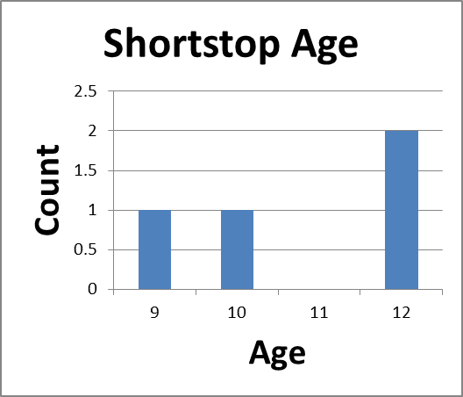
Grouping Example – Little League
Manage members | Define Groups | Analyze Members and Groups | Facilitate Group Communication
Shortstop Group
Coach 1
Name: Mike Age: 35 Position: Coach BA: --
Player 1
Name: Bob Age: 9 Position: 1B BA: .500
Player 2
Name: Stu Age: 10 Position: SS BA: .432
Player 3
Name: Dan Age: 12 Position: SS BA: .547
Player 4
Name: P.J. Age: 11 Position: P BA: .235
Coach 2
Name: Tom Age: 41 Position: Coach BA: --
Player 5
Name: Phil Age: 10 Position: 2B BA: .346
Player 6
Name: Ron Age: 9 Position: SS BA: .564
Player 7
Name: Pat Age: 12 Position: SS BA: .445
Player 8
Name: Joe Age: 12 Position: 3B BA: .367

Slide 9

Grouping Example – Little League
Manage members | Define Groups | Analyze Members and Groups | Facilitate Group Communication
Shortstop Group
Shortstop Forum
Favorite Plays
Rides to Games?
The Perfect Hit
Coach 1
Name: Mike Age: 35 Position: Coach BA: --
Player 1
Name: Bob Age: 9 Position: 1B BA: .500
Player 2
Name: Stu Age: 10 Position: SS BA: .432
Player 3
Name: Dan Age: 12 Position: SS BA: .547
Player 4
Name: P.J. Age: 11 Position: P BA: .235
Coach 2
Name: Tom Age: 41 Position: Coach BA: --
Player 5
Name: Phil Age: 10 Position: 2B BA: .346
Player 6
Name: Ron Age: 9 Position: SS BA: .564
Player 7
Name: Pat Age: 12 Position: SS BA: .445
Player 8
Name: Joe Age: 12 Position: 3B BA: .367

Slide 10

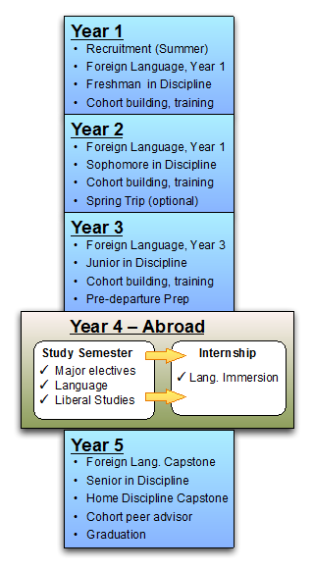
What is GSEP?
Global Science and Engineering
Program
Sponsor – Melissa Armstrong
Goal – internationalize all
STEM degree programs
Dual degree
  13 STEM majors
  5 language majors
Currently 75 students

Slide 11
GSEP Grouping Requirements
GSEP needs one tool that can:
  Manage students
    300-500
  Define groups manually and automatically
    GSEP attributes
  Analyze students and groups
    Charts and statistical breakdowns
  Facilitate group communication
    Share GSEP experiences

Slide 12
Grouping Example – GSEP
Manage members | Define Groups | Analyze Members and Groups | Facilitate Group Communication
GSEP Group
Admin 1
Name: Robert M: Com Sci L: German GPA: 4.0
Student 1
Name: Fred M: Com Sci L: German GPA: 3.8
Student 2
Name: Ali M: Com Sci L: Spanish GPA: 4.0
Student 3
Name: April M: Com Sci L: Spanish GPA: 3.7
Student 4
Name: AJ M: Com Sci L: Chinese GPA: 3.5
Admin 2
Name: Allison M: Eng L: Spanish GPA: --
Student 5
Name: Gale M: Eng L: French GPA: 3.9
Student 6
Name: Stan M: Eng L: Spanish GPA: 4.0
Student 7
Name: Carl M: Eng L: Spanish GPA: 3.6
Student 8
Name: Jim M: Eng L: Japanese GPA: 3.7

Slide 13
Grouping Example – GSEP
Manage members | Define Groups | Analyze Members and Groups | Facilitate Group Communication
Computer Science Group
Admin 1
Name: Robert M: Com Sci L: German GPA: 4.0
Student 1
Name: Fred M: Com Sci L: German GPA: 3.8
Student 2
Name: Ali M: Com Sci L: Spanish GPA: 4.0
Student 3
Name: April M: Com Sci L: Spanish GPA: 3.7
Student 4
Name: AJ M: Com Sci L: Chinese GPA: 3.5
Admin 2
Name: Allison M: Eng L: Spanish GPA: --
Student 5
Name: Gale M: Eng L: French GPA: 3.9
Student 6
Name: Stan M: Eng L: Spanish GPA: 4.0
Student 7
Name: Carl M: Eng L: Spanish GPA: 3.6
Student 8
Name: Jim M: Eng L: Japanese GPA: 3.7
Engineering Group

Slide 14
Grouping Example – GSEP
Manage members | Define Groups | Analyze Members and Groups | Facilitate Group Communication
GPA 3.80-4.0 Group
GPA 3.5-3.79 Group
Admin 1
Name: Robert M: Com Sci L: German GPA: 4.0
Student 1
Name: Fred M: Com Sci L: German GPA: 3.8
Student 2
Name: Ali M: Com Sci L: Spanish GPA: 4.0
Student 3
Name: April M: Com Sci L: Spanish GPA: 3.7
Student 4
Name: AJ M: Com Sci L: Chinese GPA: 3.5
Admin 2
Name: Allison M: Eng L: Spanish GPA: --
Student 5
Name: Gale M: Eng L: French GPA: 3.9
Student 6
Name: Stan M: Eng L: Spanish GPA: 4.0
Student 7
Name: Carl M: Eng L: Spanish GPA: 3.6
Student 8
Name: Jim M: Eng L: Japanese GPA: 3.7

Slide 15
Grouping Example – GSEP
Manage members | Define Groups | Analyze Members and Groups | Facilitate Group Communication
Spanish Group
Admin 1
Name: Robert M: Com Sci L: German GPA: 4.0
Student 1
Name: Fred M: Com Sci L: German GPA: 3.8
Student 2
Name: Ali M: Com Sci L: Spanish GPA: 4.0
Student 3
Name: April M: Com Sci L: Spanish GPA: 3.7
Student 4
Name: AJ M: Com Sci L: Chinese GPA: 3.5
Admin 2
Name: Allison M: Eng L: Spanish GPA: --
Student 5
Name: Gale M: Eng L: French GPA: 3.9
Student 6
Name: Stan M: Eng L: Spanish GPA: 4.0
Student 7
Name: Carl M: Eng L: Spanish GPA: 3.6
Student 8
Name: Jim M: Eng L: Japanese GPA: 3.7

Slide 16
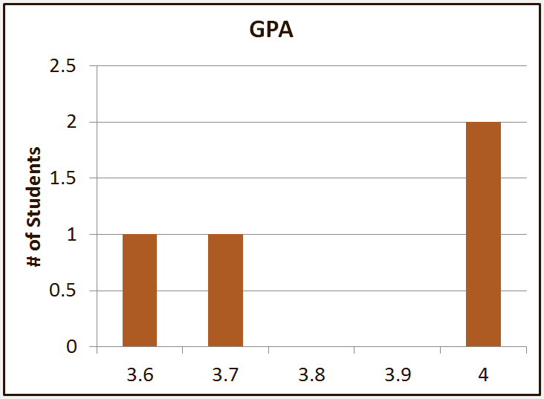
Grouping Example – Little League
Manage members | Define Groups | Analyze Members and Groups | Facilitate Group Communication
Spanish Group
Admin 1
Name: Robert M: Com Sci L: German GPA: 4.0
Student 1
Name: Fred M: Com Sci L: German GPA: 3.8
Student 2
Name: Ali M: Com Sci L: Spanish GPA: 4.0
Student 3
Name: April M: Com Sci L: Spanish GPA: 3.7
Student 4
Name: AJ M: Com Sci L: Chinese GPA: 3.5
Admin 2
Name: Allison M: Eng L: Spanish GPA: --
Student 5
Name: Gale M: Eng L: French GPA: 3.9
Student 6
Name: Stan M: Eng L: Spanish GPA: 4.0
Student 7
Name: Carl M: Eng L: Spanish GPA: 3.6
Student 8
Name: Jim M: Eng L: Japanese GPA: 3.7

Slide 17
Grouping Example – Little League
Manage members | Define Groups | Analyze Members and Groups | Facilitate Group Communication
Spanish Group
Spanish Forum
Best Places to Eat
Catalonia Las Cortes
Tranquilamente
Admin 1
Name: Robert M: Com Sci L: German GPA: 4.0
Student 1
Name: Fred M: Com Sci L: German GPA: 3.8
Student 2
Name: Ali M: Com Sci L: Spanish GPA: 4.0
Student 3
Name: April M: Com Sci L: Spanish GPA: 3.7
Student 4
Name: AJ M: Com Sci L: Chinese GPA: 3.5
Admin 2
Name: Allison M: Eng L: Spanish GPA: --
Student 5
Name: Gale M: Eng L: French GPA: 3.9
Student 6
Name: Stan M: Eng L: Spanish GPA: 4.0
Student 7
Name: Carl M: Eng L: Spanish GPA: 3.6
Student 8
Name: Jim M: Eng L: Japanese GPA: 3.7

Slide 18












Product Comparison
Manage Members | Create Groups | Analyze Groups | Facilitate Communication
Poor Fair Good Very Good Excellent

Slide 19
What is Missing?
Socially Organized Groups
Centrally Managed Groups
Self-organized
User contribution
Inter-group focus
Centrally controlled
Administrator functions
Management focus

Slide 20

What is Missing?
Socially Organized Groups
Centrally Managed Groups
Self-organized
User contribution
Inter-group focus
Centrally controlled
Administrator functions
Management focus

Slide 21
Our Solution: Group Wrangler
Web based solution for group management
Supports social interaction and group management
Satisfies the following group challenges:
  Manage members
  Create automated groups
  Analyze and maintain groups
  Facilitate group communication

Slide 22
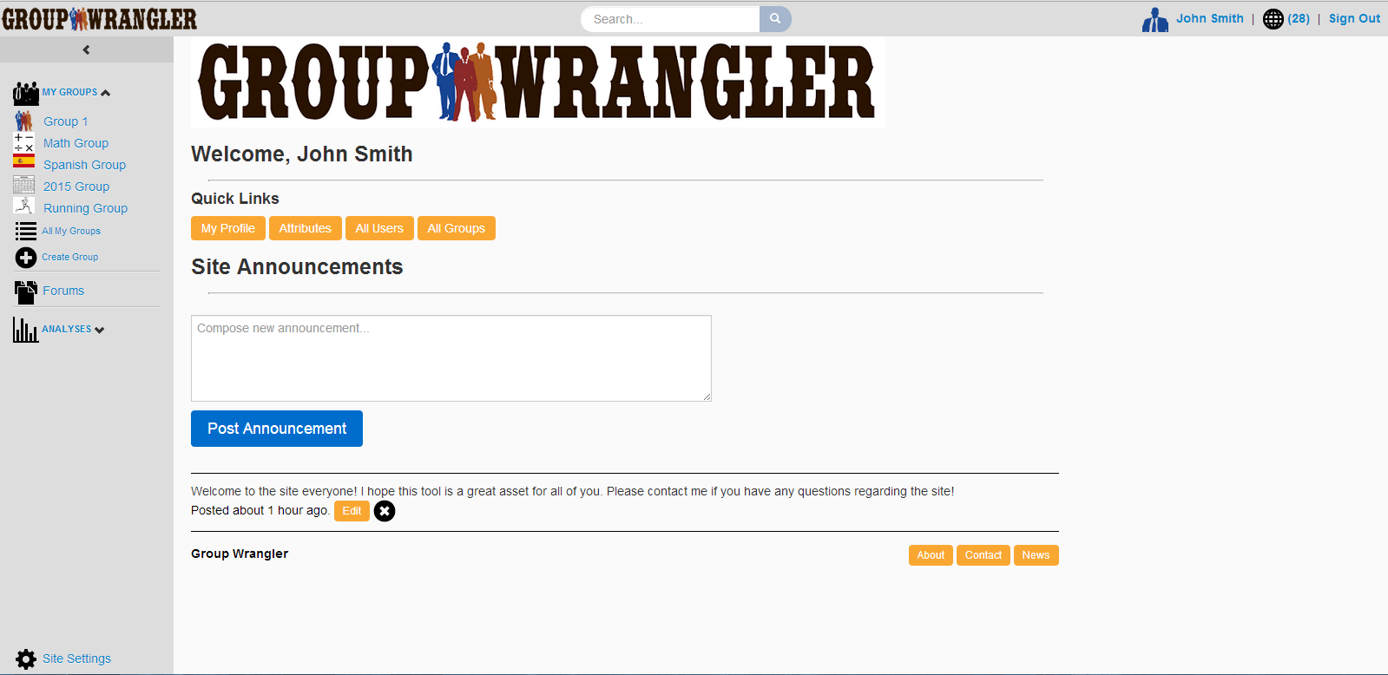
Home Page
Notes:
OK, so in our example here, our administrator, John Smith, has just logged in to the Group Wrangler site and finds themselves at the home page. The home page contains quick links to a few important pages as well as any site announcements. Let’s say John would like to set up a group for users that are part of the engineering department and speak either Spanish or German. The first thing John is going to have to do is set up a Department attribute since one does not already exist. Site attributes are set up in the site settings page, so John clicks the link found here (4).

Slide 23
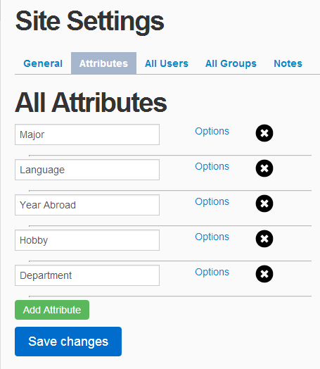
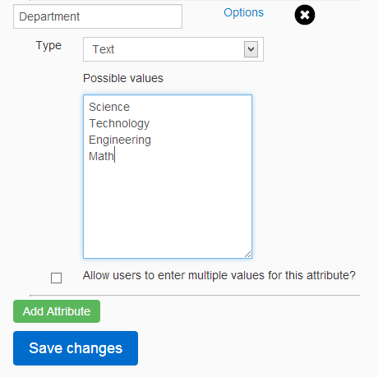
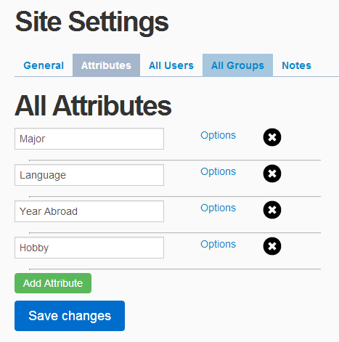
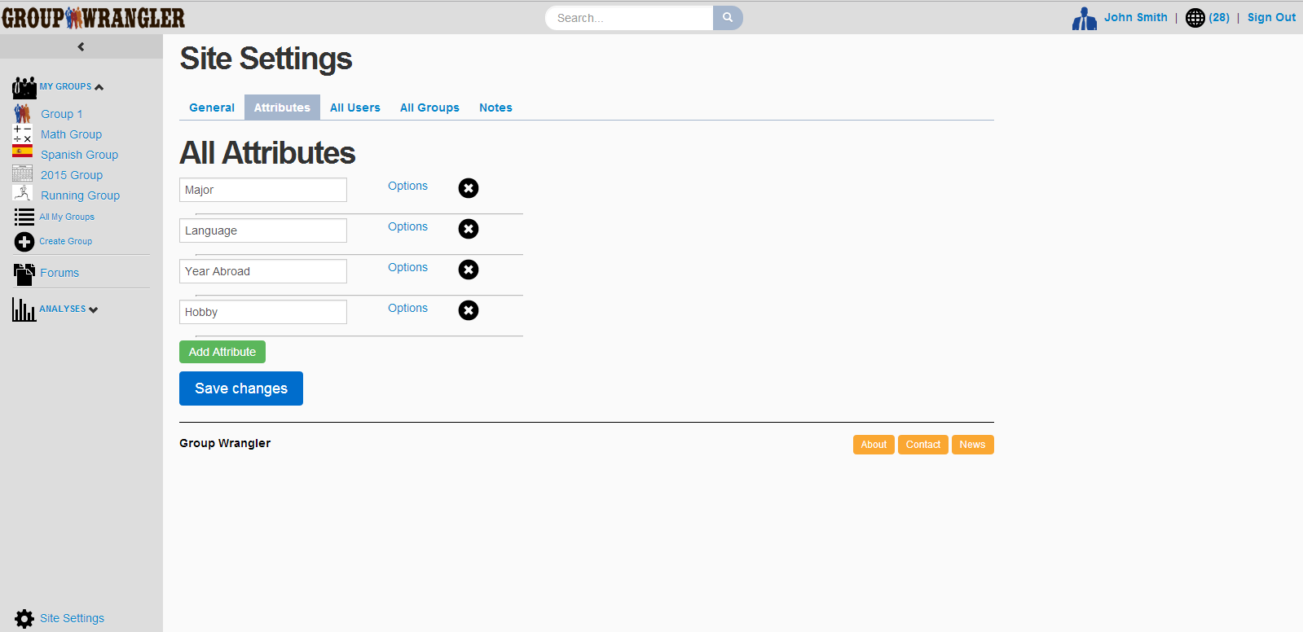
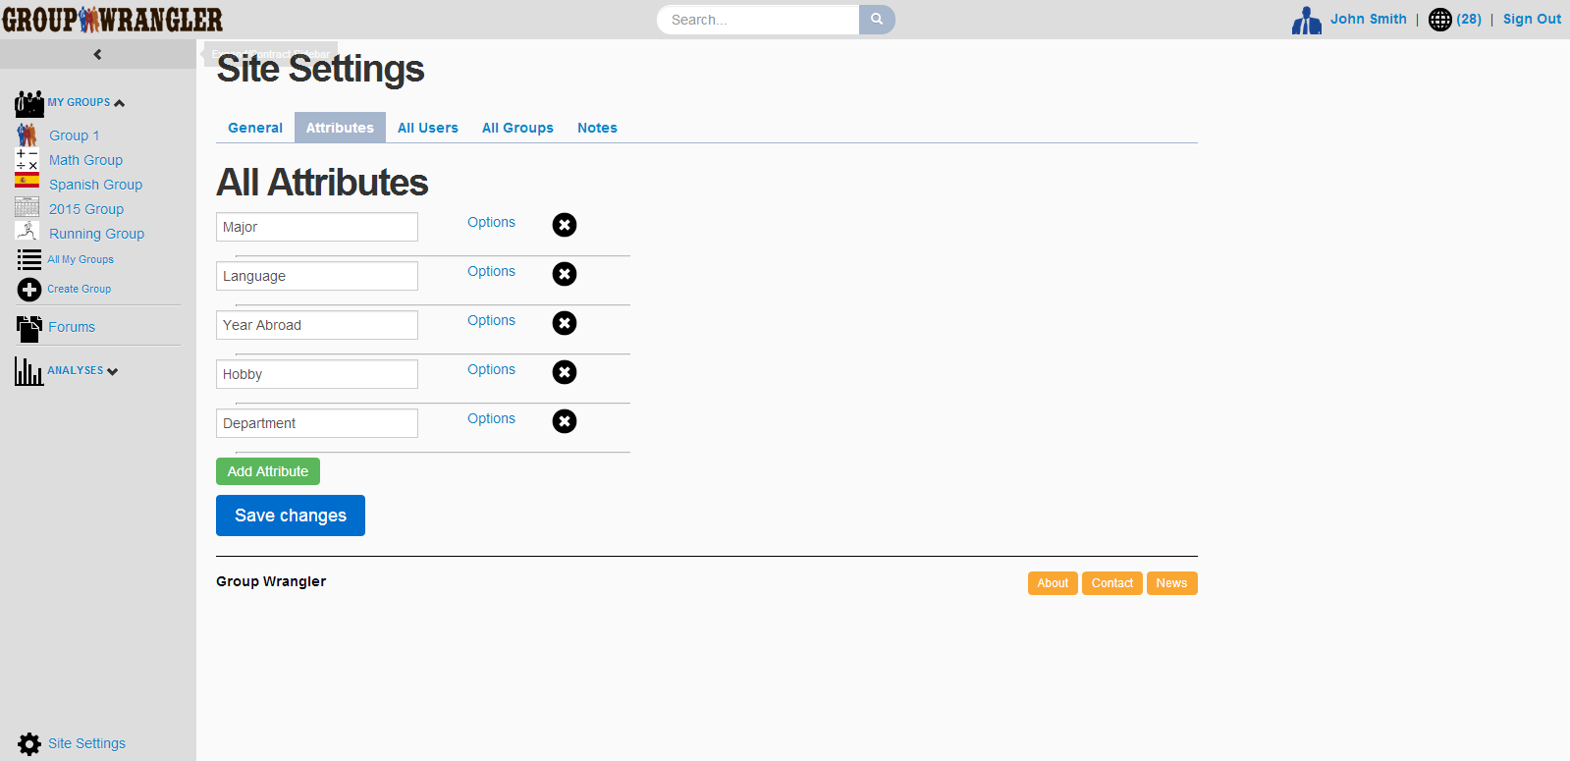
Site Settings – Attributes Tab
Notes:
Site settings tab (attributes tab)
Zoom to see just tab content

Slide 24
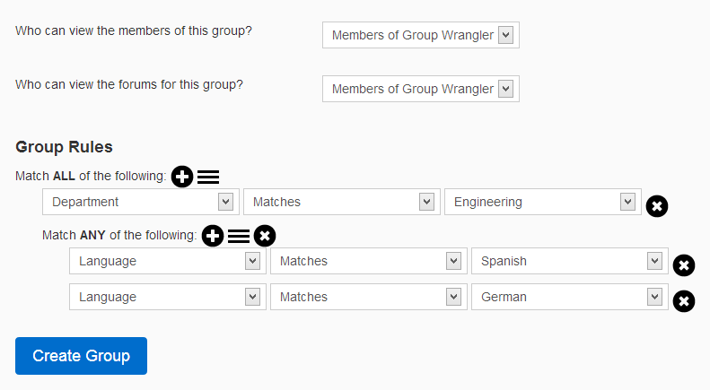
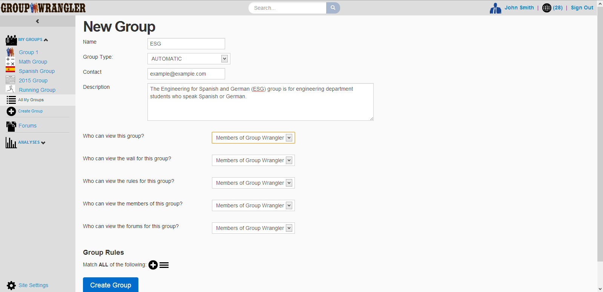
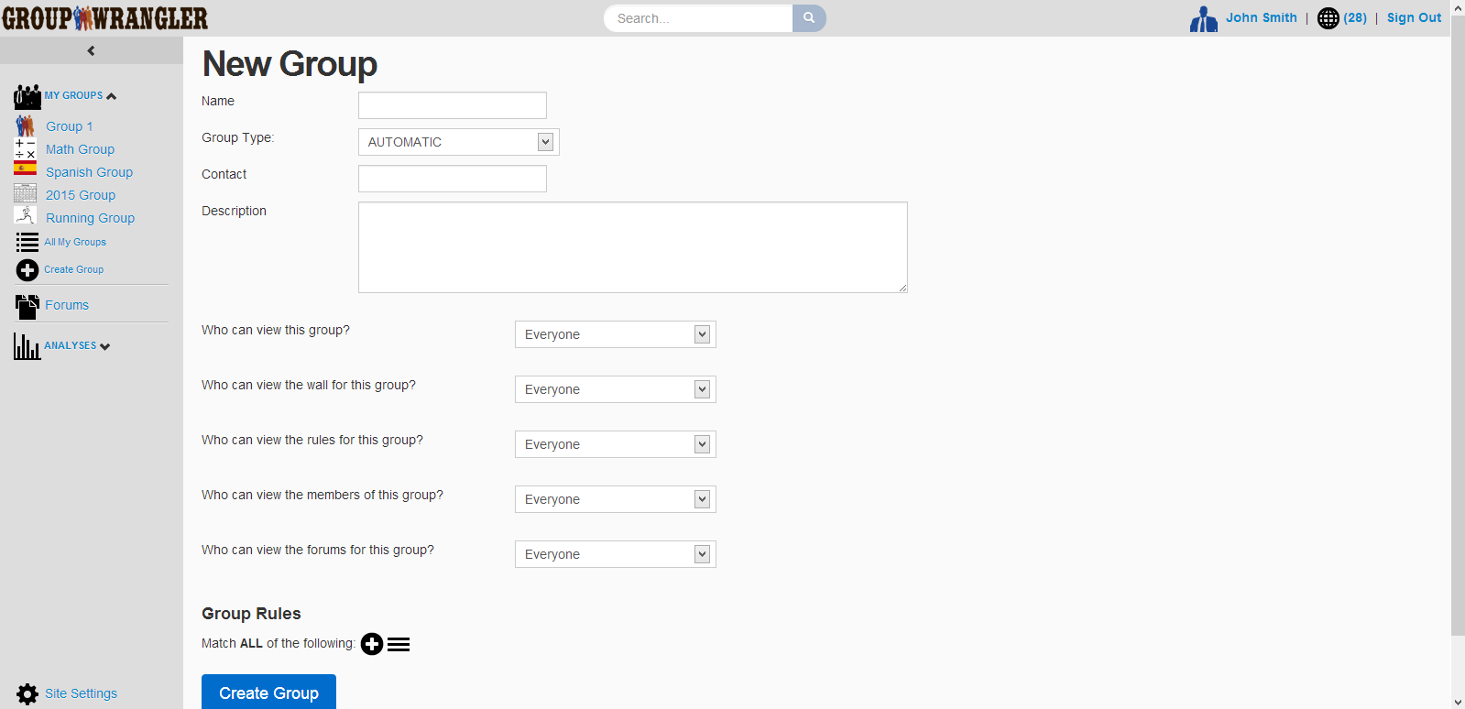
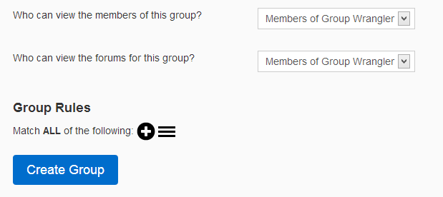
Group Creation
Notes:
Show group profile (announcement tab)
Quickly show all tabs (stop to talk about group rules)

Slide 25
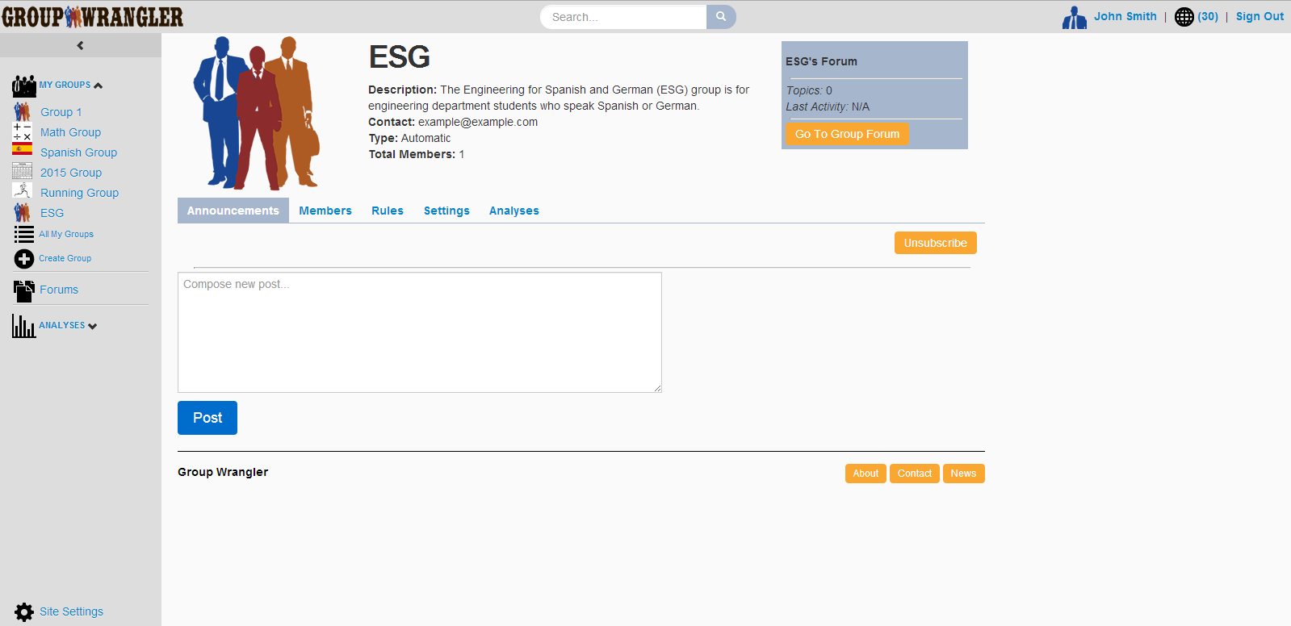
Group Profile
Notes:
Show group forums

Slide 26
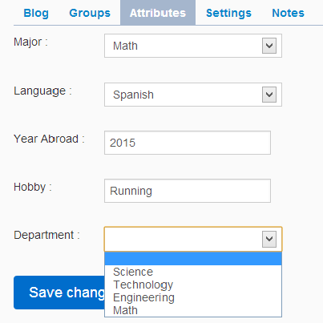
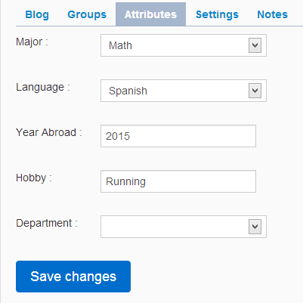
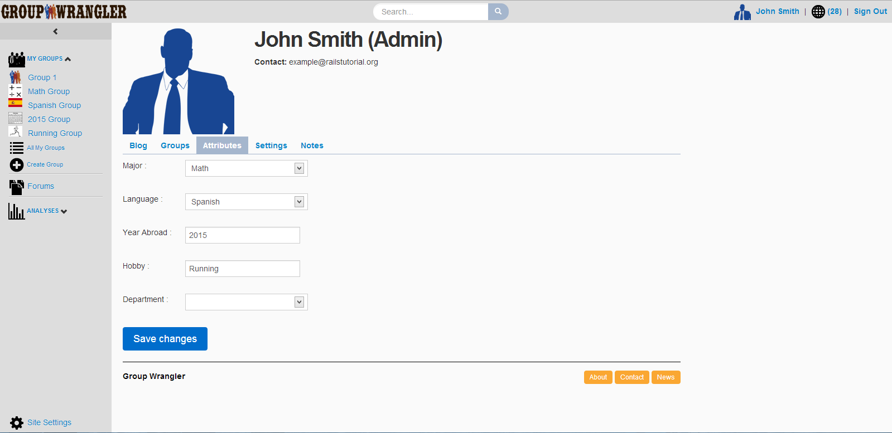
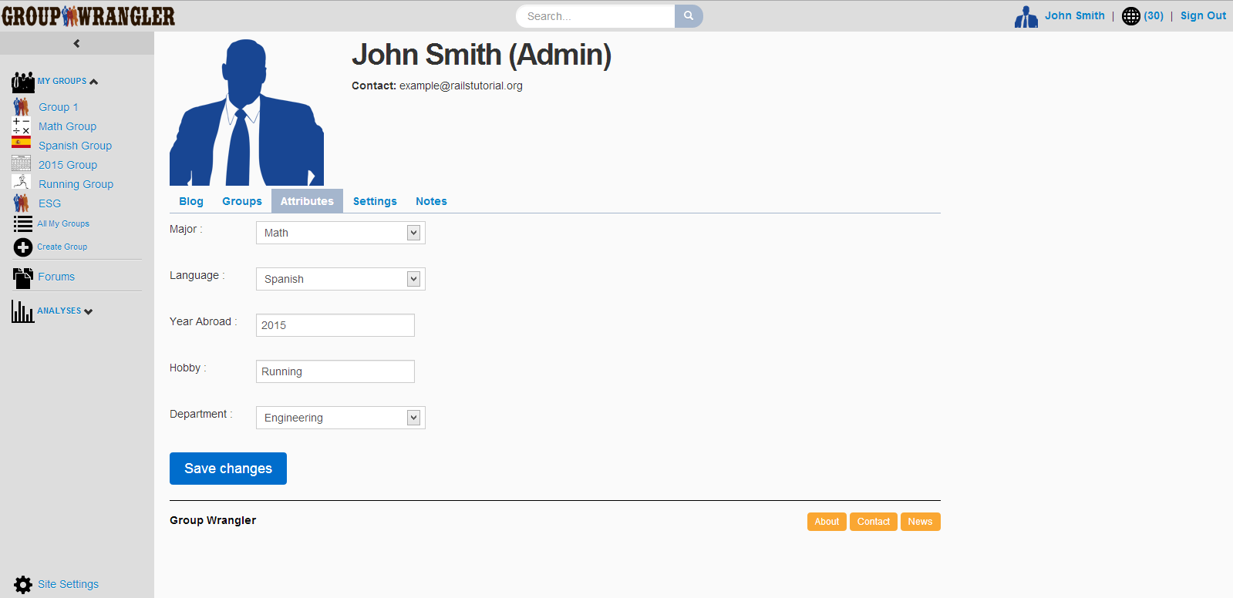
User Profile – Attributes Tab
Notes:
User profile (blog tab)
Quickly show all other tabs

Slide 27
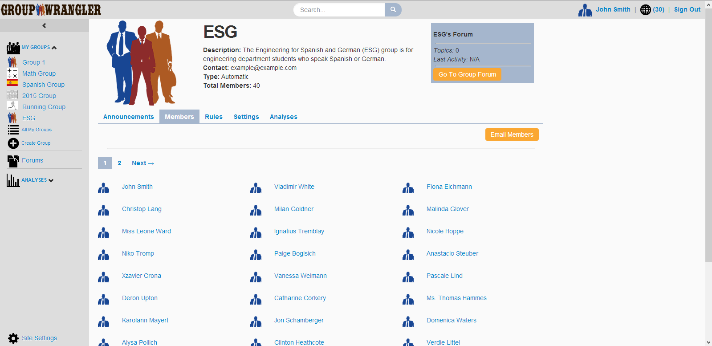
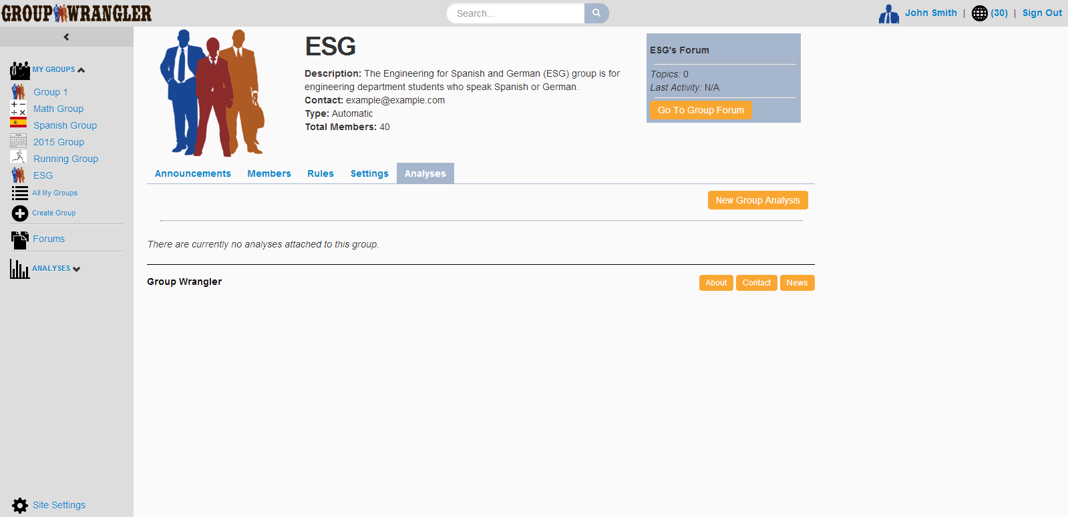
Group Profile – Members Tab

Slide 28
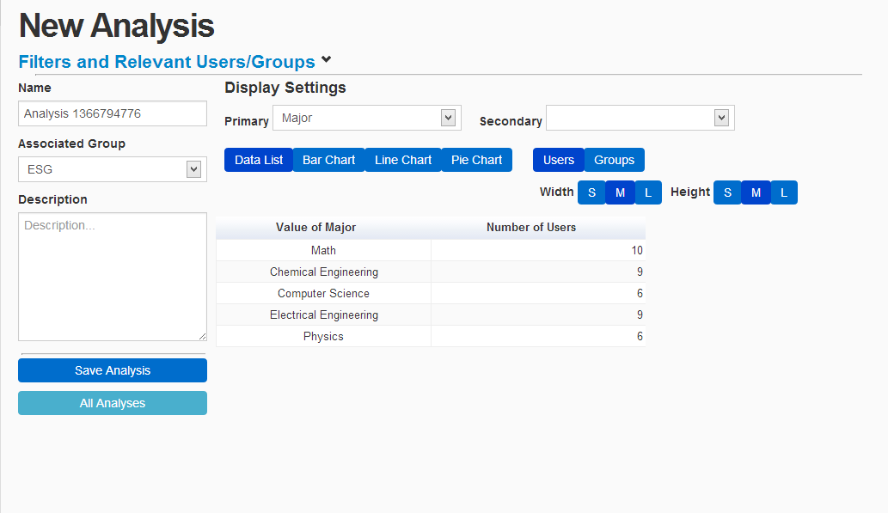
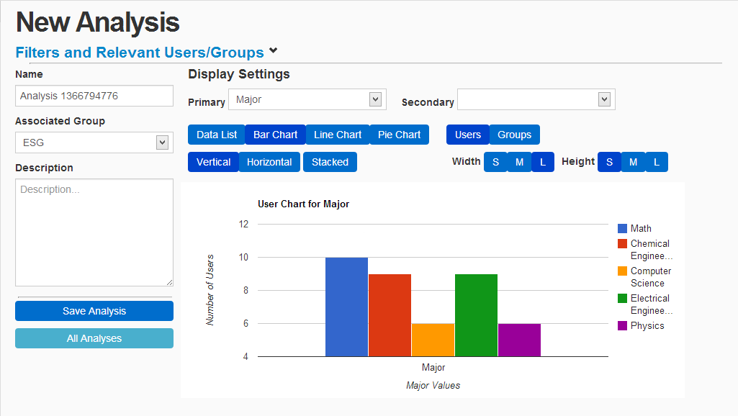
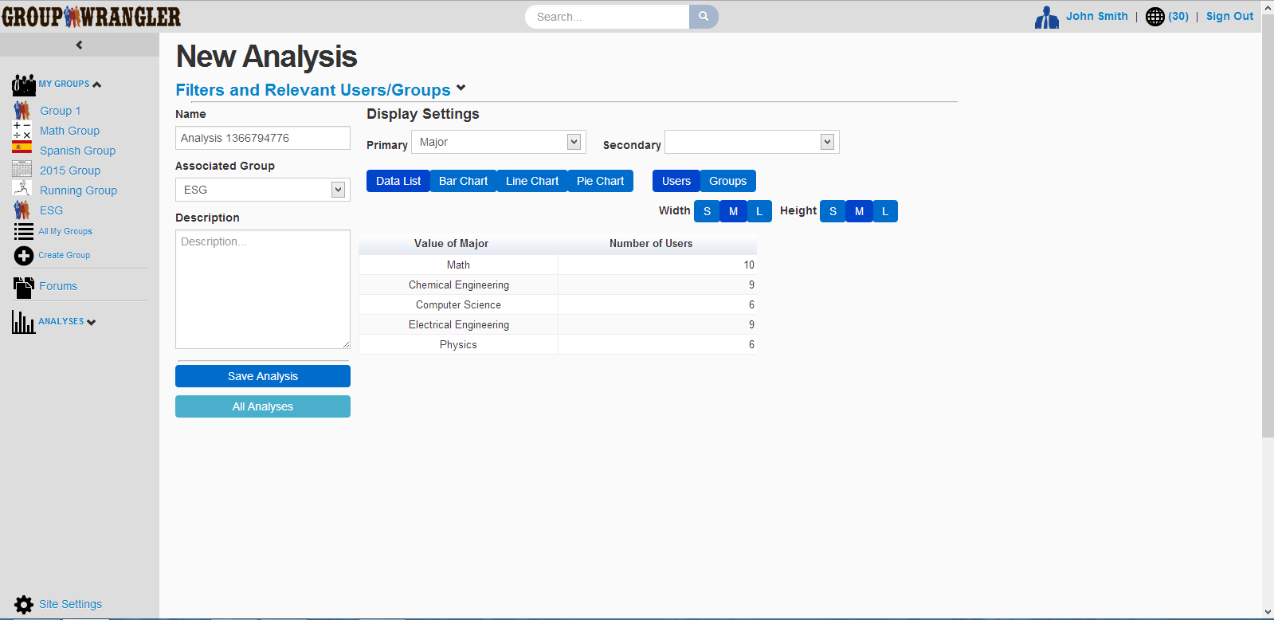
Analysis Tool
Notes:
Show analysis tool

Slide 29
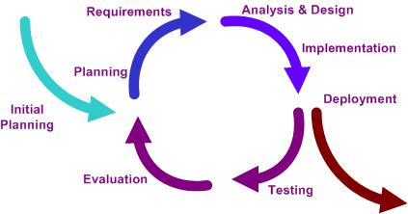
Development Process
Agile development methodology
Notes:
Now I’d like to talk more about the software process we used to develop Group Wrangler
We used an agile development methodology where we made many project versions that we improved with time by adding and updating features.
This allowed us to build versions quickly and incorporate user feedback.
We iterated through 4 main project phases, namely
Requirements
Design
Implementation
Testing and refinement

Slide 30
Requirements Acquisition
Initial meeting with Melissa Armstrong
Established functionality by user type
  Generic user and administrator
Developed initial requirements document
Later meetings to refine requirements

Slide 31
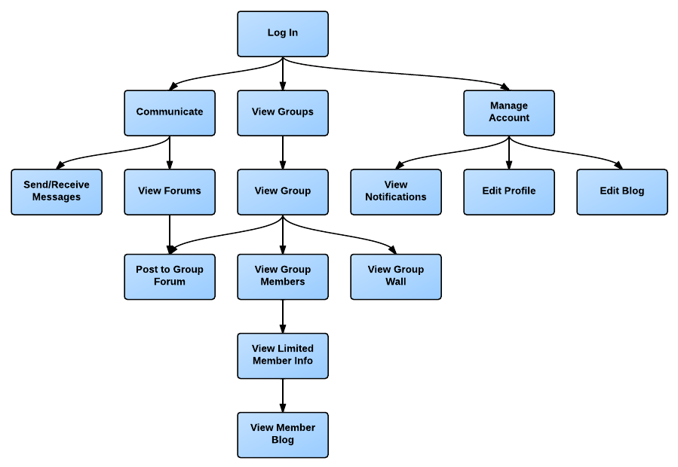
Generic User Modules
Notes:
We started by interviewing our client to determine the needed system features.
We ultimately broke down the functionality into modules based on the actions a user can perform.
Here we see the modules broken down for a general user.
At a high level, a general user can communicate, view groups, and manage his or her account.
A user may choose to view his or her groups in order to see information on individual users or post to the group’s wall or forum.

Slide 32
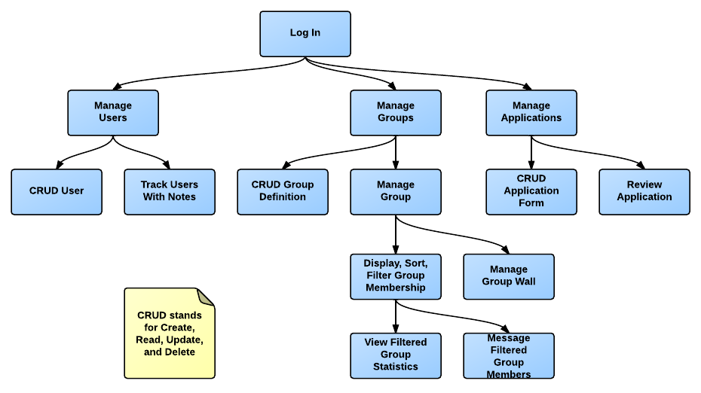
Admin Functional Modules
Notes:
An administrator can perform any action that a general user can and more.
At the top level, and administrator may choose to manage users, groups, or applications.
An admin may choose to track users with notes, display graphical breakdowns, or message members.

Slide 33





Technology
Criteria:
  Solid code structure
  Strong community support
  Fast development cycle
  Easy maintenance
  Support for software
  engineering principles
Notes:
Looked at variety of technologies
Did single page demos to test the viability of various frameworks
Looked at frameworks for Java, PHP, JavaScript, Ruby, etc.
Looking for something that met the criteria listed here:
Solid code structuring to help structure our code and link various parts of the code together
Strong community support with well-written documentation
Quick development cycle to fit our rapid versioning and agile approach
Easy to follow and maintain so that future developers can quickly build off of what we have developed
Support for software engineering principles such as the DRY principle which focuses on limiting code repetition
…also convention over configuration
Ultimately landed on Ruby on Rails for framework

Slide 34
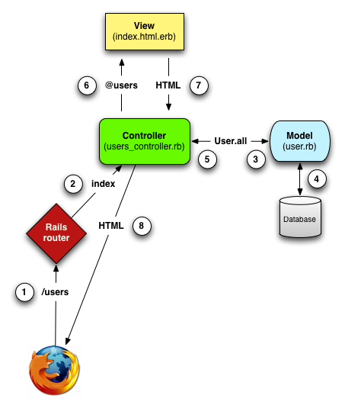
Ruby on Rails Server
Architecture
Heroku
Database
Client
Hartl, Michael. 2013. <http://ruby.railstutorial.org/ruby-on-rails-tutorial-book>
Notes:
This is a more detailed view of the system architecture.
Here we are using a model-view-controller setup
A client starts by entering a URL into his or her browser to connect to the Rails server.
This information is then read by the rails router, which then maps to a certain action in the controller.
The controller then executes the action by retrieving the necessary model information along with the relevant data in the database.
This information is then passed on to a particular view, which is where the html for the page is actually rendered dynamically.
The final page information is then passed back to the user, which shows up as a web page in his or her browser.

Slide 35
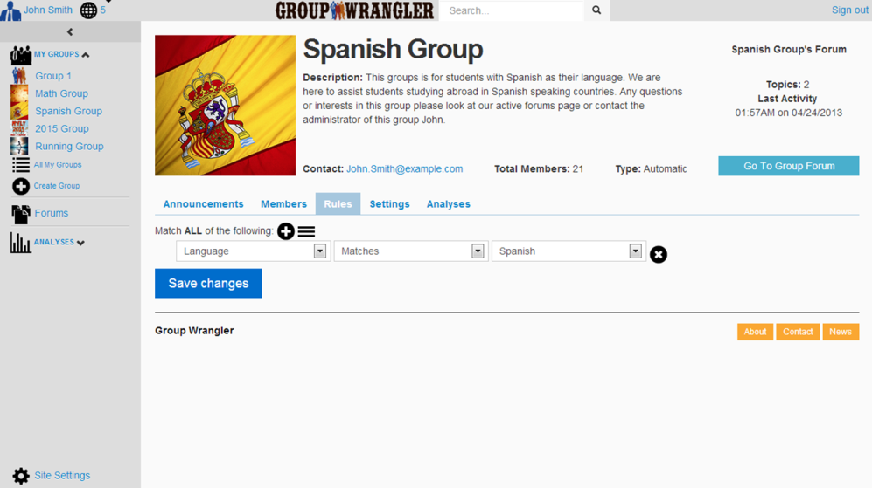
Implementation
Main components: users, groups, attributes
Group Controller
Index
Show
New
Create
Update
Destroy
Group Model
ID
Name
Description
Rules
Privacy Level
Group View

Slide 36
Testing and Refinement
Regular mentor meetings
Client/user testing
Improvements
  Page accessibility
  Screen real estate
  Sidebar layout
Notes:
Feedback from our mentor, who focuses on user interface design

Slide 37
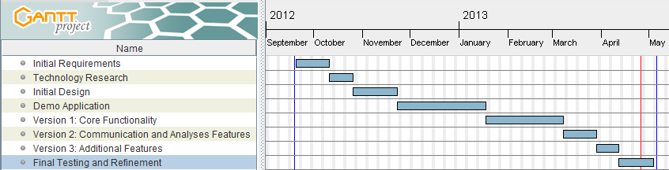
Schedule

Slide 38
Problems and Challenges
No similar system exists
  Team meetings to establish feature integration
Intuitive user interface
  User testing
Multiple browser support
  Avoiding browser-specific code
File and picture storage
  Using Amazon S3 for file/picture storage
Notes:
One of our largest challenges was that no similar system exists that integrates all of the features of our software
Much different from building a better version of an existing product
– uncharted territory!
Email clients are well-established
Minds of users
Clear metaphors
Varied technologies that we had learn and integrate

Slide 39
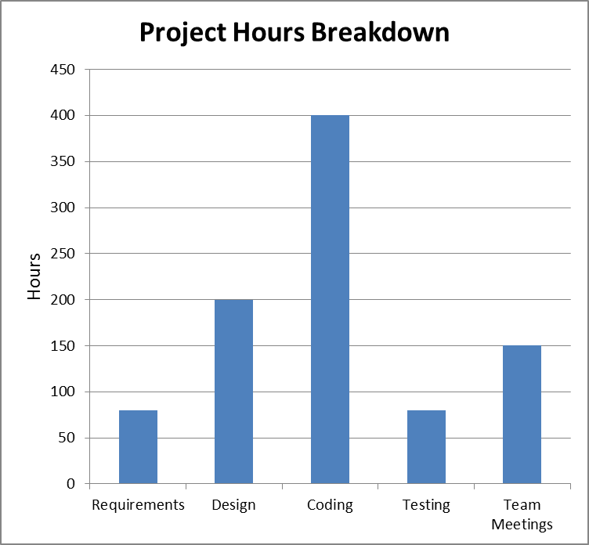
Outcomes
Used for managing GSEP students starting next fall
Publicly available
Total project value:
  570 hrs/developer
  $100/hr
  Total value: $171,000
Notes:
Requirements – 80 hrs
Design – 200 hrs
Coding – 400 hrs
Testing – 80 hrs
Team meetings – 150 hrs
1710 hours total
Really learned a lot about project development and working in teams

Slide 40
Future Work
Remaining tasks:
  Installation manual
  User interface refinement
  Delivery to client
Features for upcoming version:
  Support for large user bases (100,000+ users)
  Support for additional graph types
  Additional integration with social sites

Slide 41
Conclusion
Problem
  Lack of proper group management tool combined with social interaction
Solution
  Group Wrangler
    Manage members
    Define groups manually and automatically
    Analyze groups and members
    Facilitate group communication
Vision
  Premiere group management software
Notes:
Lack of group management tool that integrates admin control and intra group freedom
Can mention free and open source
Vision
Premiere group management software in the near future

Slide 42

Questions?
Display Board 36A
  Time: 4PM-5PM
Live demo of Group Wrangler
  Set up with all UGRADS capstone teams’ information

Slide 43
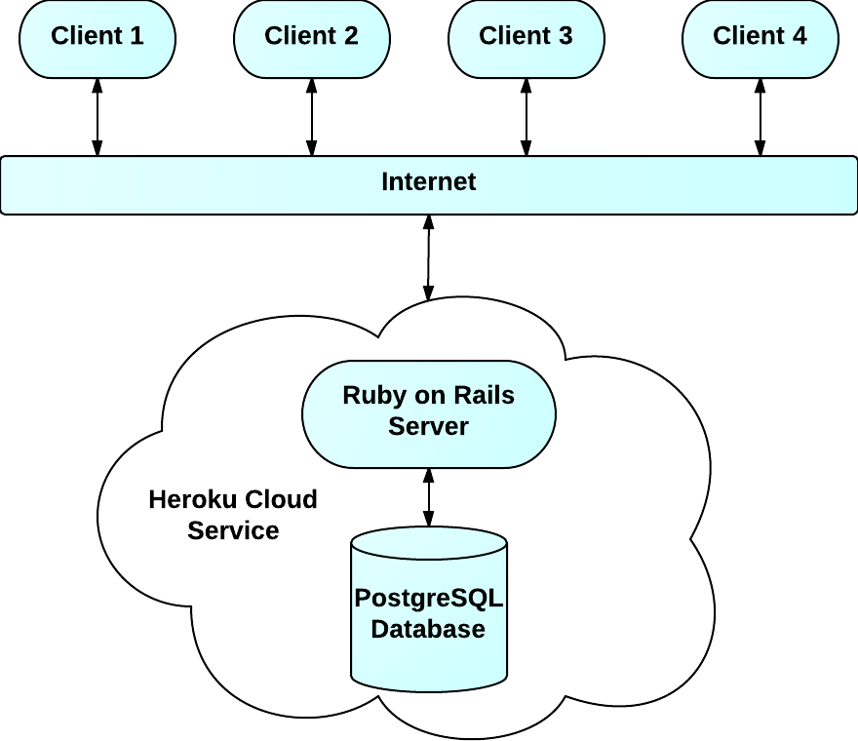
Client-Sever Architecture
Notes:
Here is a high level overview of how the main technologies work together
We can see here that this is a client server architecture where the clients connect to the ruby on Rails server.
The Rails server itself can be deployed to a physical machine, but here we see hosting with the Heroku cloud service.
The Ruby on rails server will grab information from the server and pass it back to the client.

Slide 44
Testing Results
Creating groups
  Group creation from sidebar
Screen real estate
  Compact representation of analysis information
Layout of sidebar content
  Multiple sidebar versions
Notes:
Our testing resulted in several important system improvements
Client was unable to complete even the first task on our task list because she was unable to find the group creation page
We had to move the link for group creation so that it was more intuitive
We also had to deal with making the most out of our screen real estate, particularly in the analysis page
All of the tools needed to be compact and accessible without scrolling
We also had create multiple sidebar versions in order to come up with the most useful design

Slide 46
Grouping Challenges
Types of organizations:
Common grouping challenges:
  Manage members
  Create appropriate groups
  Analyze and maintain groups
  Facilitate group communication
Small Business
Soccer League
Outdoor Club
Boy Scouts
School
Book Club
Convention
Cycling Club
Notes:
We see that groups are everywhere now in large companies, sports leagues and clubs. We have also identified five key elements to proper group management. First being able to manage members of groups, created appropriate groups for people to join, facilitating communication within groups, analyzing groups and supporting member profiles.

