Slide 1


CAPSTONE PRESENTATION
Coppermine Road Potable Water Main & Sanitary Sewer Main Extension
Courtney Freeman – Environmental Engineer
Max Burke – Civil Engineer
Andrew Singer – Civil Engineer

Slide 2
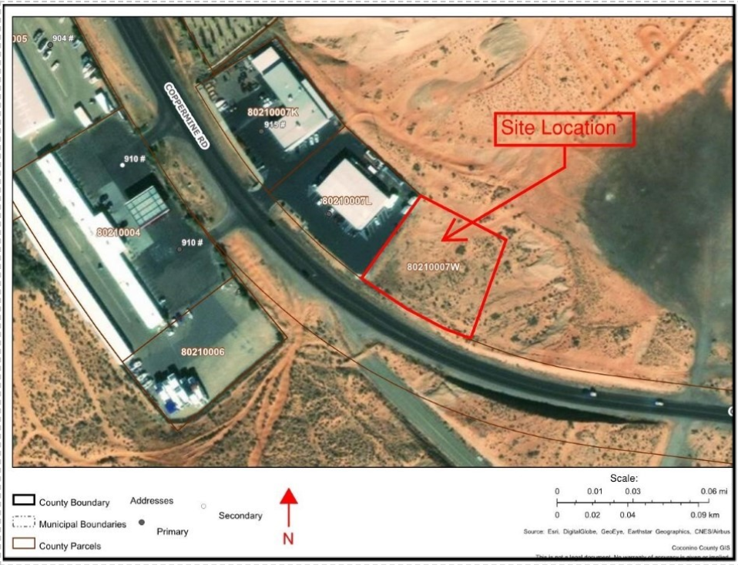
Purpose of Project
Goal: Construction plans for a potable water main and gravity sewer main extension
Client: Mark Lamer
Figure 1: GIS Parcel Viewer Map of Project Location [1]

Slide 3
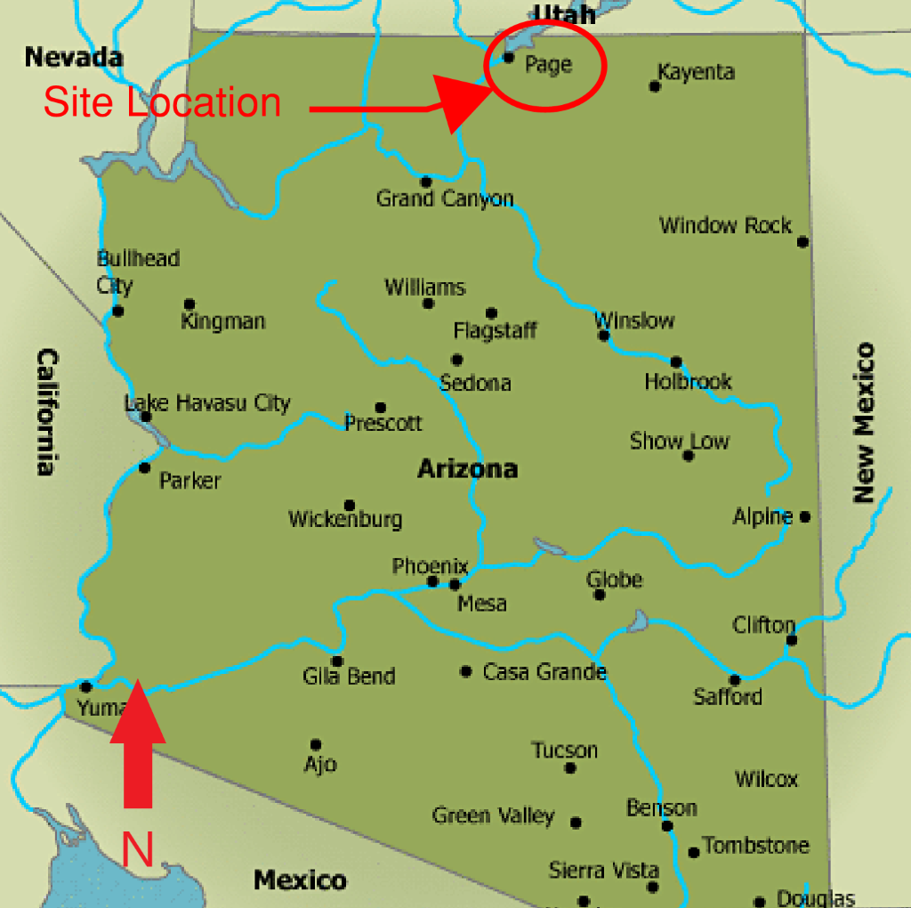
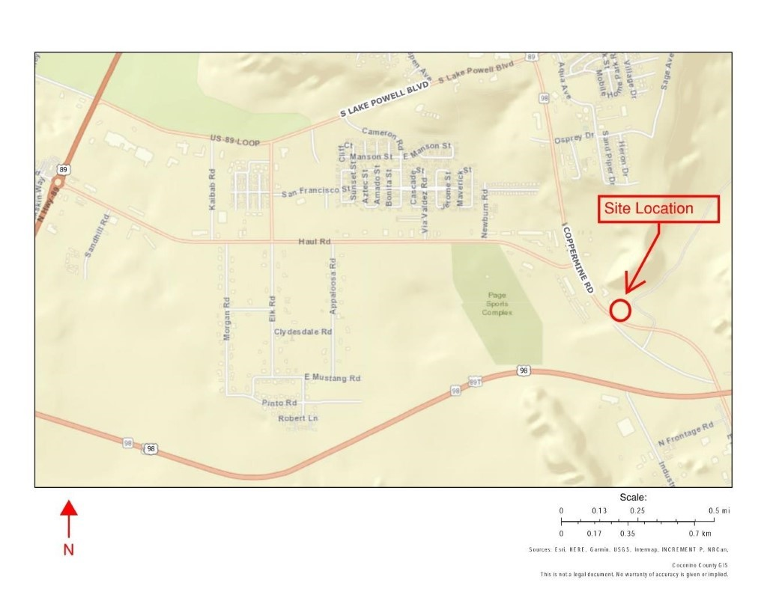

Project Location
Located in the southern part of Page, AZ along Coppermine Road.
Adjacent to Bruce's Sales and Leasing on the NW side and a vacant property on the SW side with expectations for further development
Figure 2: Ariel View of Property Location [2]

Slide 4
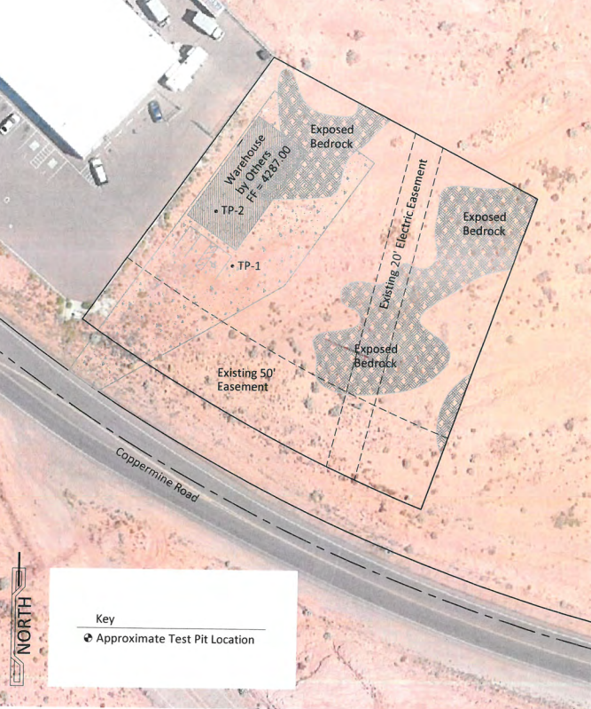
Analyze Existing Conditions
No site investigation performed due to COVID-19 restrictions
Review Geotechnical Report by Rosenberg Associates
Site consists of sandstone bedrock and very loose to loose sands
Figure 4: Geotech Report [4]
Figure 2: Survey Data

Slide 5
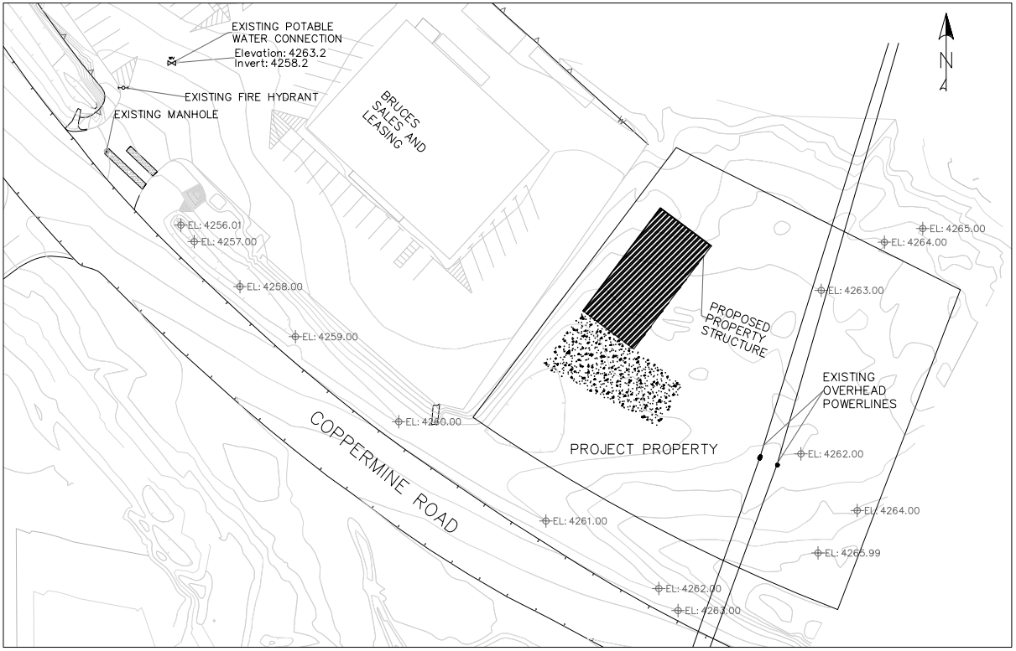
Map and Model Existing Conditions
Utilize AutoCAD Civil 3D
Create Topographic Map
Identify Property Parcels
Identify Existing Structures and Utilities
Figure 5: Site Topographic Map

Slide 6
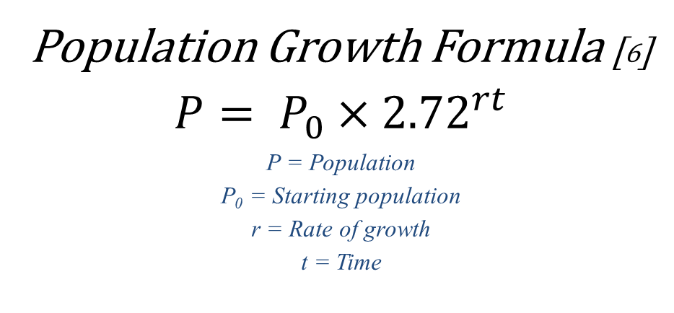
Estimate Future Population for 25-Year Period [5]
Determine Water Demand
Population Growth Formula [6]
$$P= P_{0}×{2.72}^{rt}$$
P = Population
P₀ = Starting population
r = Rate of growth
t = Time
25-Year Period
For Page and LeChee, Arizona
Table 1: Population/ Population Growth in Page and LeChee [6]

Slide 7

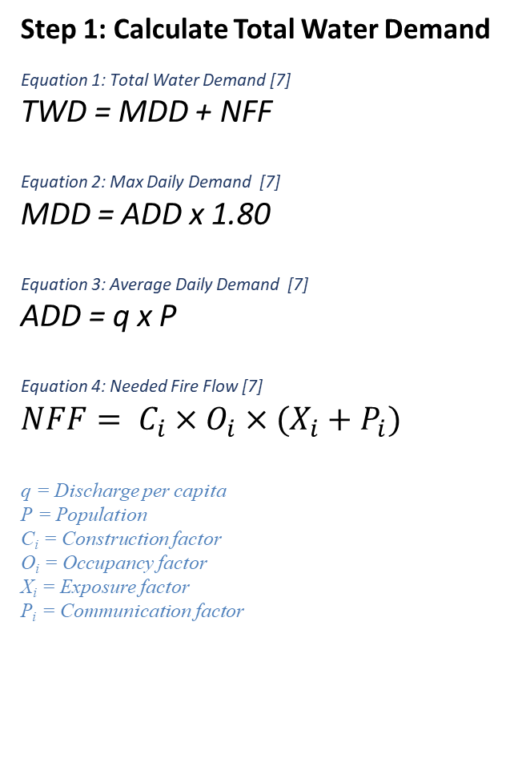
Water Demand
Calculate Future Water Demand
Water Demand Calculations:
Step 1: Calculate Total Water Demand
Equation 1: Total Water Demand [7]
TWD = MDD + NFF
Equation 2: Max Daily Demand [7]
MDD = ADD x 1.80
Equation 3: Average Daily Demand [7]
ADD = q x P
Equation 4: Needed Fire Flow [7]
$$NFF= C_{i}×O_{i}×(X_{i}+P_{i})$$
q = Discharge per capita
P = Population
C_{i} = Construction factor
O_{i} = Occupancy factor
X_{i} = Exposure factor
P_{i} = Communication factor
Step 1: Calculate Max Hourly Demand
Equation 5: Max Hourly Demand [7]
MHD = ADD x 3.25
Equation 3: Average Daily Demand [7]
ADD = q x P
Select greater of two!!!

Slide 8
Water Demand
Water Demand Selection
Table 2: TWD vs MHD

Slide 9
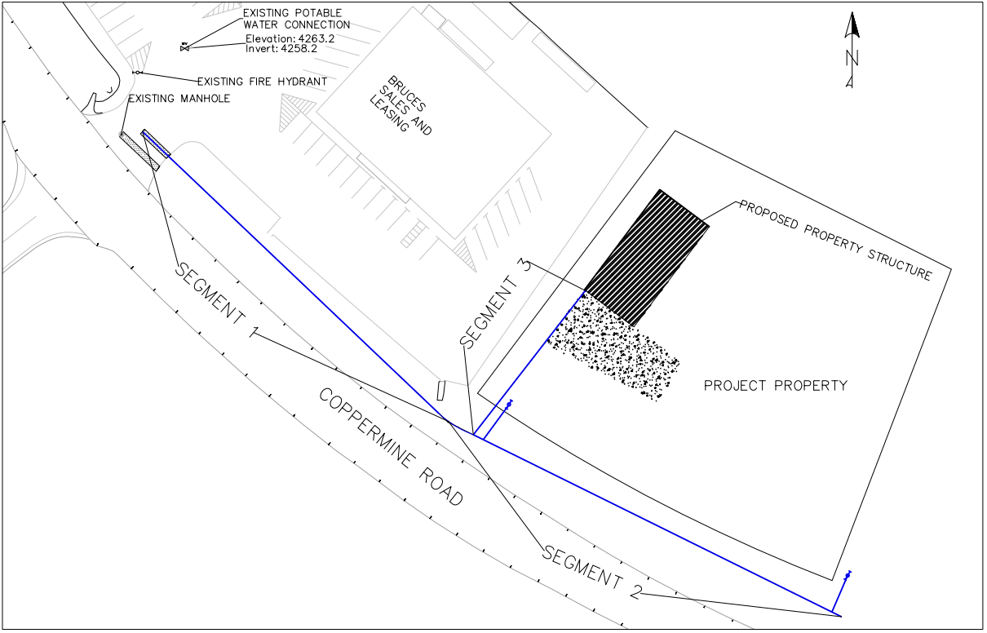
Potable Water Line Network Analysis
Utilize AutoCAD Civil 3D to find pipe lengths
Implement into Bentley FlowMaster program
C-900 PVC Pipe
Figure 6: Potable Water Line Segments

Slide 10
Potable Water Line Network Analysis
Table 3: FlowMaster Analysis

Slide 11
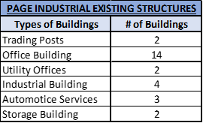
Sanitary Sewer Design Flow
Table 4: Page Industrial Existing Structures
Sanitary Sewer Demand: Arizona Administrative Code [8]
Does NOT include LeChee, Arizona
Table 5: Sewer Demand for Existing & Future Structures

Slide 12
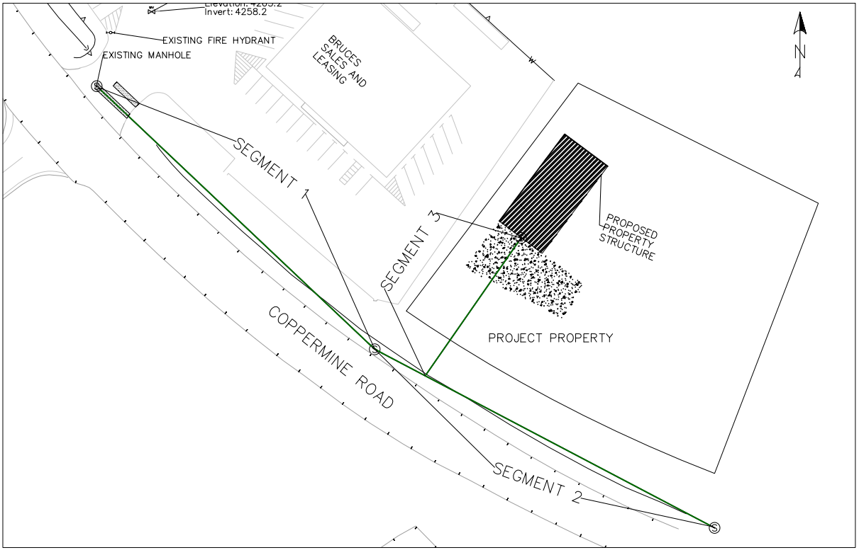
Sanitary Sewer Network Analysis
AutoCAD Civil 3D
  Upstream/ Downstream Elevations
  Length
Figure 7: Sanitary Sewer Line Segments

Slide 13

Sanitary Sewer Network Analysis
Excel
  Slope
  Hydraulic radius: R=D/4; FULL flowing
    R=0.245 feet
  Design velocity
  Depth of the pipe
  SDR-35 PVC Pipe
Sewer Velocity Equation:
Equation 6: Manning's Equation [7]
Table 6: Sewer Velocity Analysis

Slide 14
Standards vs Design
Table 7: Potable Water Demands
Demand Requirements | Page's Standard Minimum Demand | Project Demand
Water Demand | 4,394 gal/min | 5,193 gal/min
Fire Flow Demand | 1,000 gal/min | 1,250 gal/min
Sewer Demand | - | 9.98 gal/min
Potable Water
Water demand meets City of Page standards. [5]
Minimum pressure for full flow meets set standard. [5]
Pipe placement meets standards. [5]
Sanitary Sewer
Minimum and maximum velocity is satisfied. [5]
Pipe placement meets standards. [5]
Table 8: Potable Water Pressure
Water Line Requirements | Standard | Projects Results
Min Pressure | ≥ 20 psi | 33
Table 9: Sewer Velocity Analysis
Sewer Line Requirements | Standard | Projects Results
Min Slope: 12" pipe | 0.20% | 0.50%
Max Slope: 12" pipe | 4.9% | 3.12%
Min Velocity | 2 fps | 3.18 fps
Max Velocity | 11 fps | 7.94 fps
Min depth of pipe | 3 ft | 13.84 ft

Slide 15
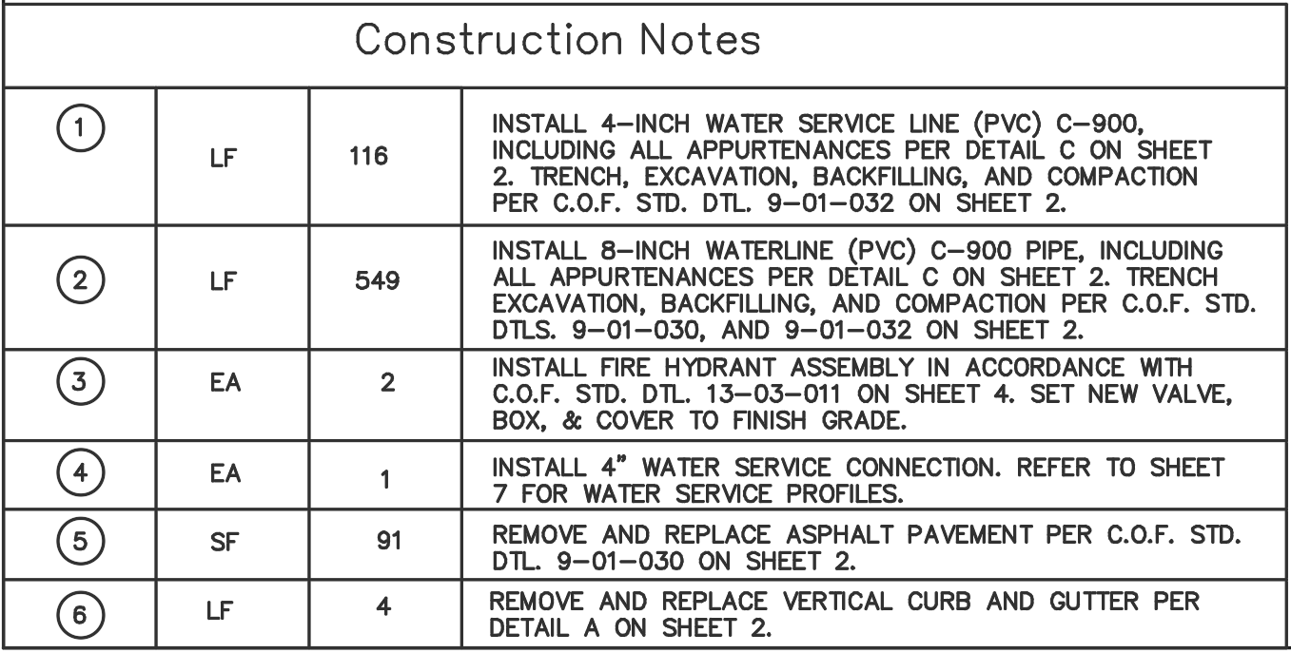
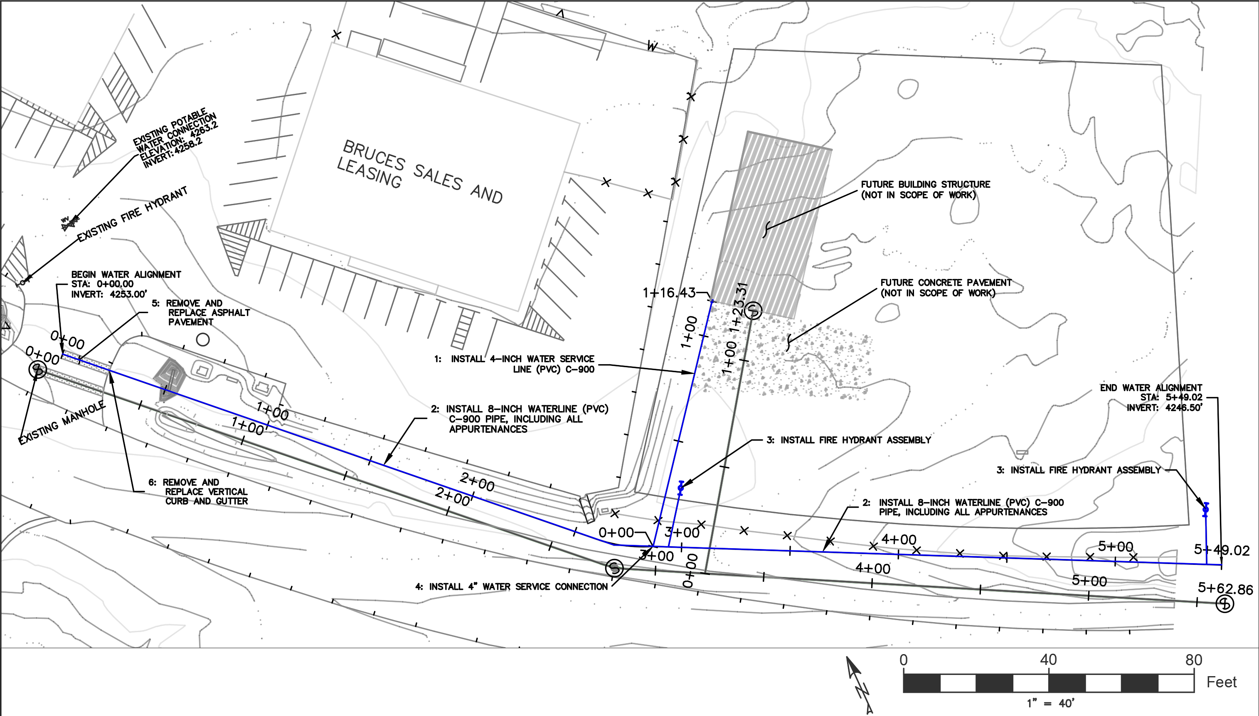
Waterline Extension Plan
Figure 8: Waterline Plan

Slide 16
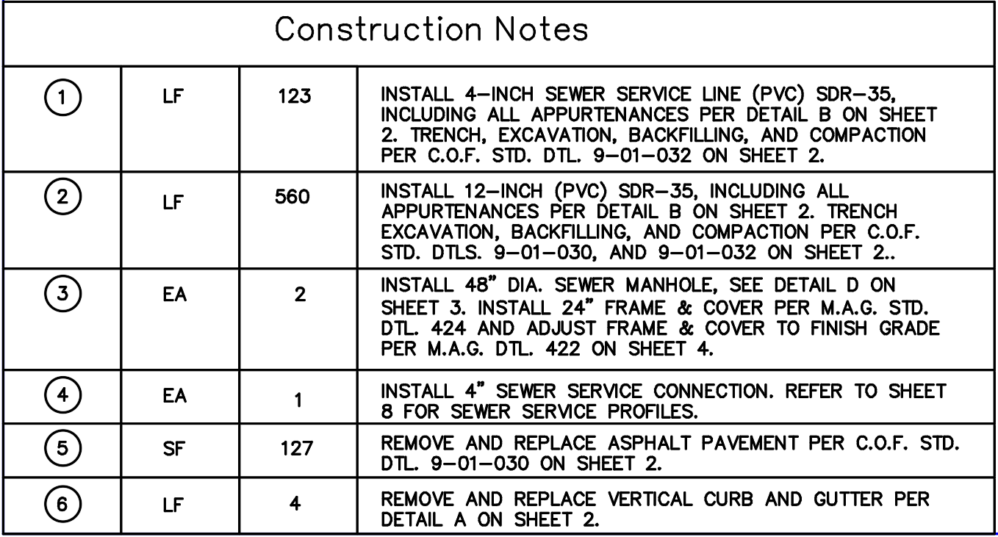
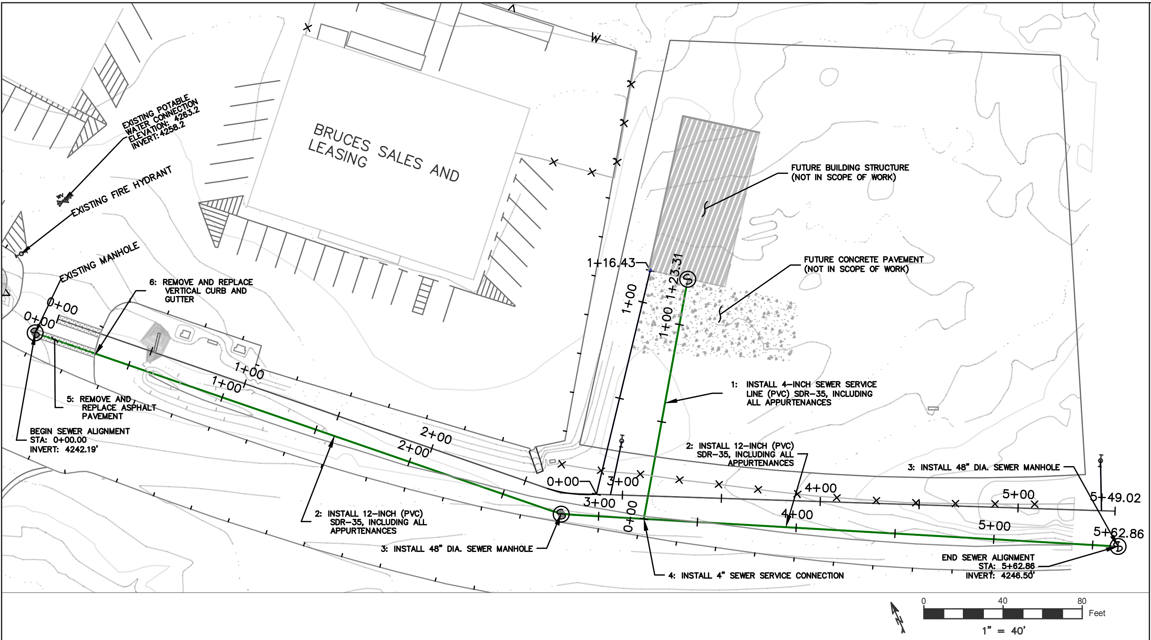
Sewer Line Extension Plan
Figure 9: Sewer line Plan

Slide 17
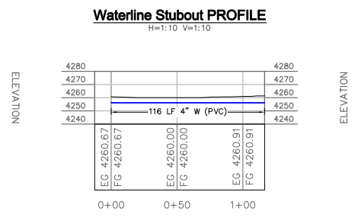
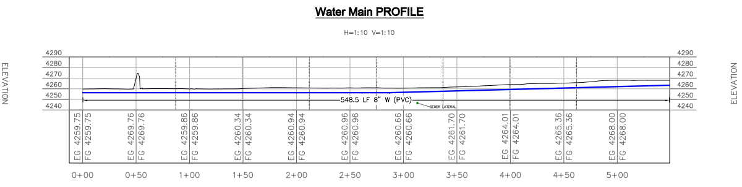
Potable Water Line Profiles

Slide 18
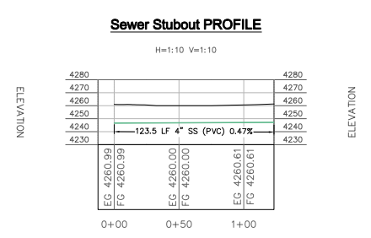
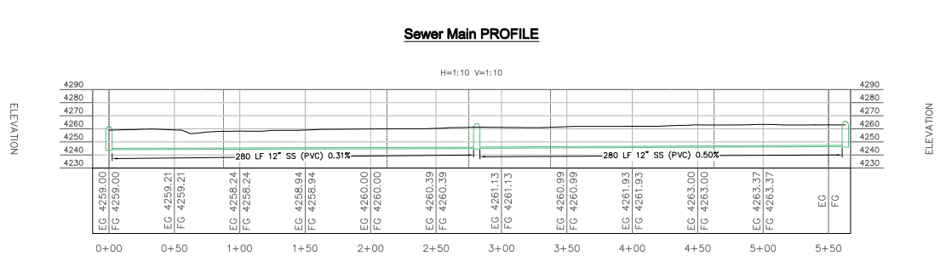
Sanitary Sewer Line Profiles

Slide 19
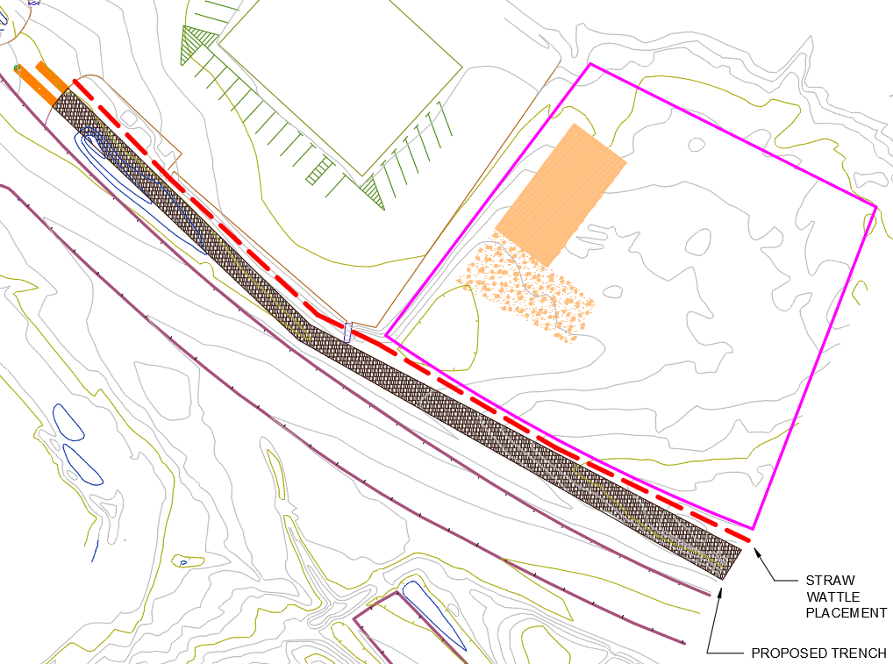
Stormwater Pollution Prevention Plan (SWPPP)
Existing Manhole
Bruce's Sales and Leasing
Proposed Property Development
Best Management Practices (BMPs):
  Avoid winter construction from October 1 through April 1
  Hydroseeding for native vegetation
  Watering as a wet suppression
  Storage for pollutants
  Routine inspections
  Straw wattles adjacent to main trench
    Staked 3-4' apart
    3-4' away from trench to allow for construction
    Stakes must go 2' below surface
Referenced from:
Maricopa Association of Governments (MAG) [9]
Coconino County CADD Standards Manual [10]
EPA National Menu of Best Management Practices [11]
Project Site
Coppermine Road
Figure 10: SWPPP

Slide 20
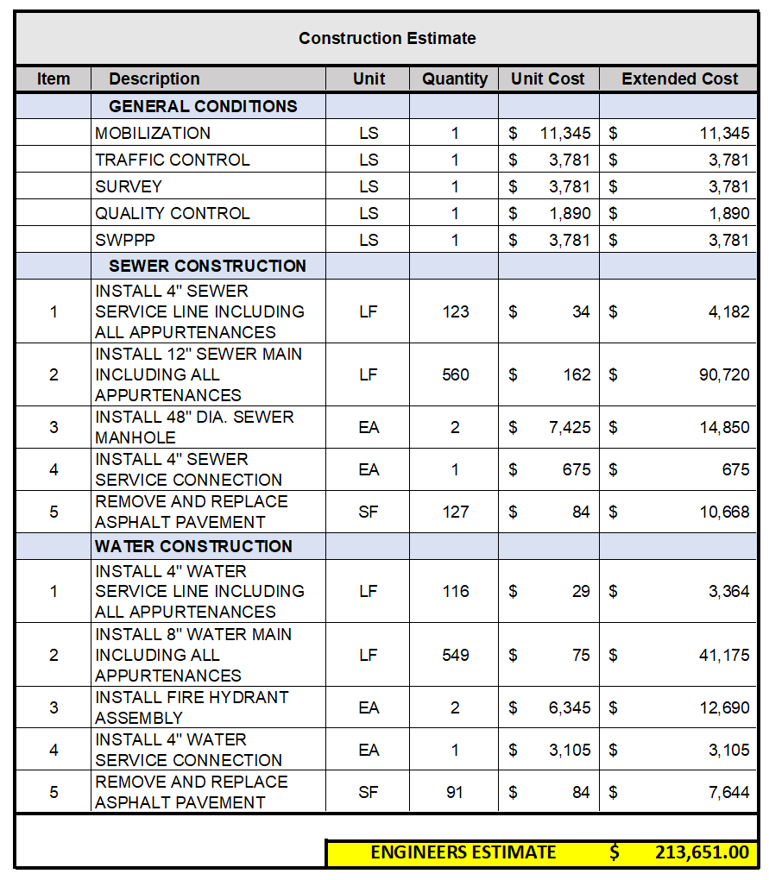
Engineer’s Construction Cost Estimate
Job Cost + 35% Gross Contractor Margin
Total Overhead:
Administration
Insurance
Rent
Utilities
Profit

Slide 21
Project Impacts
Social Impacts:
  New developments will have access to a water and sewer main along Coppermine Road going south, leading to growth
  Possible tensions among long-time Page residents may arise
  Noise pollution from construction and future development may increase for neighboring residential communities
  Traffic congestion may occur along the high-density Coppermine Road as there will be flaggers along the road slowing vehicles
Economic Impacts:
  A costly project for an independent client who has yet to develop any other infrastructure on his property
  Beneficial to the City of Page by adding a tax-paying commercial property within city limits
  Creates construction jobs in a small community which can boost the local economy
Regulatory Impacts:
  Adheres to regulations set by the City of Page
Environmental/Health Impacts:
  It ensures the removal of waste from this property and future developments and the safety of the water (hydrants, consuming, etc.)
  Any displaced sediment, hazardous waste, or pipe leakage from construction or post-construction may cause serious damage to neighboring ecosystems; most notably, the Colorado River roughly 3 miles west of site
  Landscape alteration may lead to new drainage patterns, directing runoff in harmful new areas
  Dust may be generated during construction causing issues with neighboring businesses and residents, and even possibly dust storms

Slide 22
References
[1] "Coconino County Parcel Viewer," Coconino County Arizona , Page, 2020.
[2] "Coconino County Parcel Viewer," Coconino County Arizona , Page, 2020.
[3] "Arizona Map," Destination 360, 2020. [Online]. Available: http://www.destination360.com/north-america/us/arizona/map. [Accessed 22 February 2020]
[4] P. Custer, "Geotechnical Investigation: Proposed Custer Storage Warehouse," Rosenberg Associates, Page, 2020
[5] City of Page, "Page General Development and Subdivision Regulations"
[6] https://datausa.io/profile/geo/lechee-az/
[7] D. Chin, Water Resource Engineering, Upper Saddle River: Pearson, 2014.
[8] Arizona Administrative Code Department of Environmental Protection, "TITLE 18. ENVIRONMENTAL QUALITY CHAPTER 9. DEPARTMENT OF ENVIRONMENTAL QUALITY," Sewage Collection System.
[9] "Uniform Standard Specifications and Details for Public Works Construction," Maricopa Association of Governments, Phoenix, 2020.
[10] "Coconino County Engineering CADD Manual," Coconino County Arizona Public Works, Flagstaff, 2019.
[11] "National Menu of Best Management Practices (BMPs) for Stormwater," EPA, October 2020. [Online]. Available: https://www.epa.gov/npdes/national-menu-best-management-practices-bmps-stormwater. [Accessed September 2020].

