Slide 1
Grand Canyon K-12 School Retaining Wall Redesign
December 7th, 2018
By: Kurtis Chivens, Emory Chamberlain, Spencer Floyd, and Josh Madrigal
Grading Instructor: Bill Mancini
Technical Advisor: Chun-Hsing Ho
Client: Ivan Landrey

Slide 2
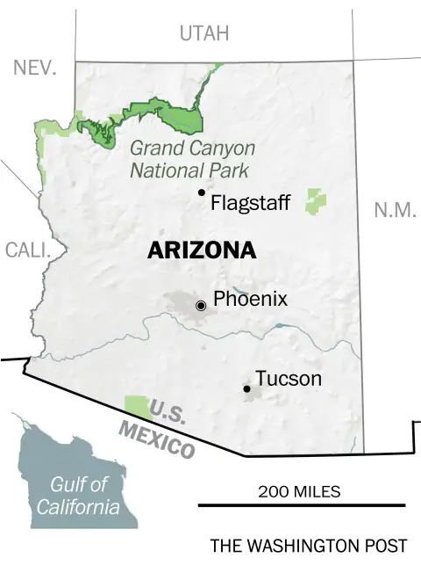
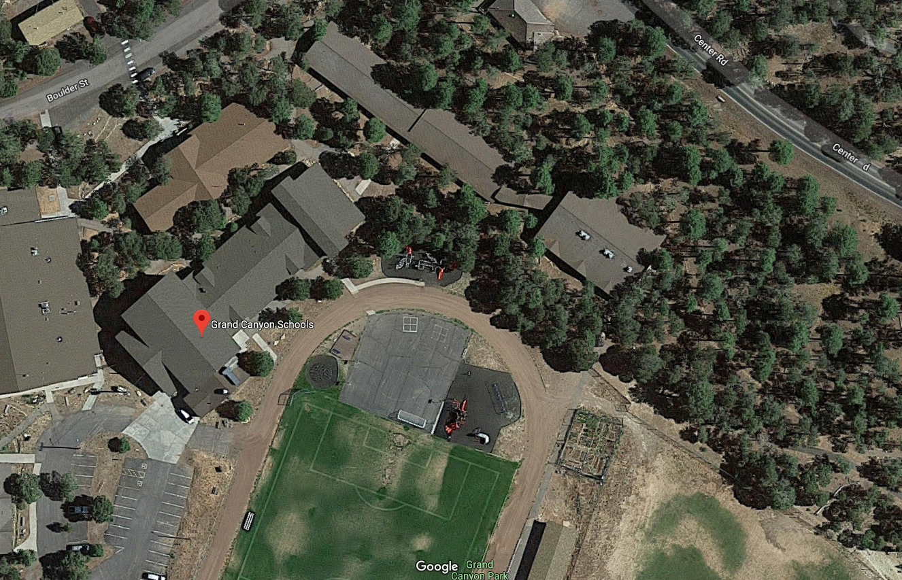
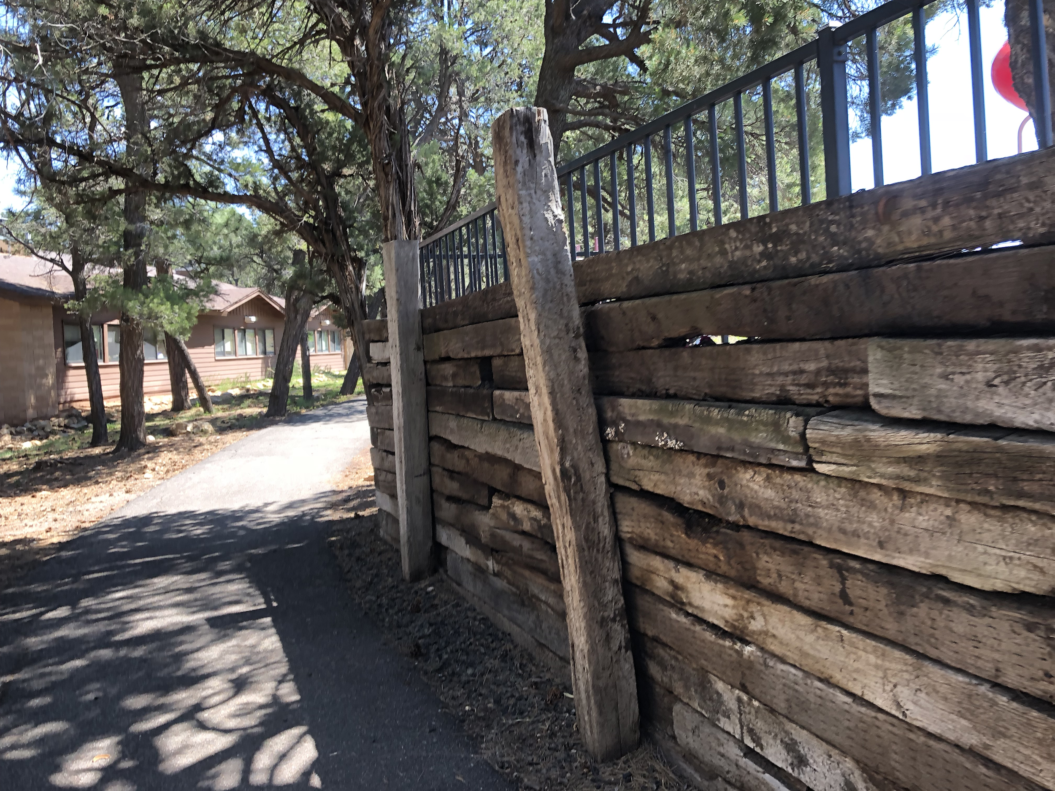
Project Overview
N
N
Figure 2: Approximate location of the wall highlighted in red [1]
Figure 3: Face of Wall [2]
Figure 1: Grand Canyon Village, AZ [1]

Slide 3
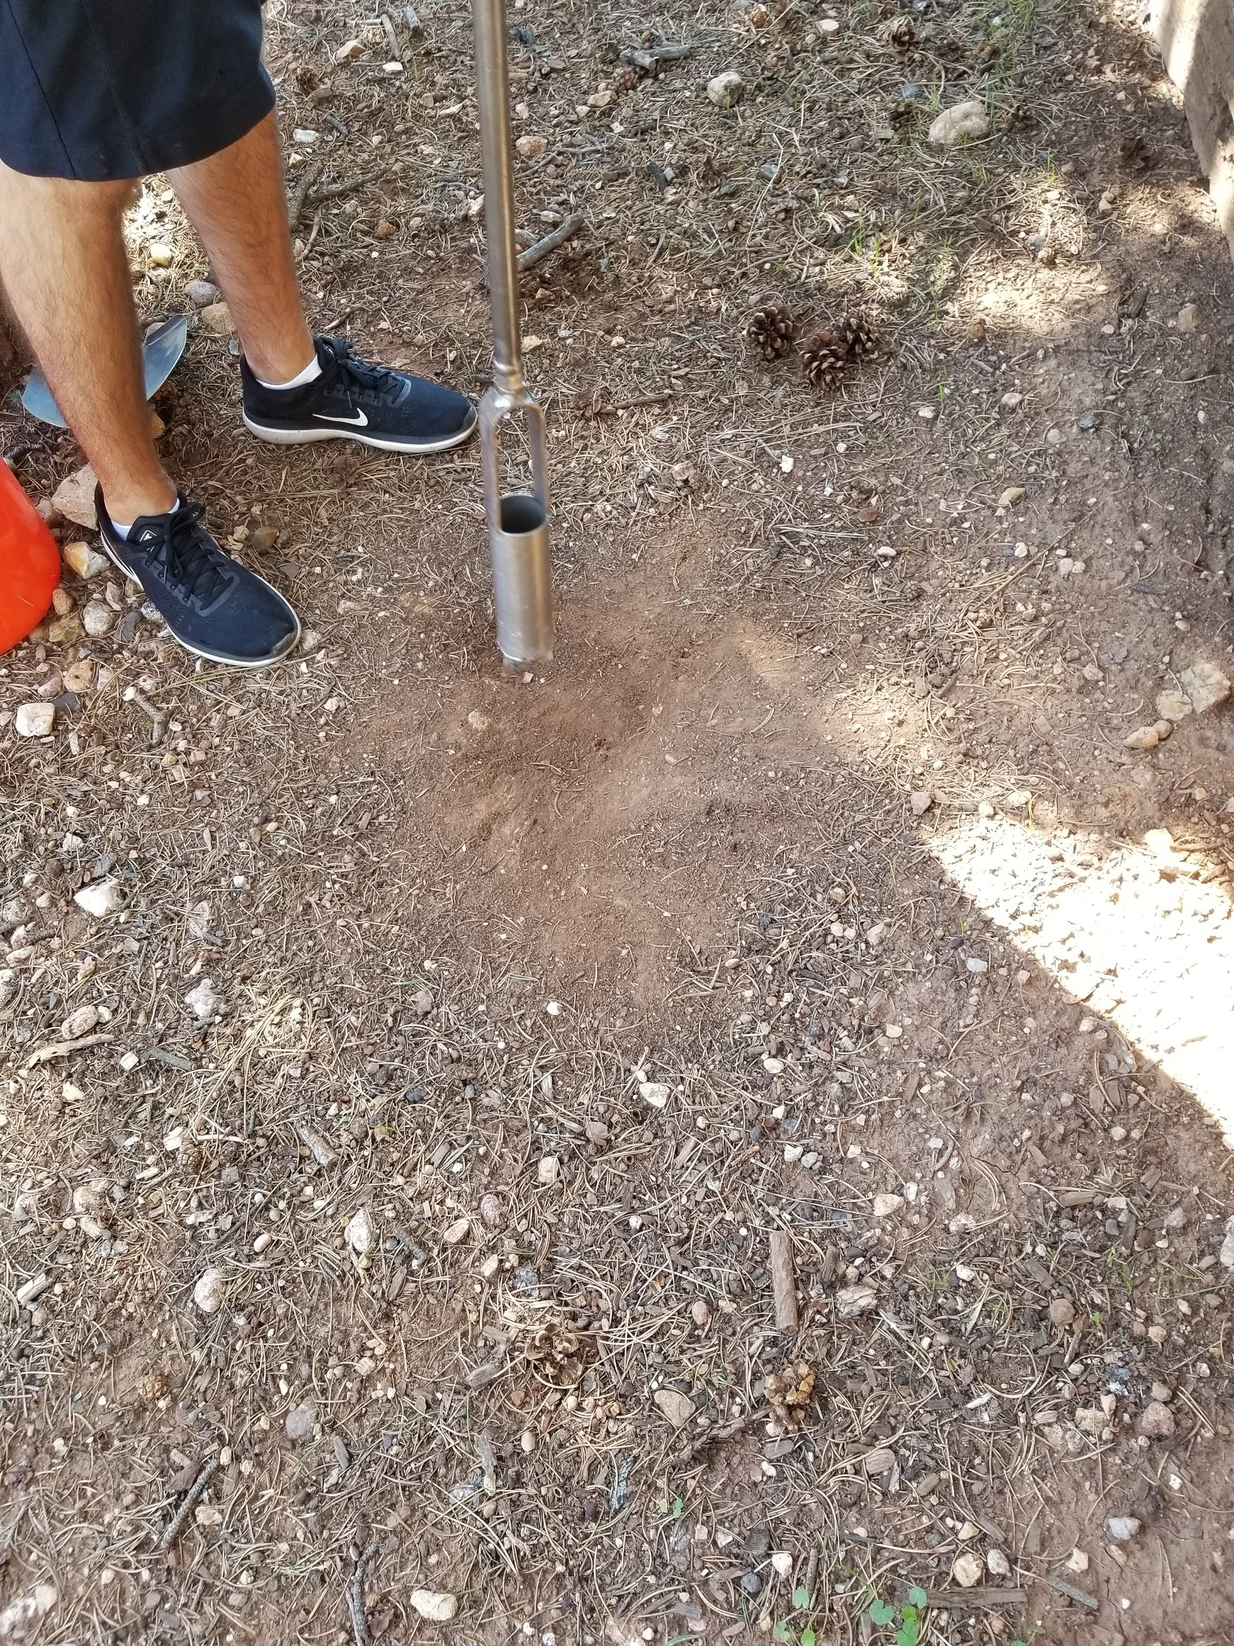
Field Work
Collecting Soil Samples
Equipment: 2” hand auger, shovel, 5 gallon buckets (ASTM D1452)
6 samples taken, 3 from top of wall and 3 from bottom of wall
Samples ranged from 1’ to 4’ below ground surface
Encountered gravel, sand, clay, tree roots and mulch
Figure 4: Collecting Soil Sample [2]

Slide 4
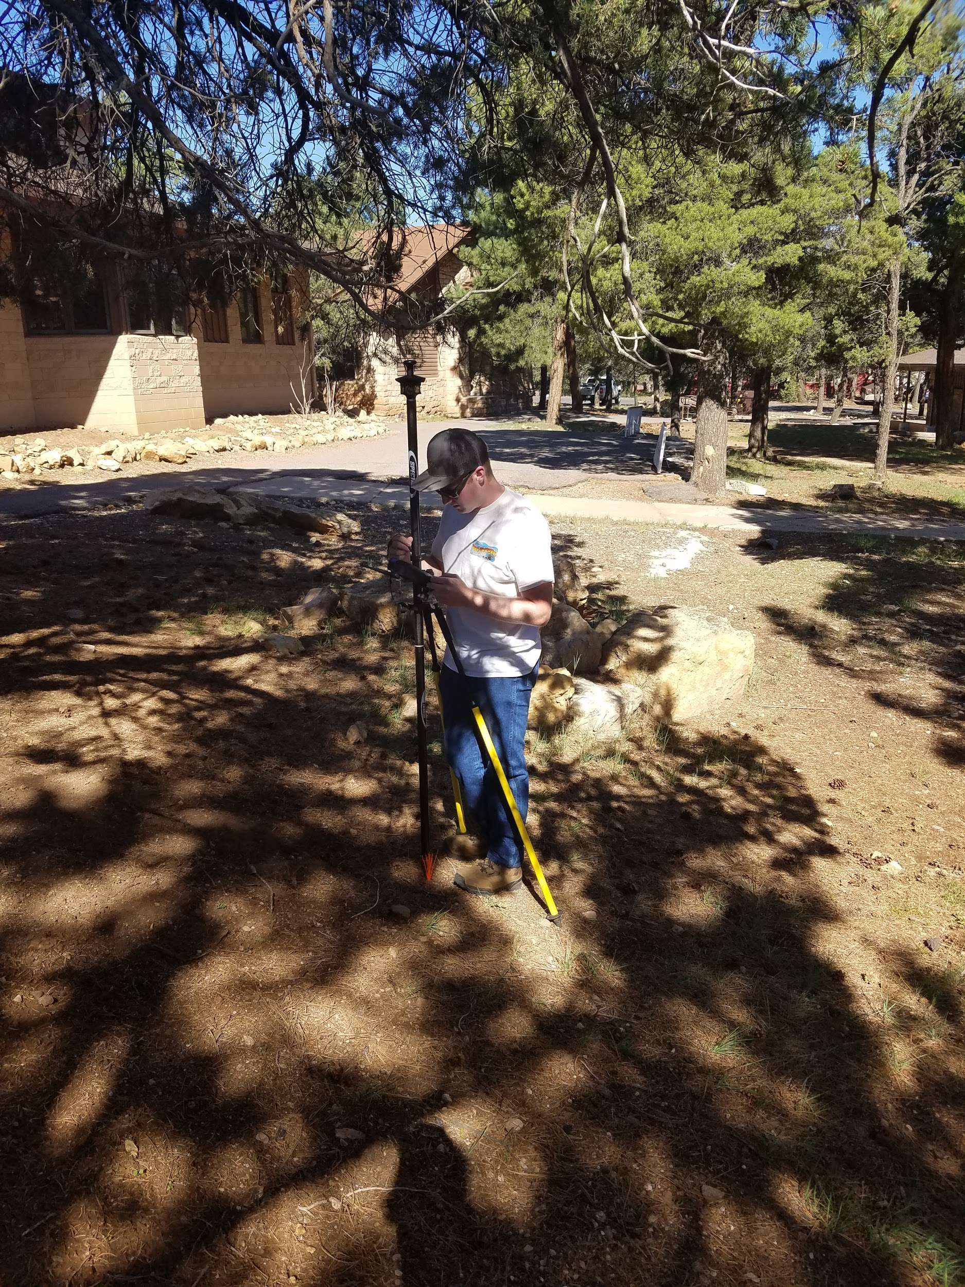
Field Work
Surveying
Equipment: Robotic Total Station, prism rod, survey nails, and tape measure.
Surveyed top and bottom of wall as well as existing grade and trees around the wall
Also surveyed track and field behind the wall to analyze paths of drainage.
Figure 5: Shooting into the first backsight [2]

Slide 5
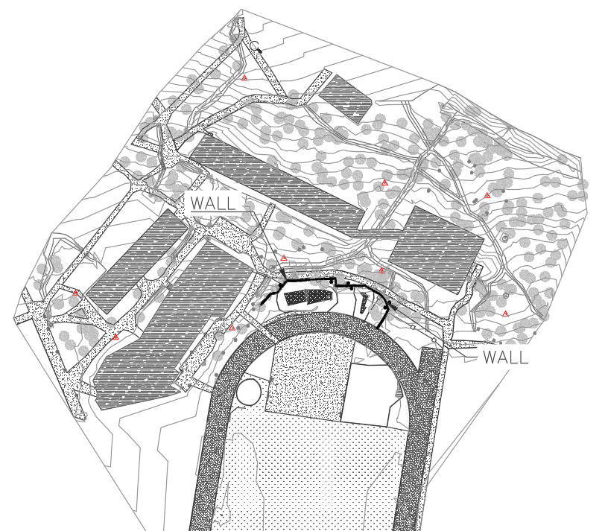
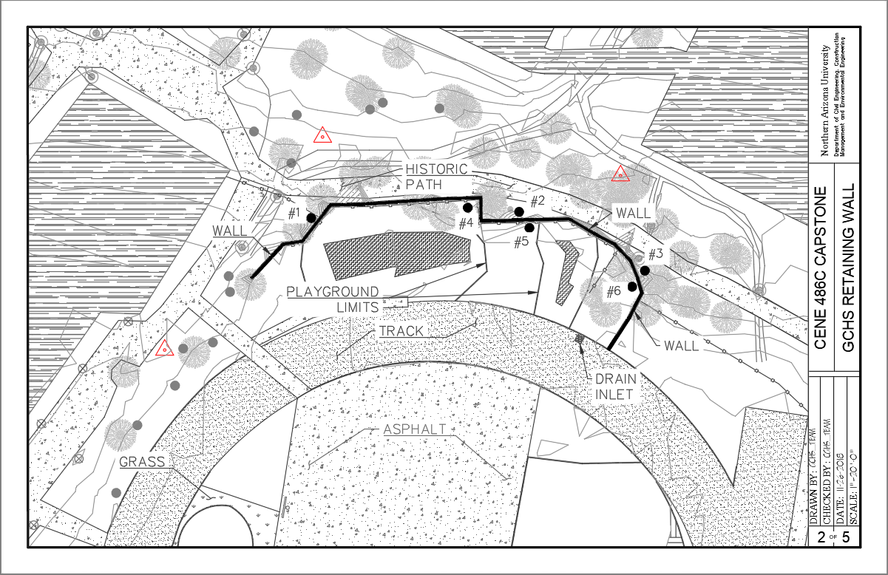
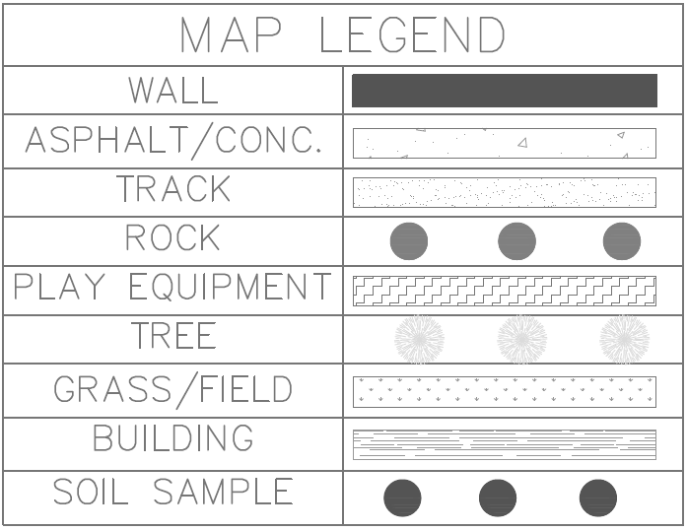
Topographic Map
Figure 6b: Wall Location in School
Figure 6a: Area Around Wall
Figure 6c: Map Legend

Slide 6
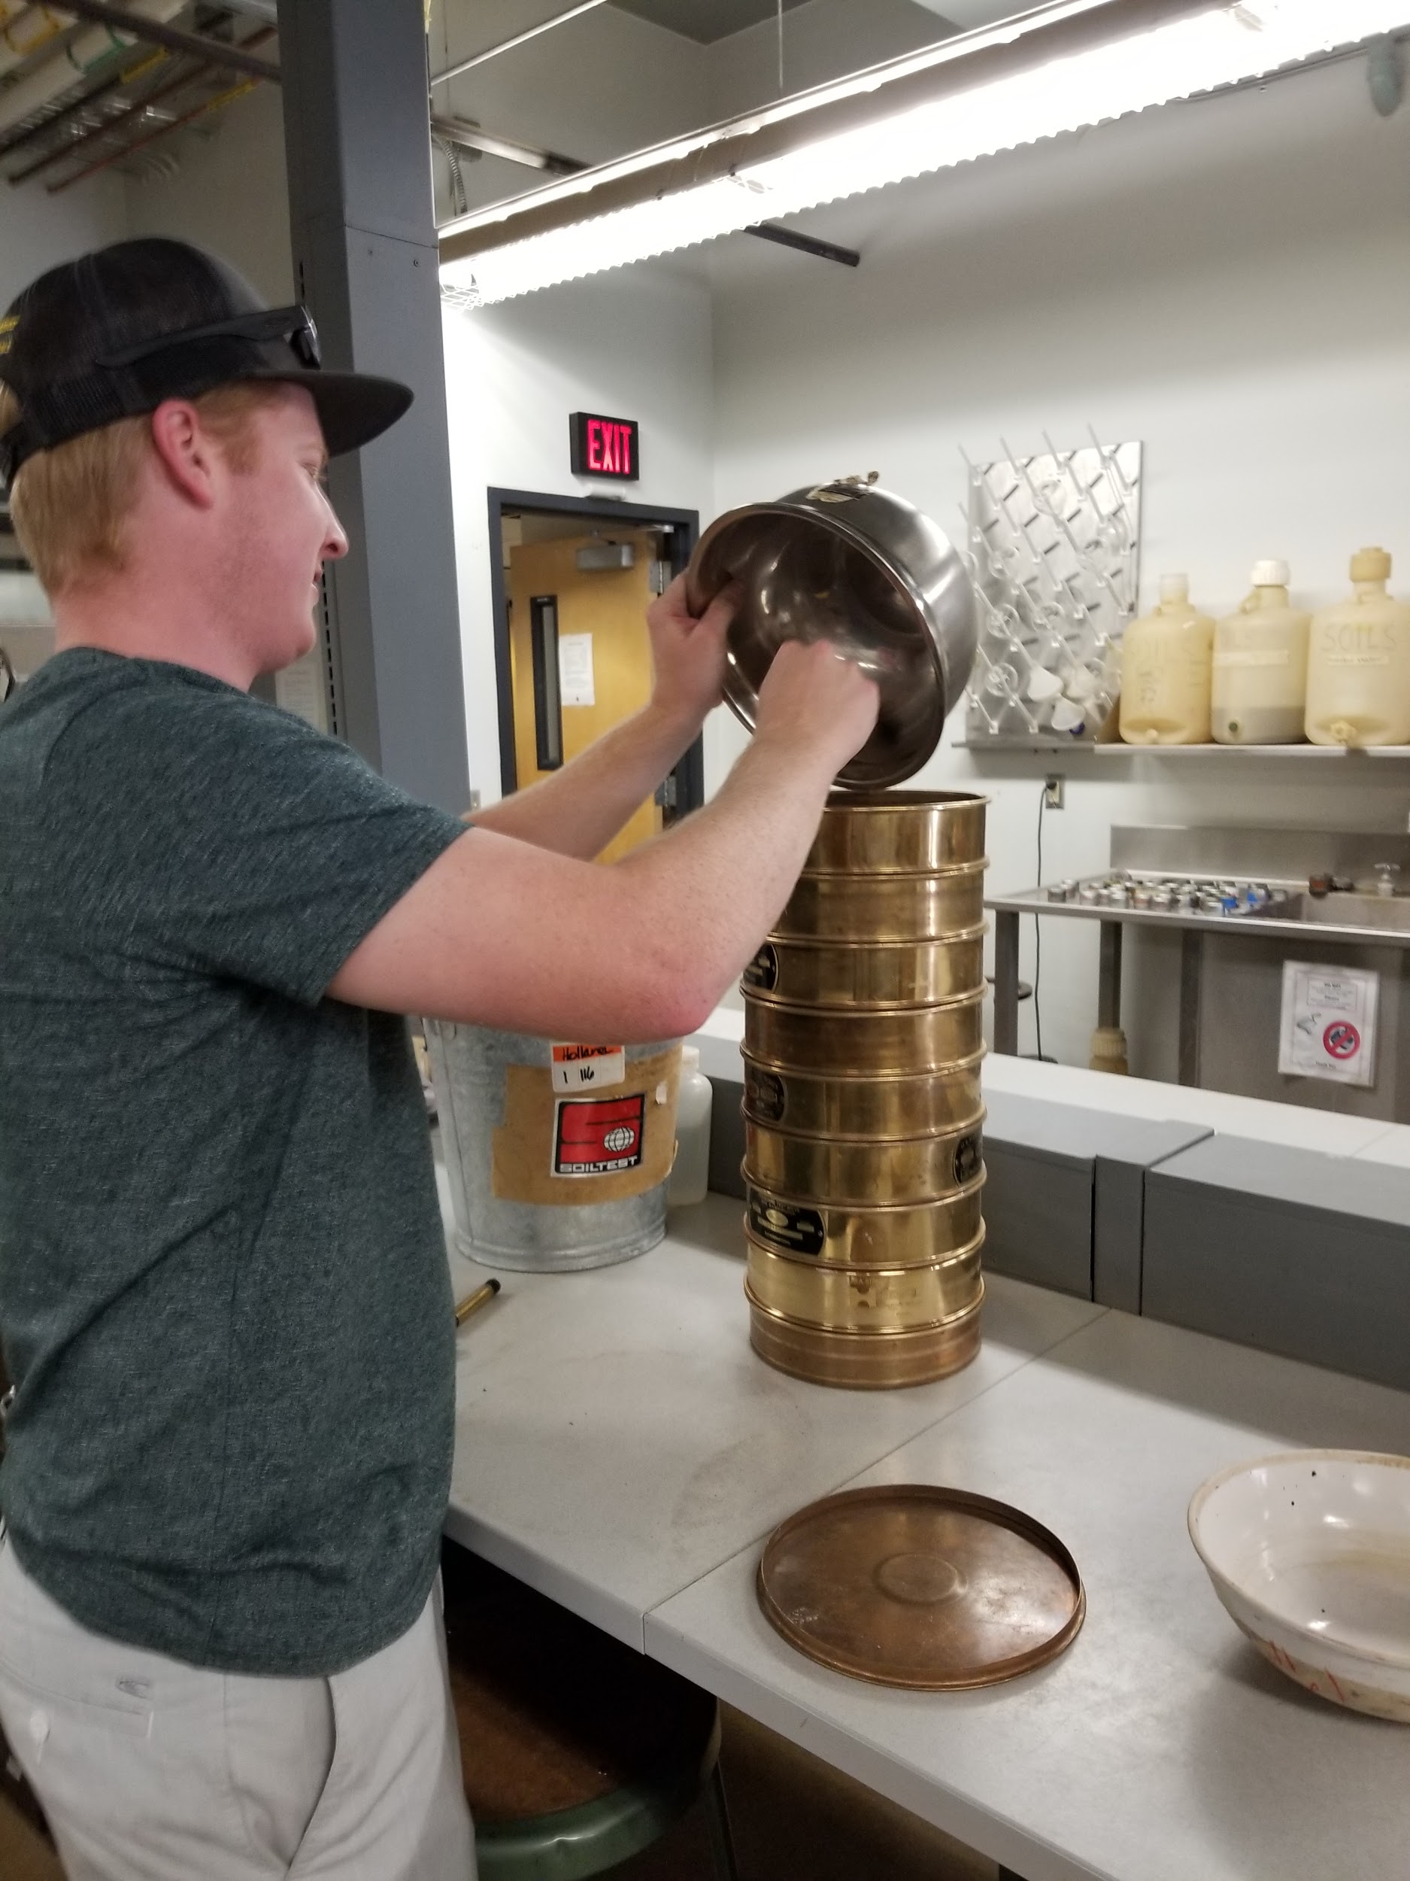
Lab Work
Particle-size distribution (ASTM D6913)
1 sieve analysis for each of the 6 samples collected
Shows how much gravel, sand and fines are in each sample
Moisture Content (ASTM D2216)
3 tests per sample
Results are used for future re-compaction at optimal moisture content during construction
Figure 7: Conducting Sieve Analysis [2]

Slide 7
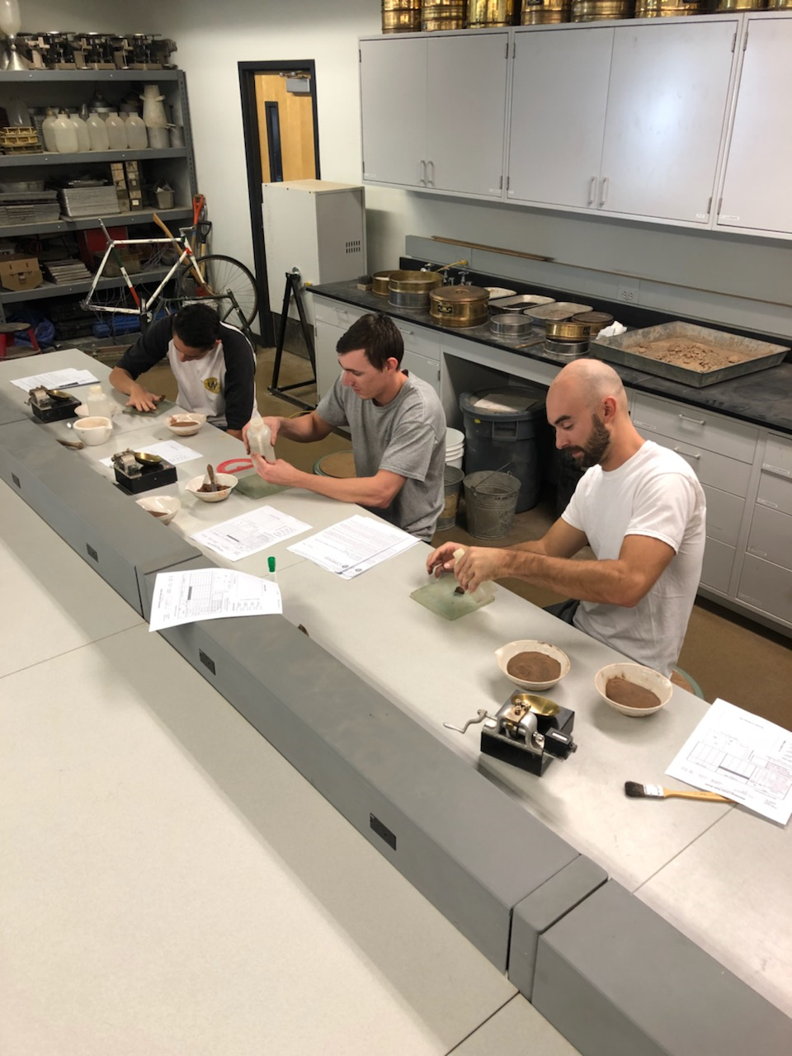
Lab Work
Atterberg Limits (ASTM D4318)
Liquid limit (LL) of a soil is defined as the moisture content at 25 blows using Casagrande’s liquid device
Plastic limit (PL) of a soil is defined as the moisture content at which the soil crumbles when rolled into a ⅛ in. diameter thread.
Plasticity Index (PI) = LL - PL
Figure 8: Conducting Atterberg Limits Test [2]

Slide 8
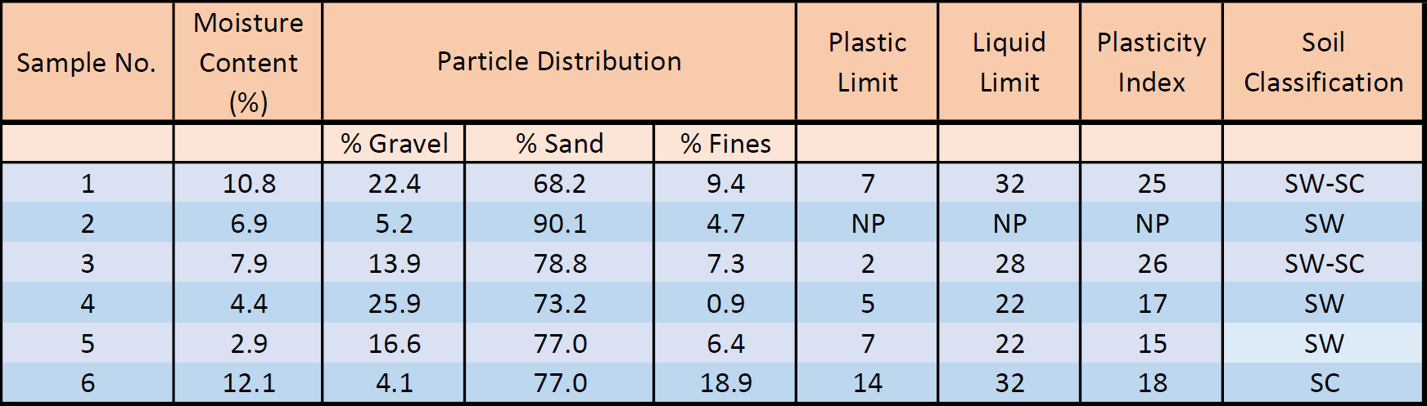
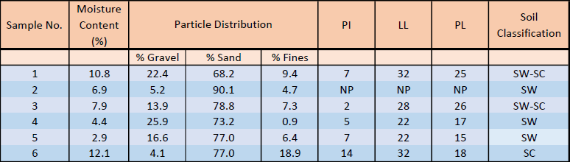
Lab Work
Table 1: Lab Test Results
SW - Well Graded Sand
SC - Clayey Sand
SW-SC - Well Graded Sand with Clay

Slide 9
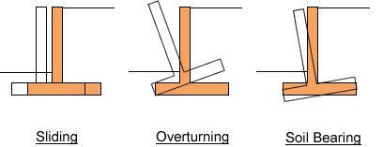
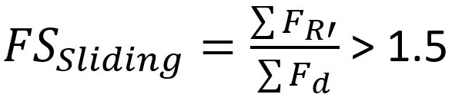
Geotechnical Analysis
Figure 9: Sliding Failure [3]
Failure Checks for Soil:
Sliding: Resisting force must be greater than driving force
[4]

Slide 10
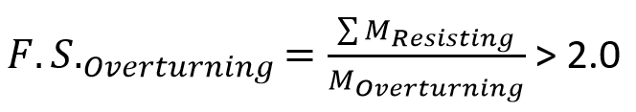
Geotechnical Analysis
Overturning: Moments resisting overturning about toe must be greater than moments overturning about toe
Figure 10: Overturning Failure [3]
[4]

Slide 11
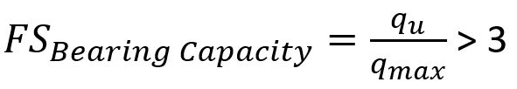
Geotechnical Analysis
Bearing Capacity: The soil below the foundation must be able to support the weight of the wall and soil above it
Figure 11: Bearing Capacity[3]
[4]

Slide 12
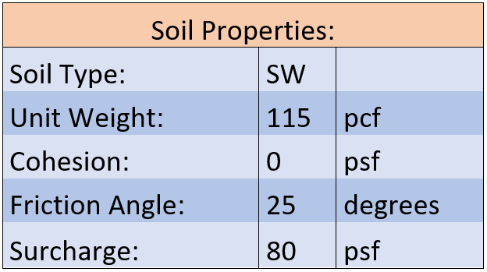
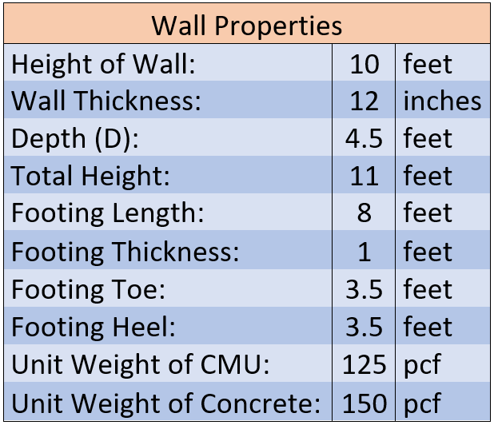
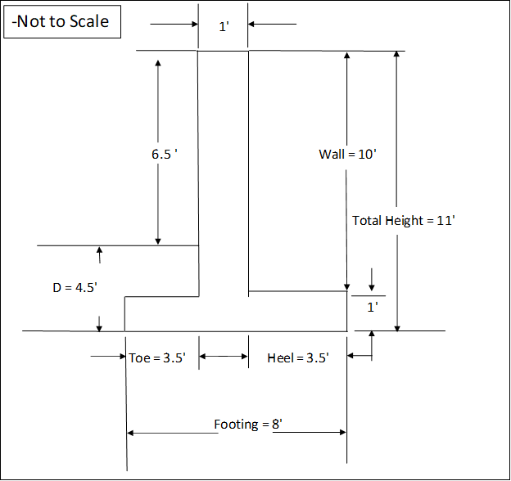
Geotechnical Analysis
Table 2: Soil Properties
Table 3: Wall Properties
Figure 12: Wall Dimensions [2]

Slide 13
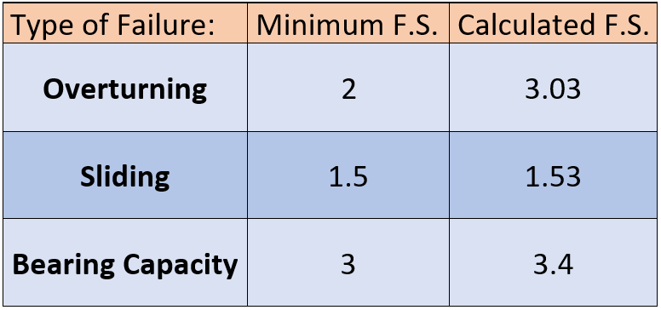
Geotechnical Analysis
Table 4: Factors of Safety

Slide 14
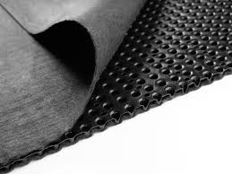
Drainage Design
3” PVC Pipe Weep Holes
Spaced 8 feet on center
Geocomposite drain on backside of wall
Figure 13: Geocomposite Drain [5]

Slide 15
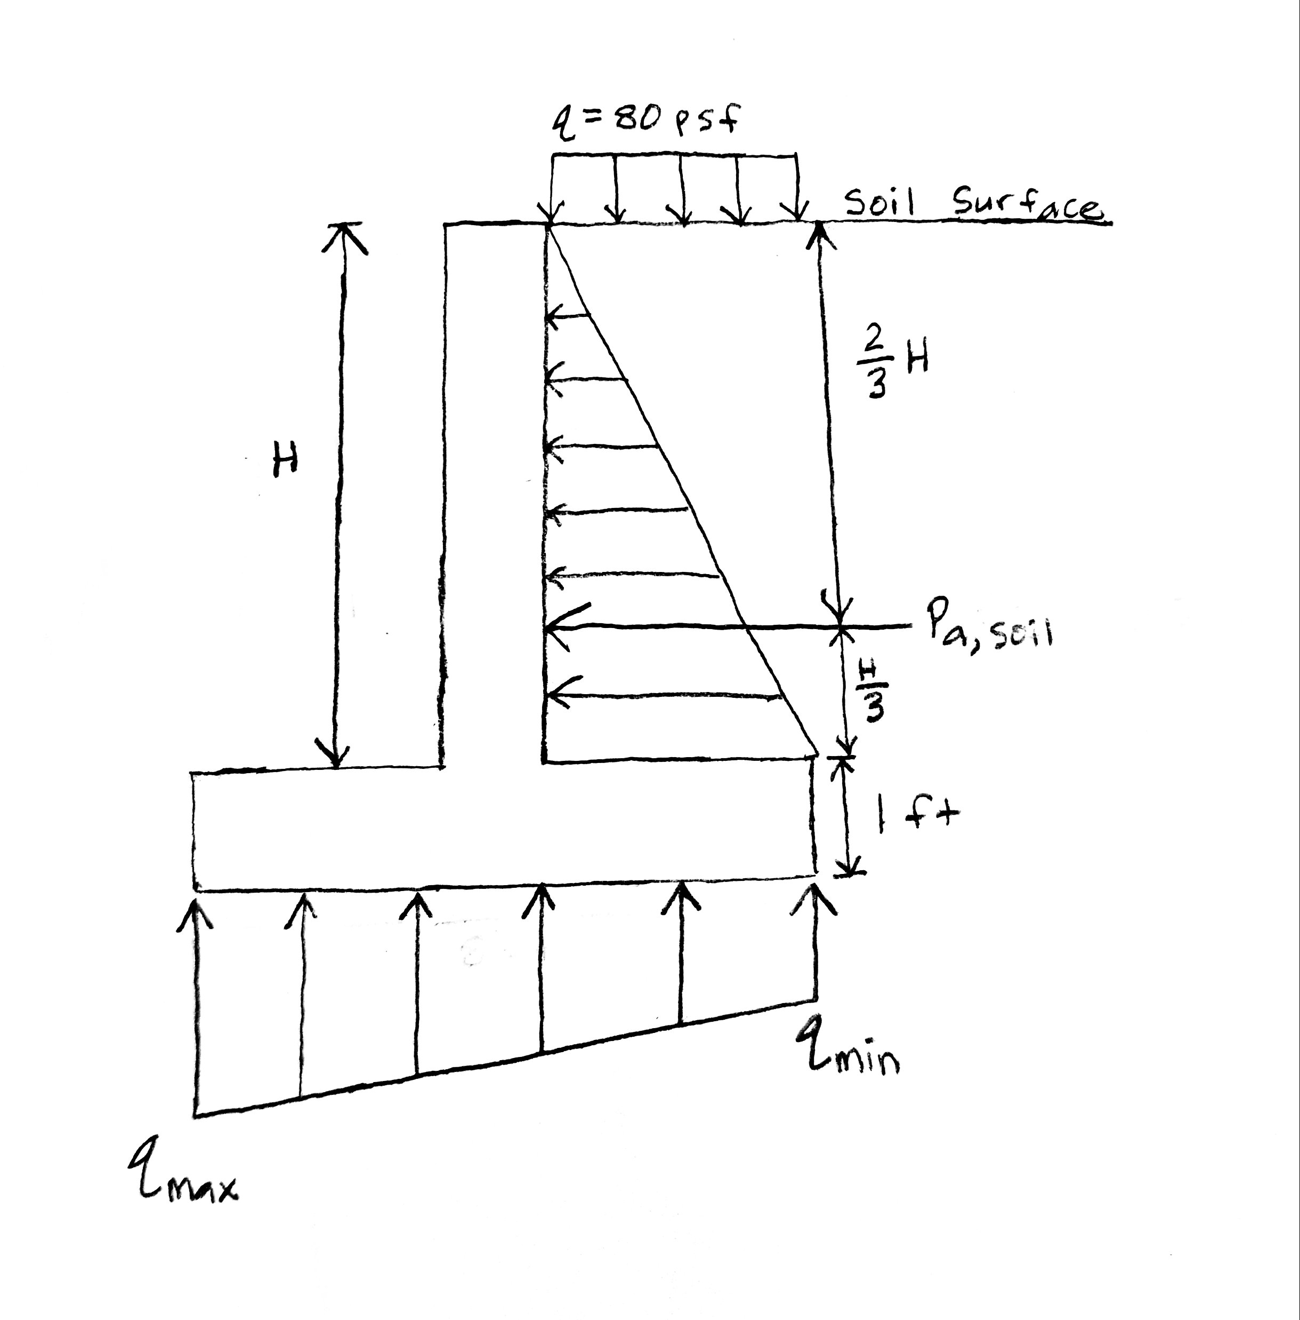
Structural Design
Largest part of the wall was designed for
Moment at base of wall was calculated due to active earth forces and an applied surcharge of 80 psf
Moment due to soil forces under foundation also calculated
The amount of steel needed in the wall and foundation was calculated based off of these moments
ACI 318-14 standards adhered to
Figure 14: Loading Used for Structural Design [2]

Slide 16
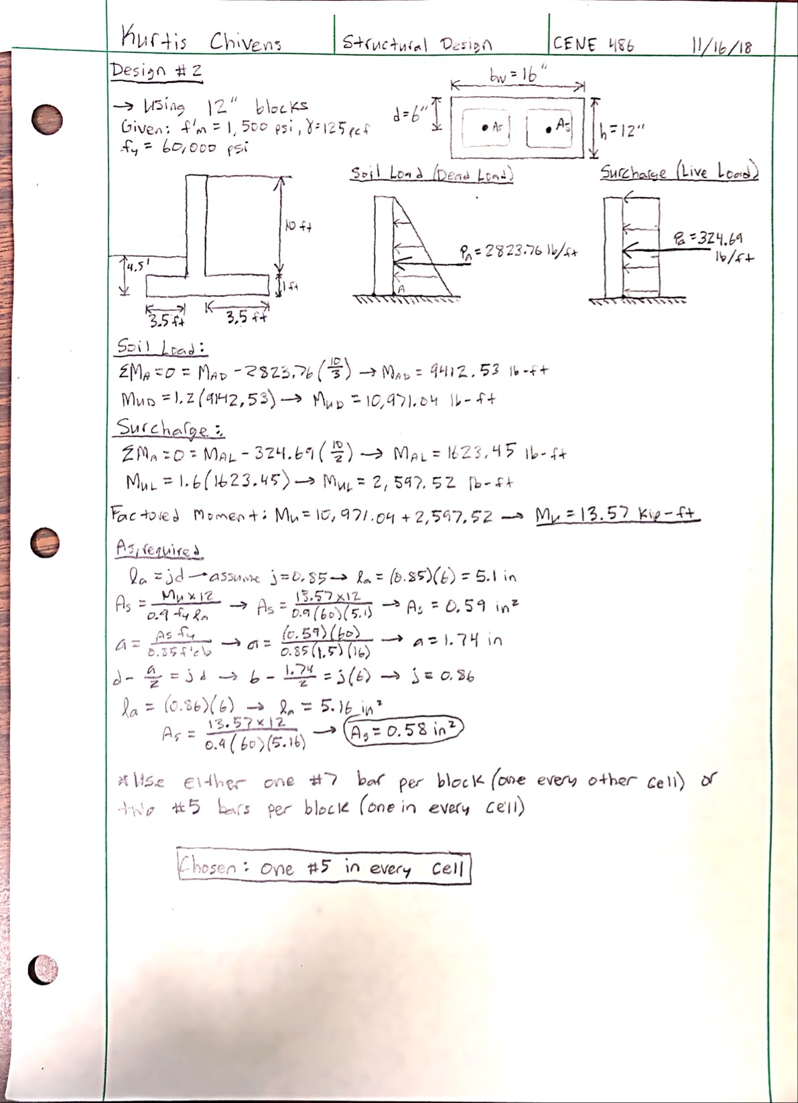
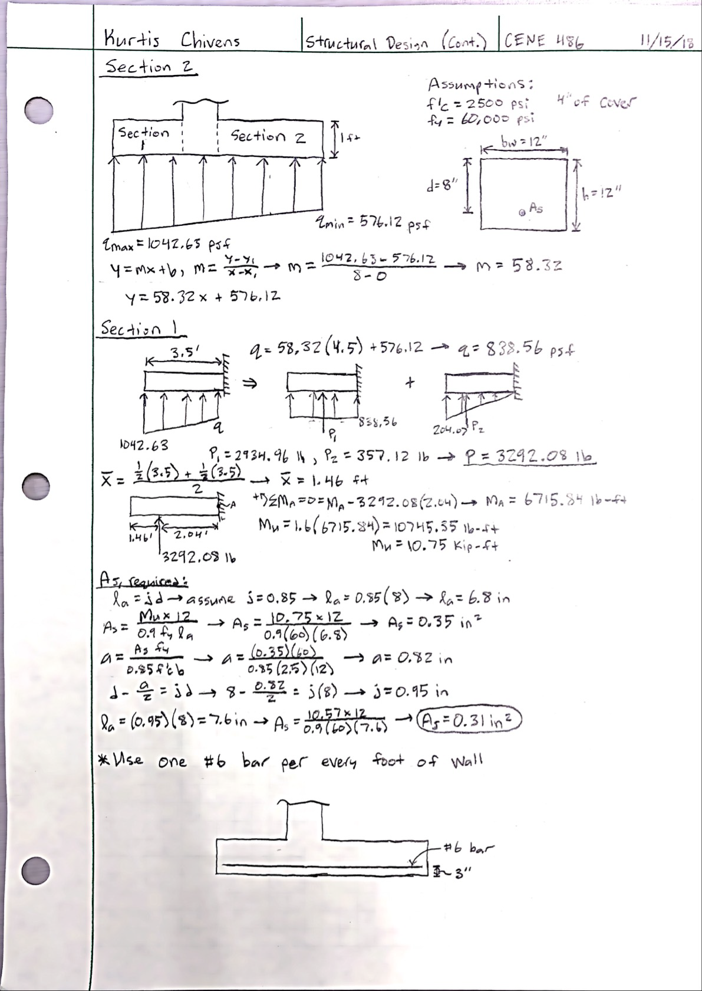
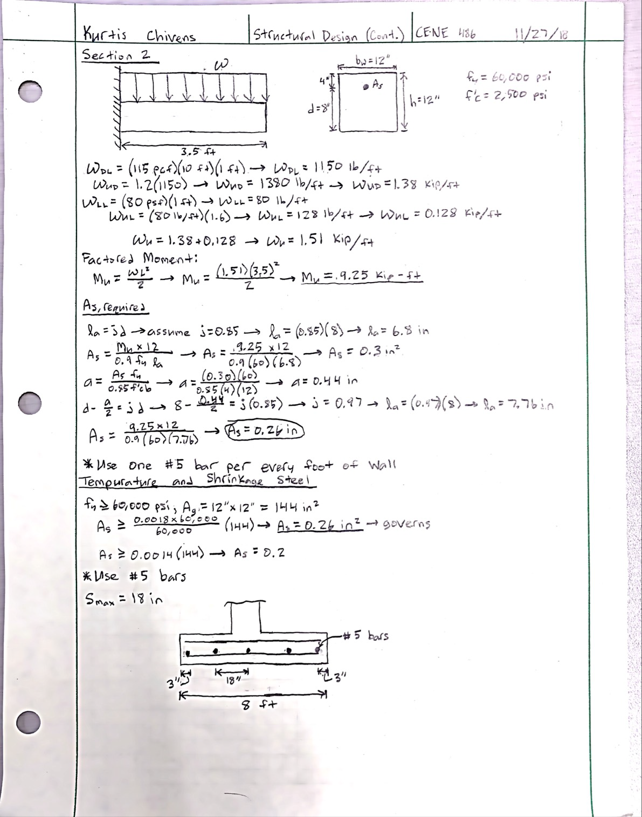
Structural Design
Figure 15a: Structural Calculations
Figure 15b: Structural Calculations
Figure 15c: Structural Calculations

Slide 17
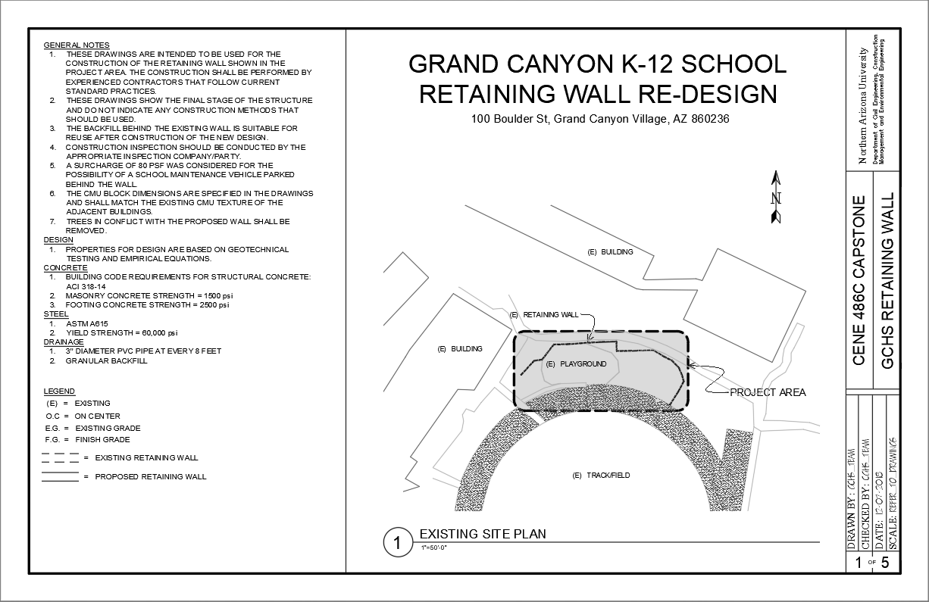
Construction Documents
Figure 16: Page 1 of Construction Documents

Slide 18
Construction Documents
Figure 17: Page 2 of Construction Documents

Slide 19
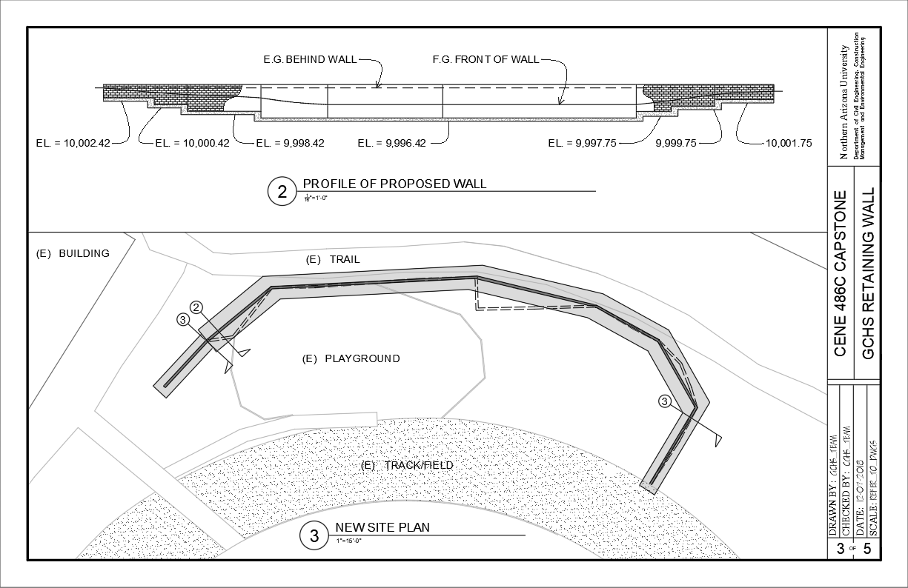
Construction Documents
Figure 18: Page 3 of Construction Documents

Slide 20
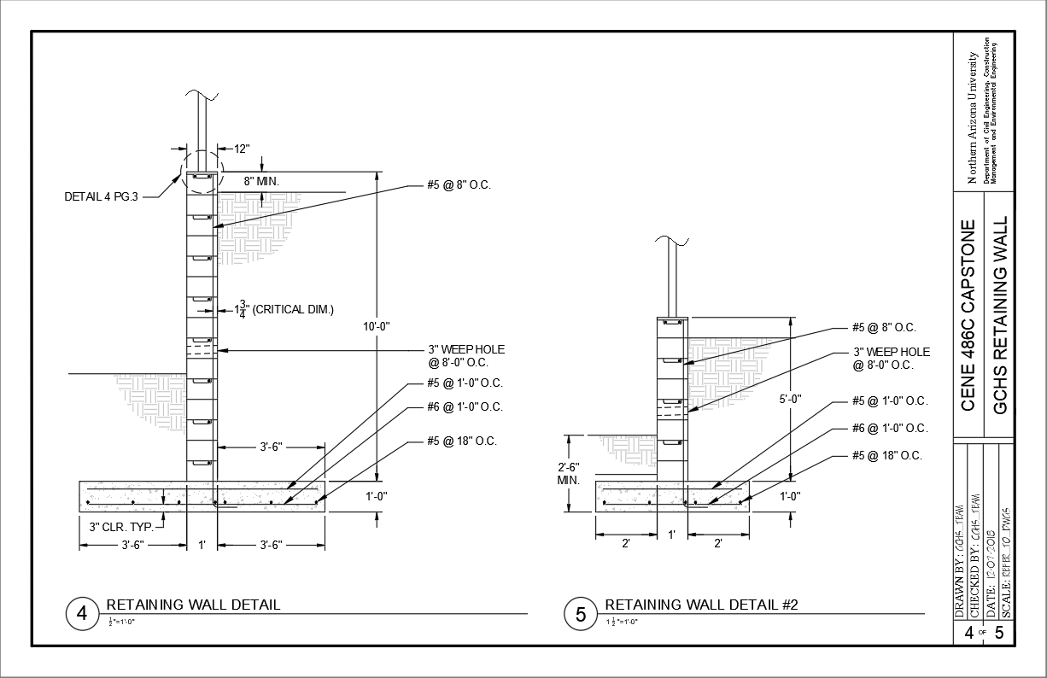
Construction Documents
Figure 18: Page 4 of Construction Documents

Slide 21
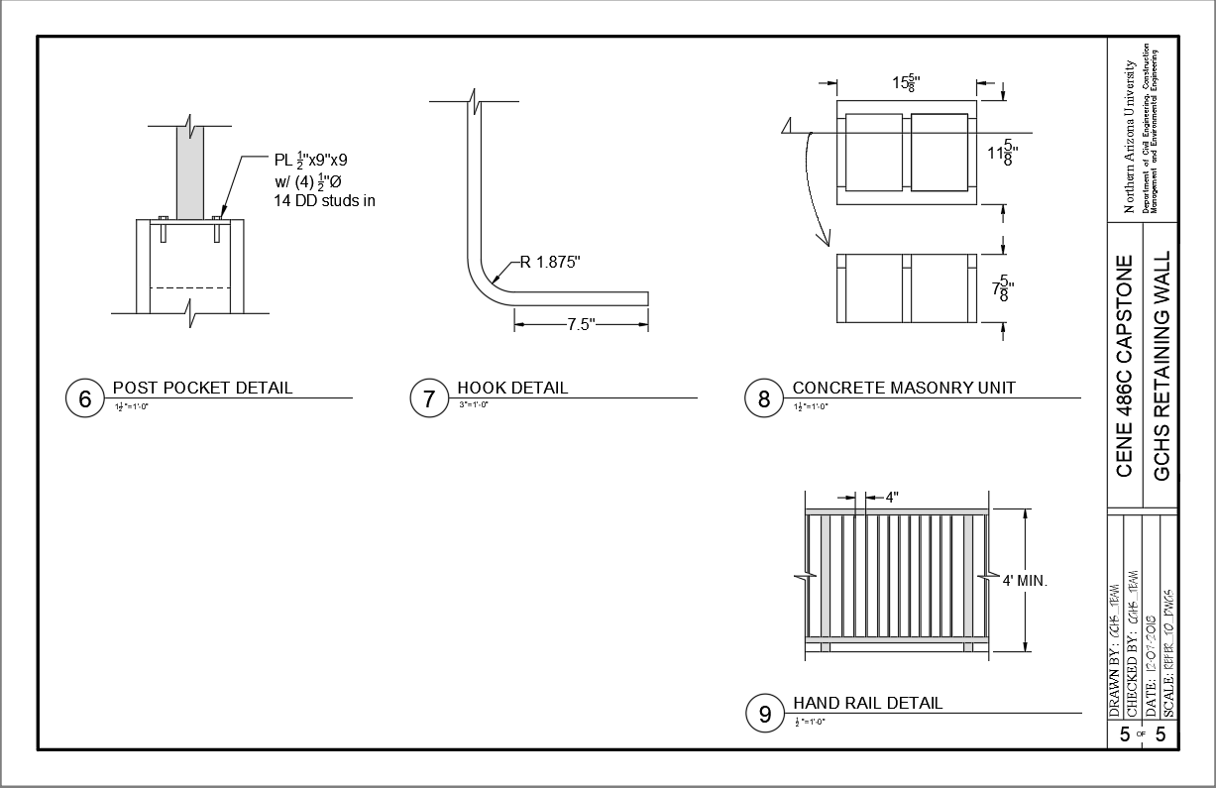
Construction Documents
Figure 18: Page 5 of Construction Documents

Slide 22
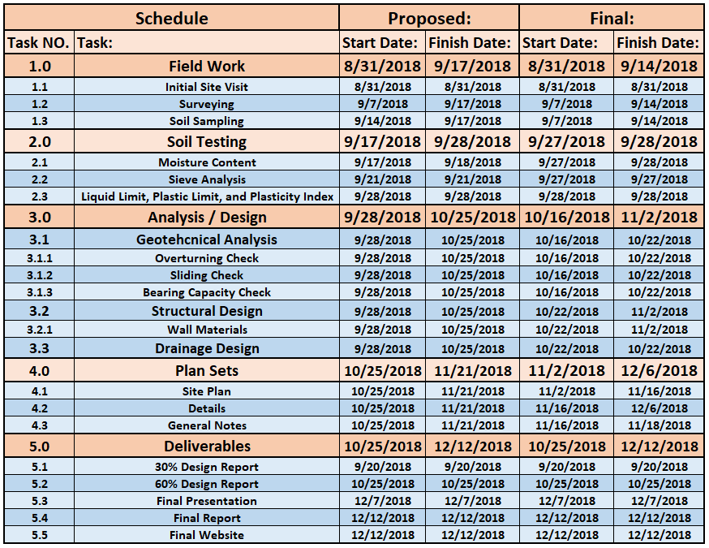
Schedule
Table 5: Proposed and Actual Schedule

Slide 23
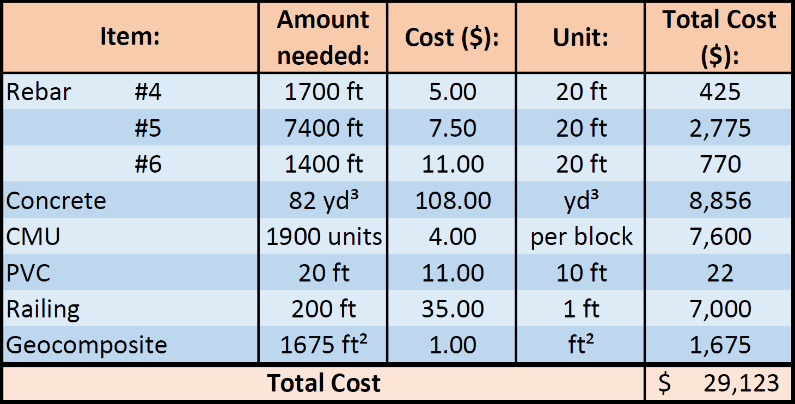
Material Cost
Currently In Progress
Table 6: Materials Cost [5-12]

Slide 24
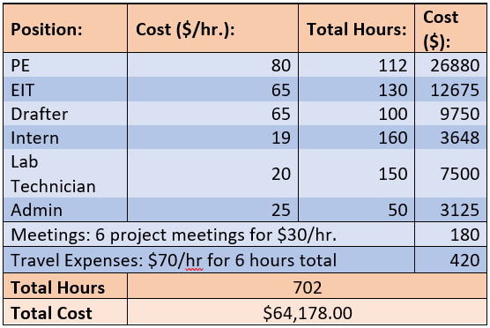
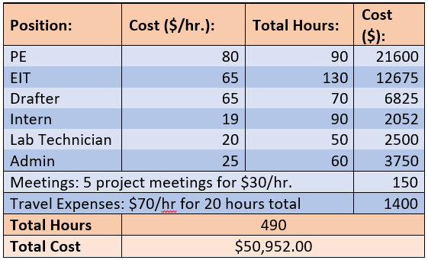
Summary of Engineering Costs
Table 7: Proposed Engineering Costs
Table 8: Actual Engineering Costs

Slide 25
References
[1] [Online]. Available: https://www.washingtonpost.com/lifestyle/travel/at-the-grand-canyon-a-cancer-survivor-rises-to-the-challenge-of-a-rim-to-rim-to-rim-hike/2017/01/05/c86d64f8-bd8f-11e6-91ee-1adddfe36cbe_story.html?noredirect=on&utm_term=.5f7e316e4dac.
[2] Pictures and work completed by Grand Canyon K-12 Retaining Wall Redesign Capstone Team (2018).
[3] "Retaining Wall Failure - Best Image Barokah.goodlook.site", Best Image Barokah.goodlook.site, 2018. [Online]. Available: http://barokah.goodlook.site/retaining-wall-failure/. [Accessed: 14- Apr- 2018].
[4] B. M. Das and N. Sivakugan, Principles of Foundation Engineering, Boston, MA: Cengage, 2017.
[5] "Mirafi® G-Series - TenCate Geosynthetics", Tencategeo.us, 2018. [Online]. Available: https://www.tencategeo.us/en-us/products/geocomposites/mirafi-g-series. [Accessed: 29- Nov- 2018].
[6] "Hugohd.com/editor - Free Online Image Editor For Everyone", Hugohd.com, 2018. [Online]. Available: http://hugohd.com/editor/?. [Accessed: 29- Nov- 2018].
[7] "W C Rebar," [Online]. Available: http://wcrebar.com/rebar-prices/.
[8] [Online]. Available: https://www.homeadvisor.com/cost/outdoor-living/deliver-concrete/.
[9] [Online]. Available: https://www.lowes.com/pl/Concrete-block-Concrete-cement-masonry-Building-supplies/4294515408.
[10] [Online]. Available: https://www.homedepot.com/b/Plumbing-Pipes-Fittings-PVC-Pipe-Fittings/N-5yc1vZbuf5.
[11] [Online]. Available: https://www.amazon.com/dp/B005TLKZLO/ref=psdc_10304191_t1_B005TLKSTS.
[12] [Online]. Available: http://www.centralconstructionsupply.com/j-drain-400-series-wall-drainage/?gclid=EAIaIQobChMIy6e1vq6M3wIVwx-tBh0aswBpEAkYASABEgKwdfD_BwE.

