Slide 1
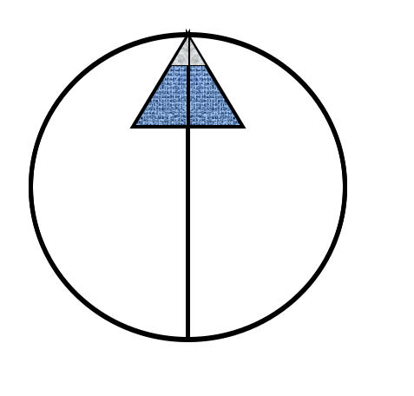
Copper Age Mine:
Preliminary Assessment and Site Inspection
Northern Arizona Consulting
UGRADS: April 27, 2018
Laura Garcia
Spencer Harvey
Carl Haskie
Sarah Reddinger
Notes:
spencer

Slide 2
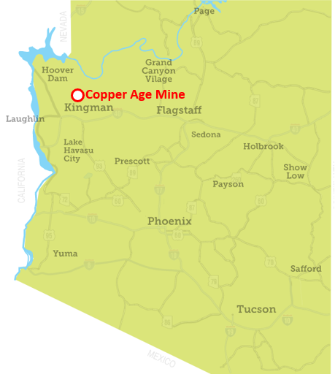

Project Background
Client: Bureau of Land Management
Location: Northwestern Arizona,
approximately 15 miles north of Kingman
Current Status: “Past Producer” [1]
Shipped mining commodities: 1900s-1940s
Objective: Perform a combined Preliminary Assessment and Site Inspection (PA/SI) via
the Comprehensive Environmental Response, Compensation, and Liability Act (CERCLA)
Figure 1: Copper Age Mine statewide location with respect to Kingman, AZ [2]
Notes:
spencer
Superfund = CERCLA
BLM wants site analyzed because recreationalists and potential wildlife exposure
Identify contaminants of concern; they need to know if there is contamination and if it’s severe enough to require removal
Operational from early to mid-1900s
Past producer indicates it produced zinc, gold, and copper

Slide 3
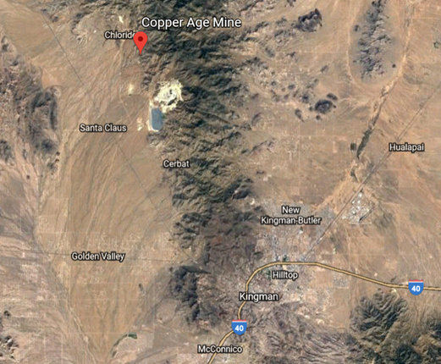
Project Background
Client: Bureau of Land Management
Location: Northwestern Arizona, approximately 15 miles north of Kingman
Current Status: “Past Producer” [1]
Shipped mining commodities: 1900s-1940s
Objective: Perform a combined Preliminary Assessment and Site Inspection (PA/SI) via the Comprehensive Environmental Response, Compensation, and Liability Act (CERCLA)
Figure 2: Regional location of the Copper Age Mine [3]
Notes:
spencer
BLM wants site analyzed because recreationalists and potential wildlife exposure
They need to know if there is contamination and if it’s severe enough to require removal
Chloride closest population, 2 miles northeast, 270 people
Operational from early to mid-1900s

Slide 4
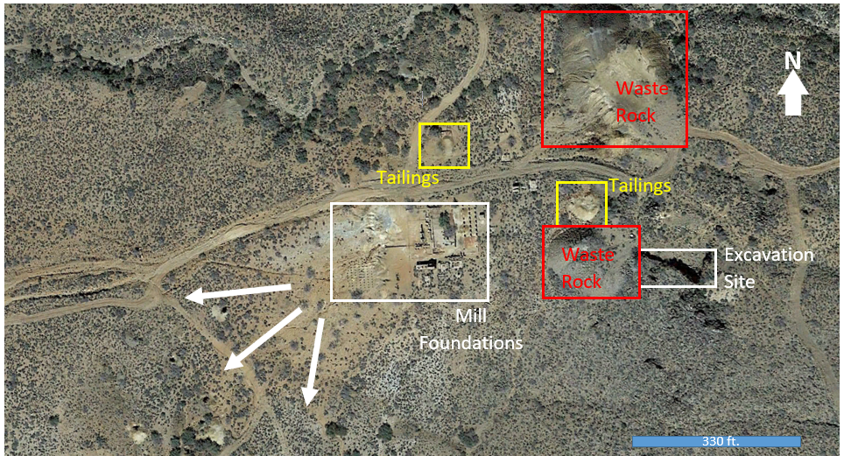
North
Wash
Figure 3: Aerial view of the Copper Age Mine [3]
Notes:
spencer
The labels, including tailings and waste rock, were provided by BLM. The arrows near the southwestern area of the site depict the general slope and possible migration pathways (arroyo).

Slide 5
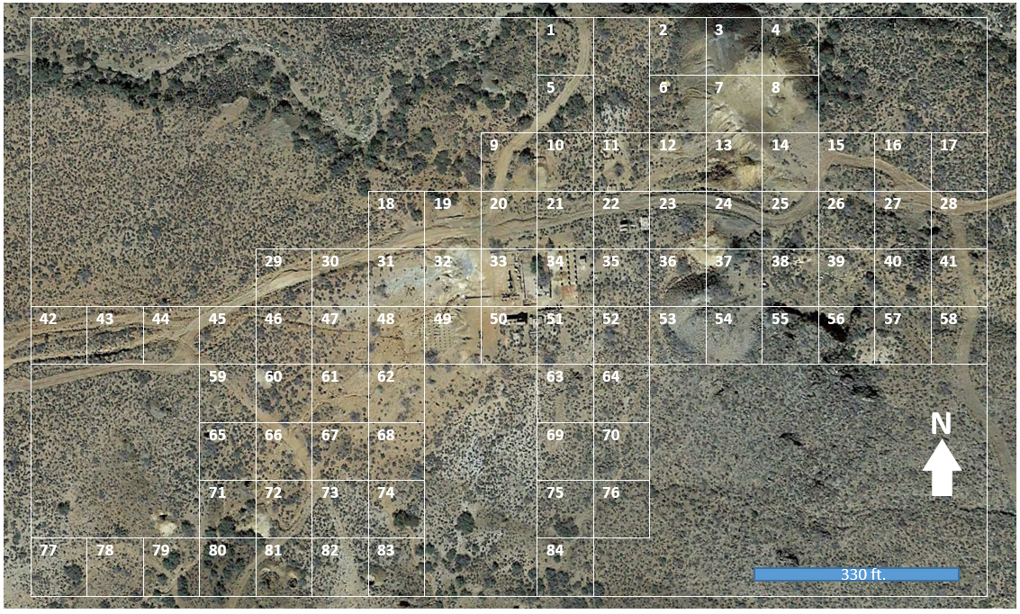
Figure 4: Proposed sampling grid for Copper Age Mine
Notes:
spencer
Grid sampling to minimize bias
Hotspot in north wash
Backgrounds

Slide 6
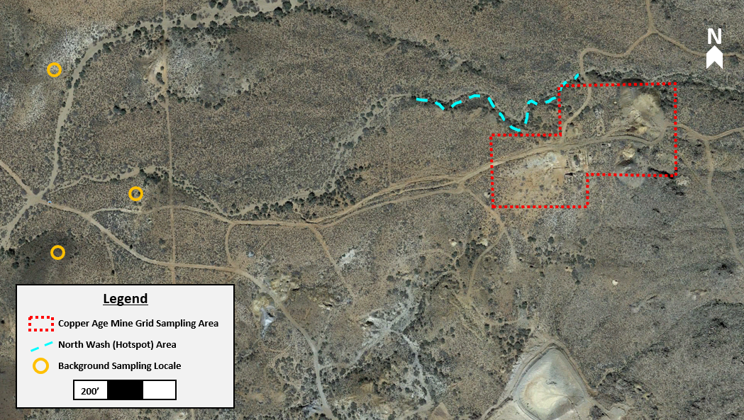
Figure 5: Grid, hotspot, and background sampling locations map

Slide 7
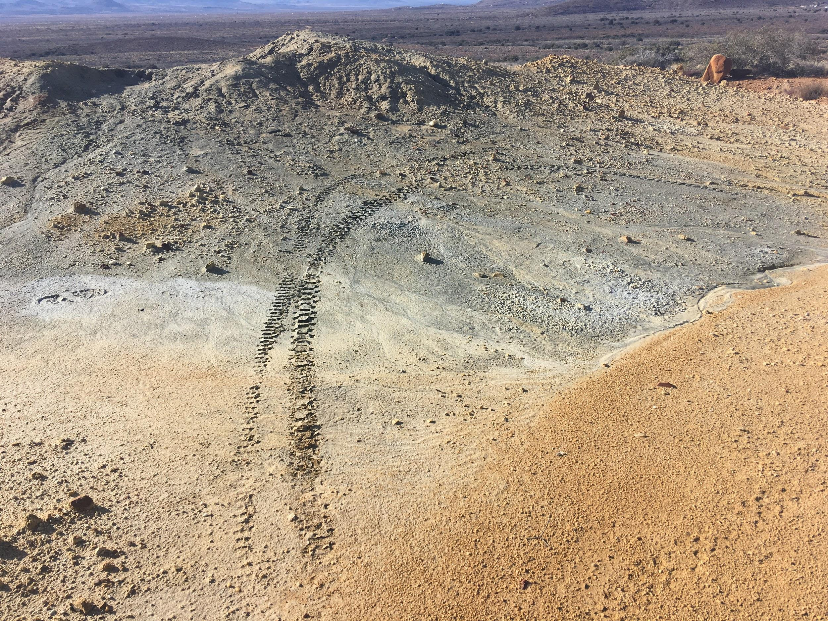
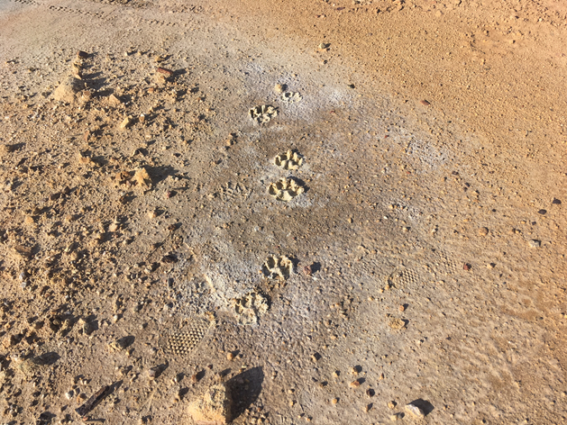
Field Work
Figure 6: Tire tracks found on site indicating human use. Photo Credit: Sarah Reddinger
Site Visit: January 19-20, 2018
Site Reconnaissance:
Identify potential hotspots
Observe site conditions for evidence of:
  Recreational activity
  Animal activity
Soil Sampling:
Grid (84)
Hotspot (7)
Background samples (3)
Figure 7: Human and Animal tracks found on site indicating recreational use. Photo Credit: Sarah Reddinger
Notes:
spencer
Total of 94 samples
Decon
Gps points

Slide 8
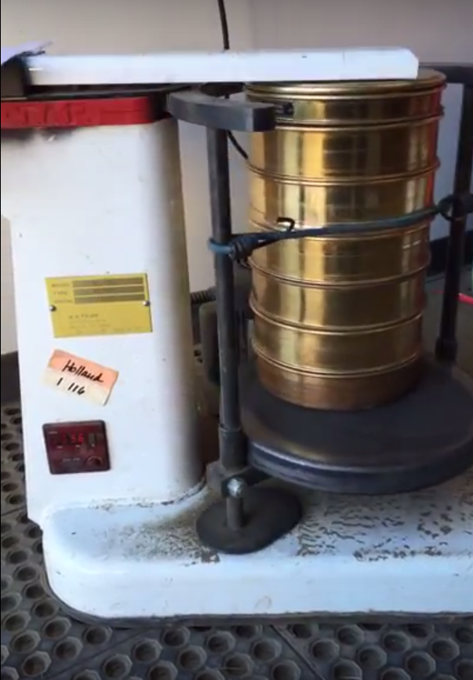
Laboratory Analysis: Sample Preparation
EPA Method 6200: Field Portable X-Ray Fluorescence Spectrometry for the Determination of Elemental Concentrations in Soil and Sediment [4]
Drying: 24 hours at 145 ℃
Sieving: Approximately 5-10 minutes; sample passed through 0.250 mm collected and bagged
Bagging: One-gallon freezer bag with a three by three grid
Figure 8: Mechanical shaker used to collect XRF samples. Photo Credit: Sarah Reddinger
Notes:
sarah

Slide 9
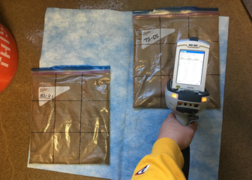
Laboratory Analysis: X-Ray Fluorescence
EPA Method 6200: Field Portable X-Ray Fluorescence Spectrometry for the Determination of Elemental Concentrations in Soil and Sediment [4]
Tasks Performed:
Sieved samples analyzed nine times with XRF
90-second readings of each grid square
Maximum and minimum readings removed, remaining averaged to identify contaminants of concern
Figure 9: Typical XRF analysis of samples. Photo credit: Sarah Reddinger
Notes:
sarah
Task 3: Laboratory Analysis
3.4 Data Analysis
●Antimony – FAAS results were Non-detect [3]
●Arsenic - Ouliers consisted of values exceeding the lead to arsenic ratio of 10:1 [4]
○These were removed
○Help increase correlation coefficient to 0.41

Slide 10
Preliminary Data Analysis
Contaminants of Concern: Arsenic, lead, and antimony were selected based on Arizona Non-Residential Soil Standards
Sample Selection: Twenty samples that best represented the arsenic, lead, and antimony concentration ranges
Samples then underwent further laboratory analysis at Colorado Plateau Analytical Lab on NAU campus
Table 1: Contaminants of concern concentration ranges, used in the selection of acid digestion samples
Concentration Range | Arsenic (mg/kg) | Lead (mg/kg) | Antimony (mg/kg)
Low | 0 | 25 | 0
Average | 450 | 46,610 | 250
High | 2,675 | 203,340 | 1,015
AZ Non-Residential Standard | 10 | 800 | 400
Notes:
sarah
Task 3: Laboratory Analysis
3.4 Data Analysis
●Antimony – FAAS results were Non-detect [3]
●Arsenic - Ouliers consisted of values exceeding the lead to arsenic ratio of 10:1 [4]
○These were removed
○Help increase correlation coefficient to 0.41

Slide 11
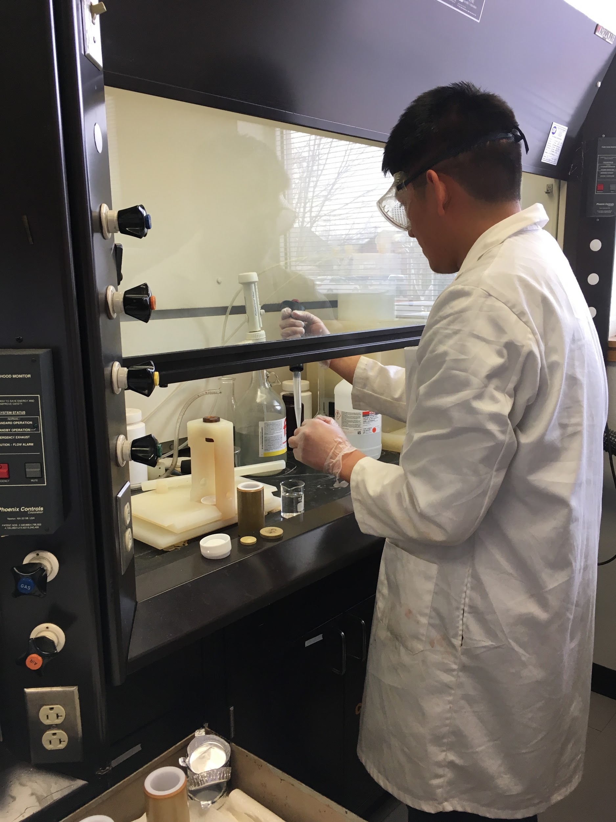
Laboratory Analysis: Flame Atomic Absorption Spectrophotometry
Laboratory Analysis: Flame Atomic Absorption Spectrophotometry
Sample Preparation: Acid Digestion
Colorado Plateau Analytic Lab Protocol: Total Phosphorus in Microwave Digests [5]
Third-Party Analysis: CPAL
Twenty samples underwent acid digestion, followed by Flame Atomic Absorption Spectrophotometry
Figure 10: Carl Haskie preparing samples for acid digestion. Photo Credit: Laura Garcia
Notes:
Carl
CPAL located at NAU

Slide 12
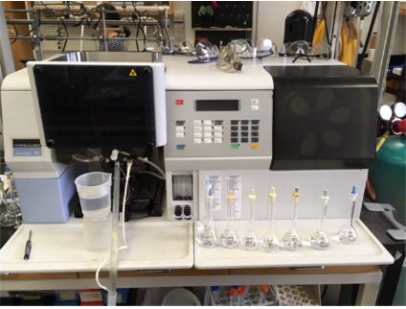
Laboratory Analysis: Flame Atomic Absorption Spectrophotometry
Sample Preparation: Acid Digestion
Colorado Plateau Analytic Lab Protocol: Total Phosphorus in Microwave Digests [5]
Third-Party Analysis: CPAL
Twenty samples underwent acid digestion, followed by Flame Atomic Absorption Spectrophotometry
Figure 11: FAAS Instrument in the CPAL at Wettaw Biology Building. Photo Credit: Carl Haskie
Notes:
carl

Slide 13
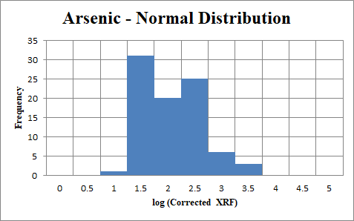
Data Analysis: Arsenic Correlation
Outliers: Samples with lead to arsenic ratios equal or greater than 10:1 [4]
Correlation Coefficient (R): 0.64
Represents the relationship between FAAS and XRF data
Data Distribution:
Initially lognormally distributed
Log transformation to acquire normal distribution
Figure 12: Normal distribution of log transformed arsenic soil concentration using corrected XRF data
Notes:
carl

Slide 14
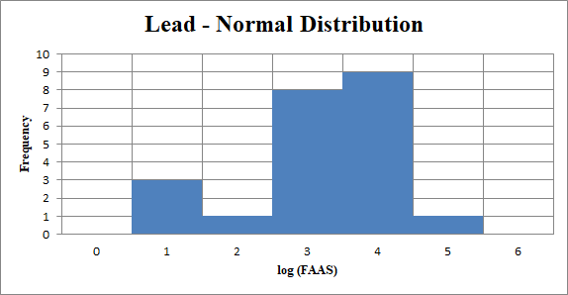
Data Analysis: Lead Correlation
Raw XRF data not included due to inconsistencies; only FAAS data was used
XRF Interferences:
Emission overlap with arsenic
Peak overlap with iron [6]
Correlation Coefficient (R): N/A
Data Distribution:
Binomial distribution after log transformation with raw XRF data
FAAS data used instead
Figure 13: Lognormally transformed normal distribution of FAAS lead data
Notes:
carl

Slide 15
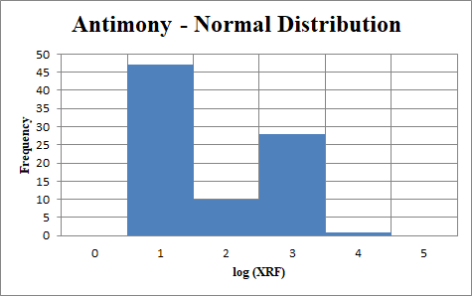
Data Analysis: Antimony Correlation
Non-detect in all FAAS results; only XRF data was used
Interference: Microwave acid digestion method found to be inefficient for antimony extraction [7]
Correlation Coefficient (R): N/A
XRF Data Distribution:
Initially lognormally distributed
Log transformation to acquire normal distribution
Figure 14: Lognormally transformed normal distribution of antimony soil samples
Notes:
carl

Slide 16
Data Analysis: Concentration Levels
Normally Distributed Data:
50% Concentration: Average of the applied data
95% Concentration: 50% concentration plus two standard deviations
Table 2: 50% and 95% Concentrations for the Contaminants of Concern
 | AZ Non-Residential Soil Remediation Levels (mg/kg) | 50% Concentration (mg/kg) | 95% Concentration (mg/kg)
Arsenic | 10 | 186 | 1,070
Lead | 800 | 3,245 | 15,800
Antimony | 400 | 176 | 732
Notes:
carl

Slide 17
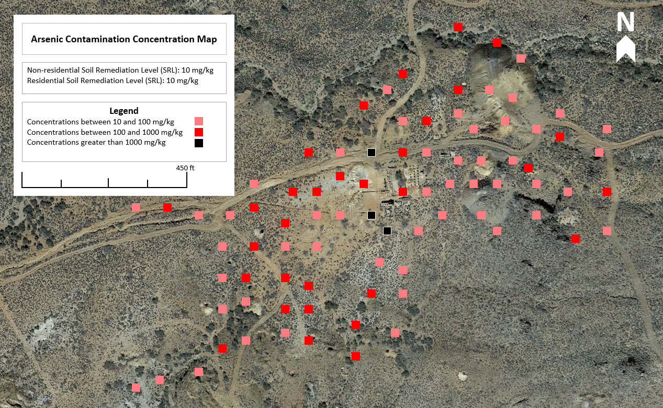
Notes:
spencer

Slide 18
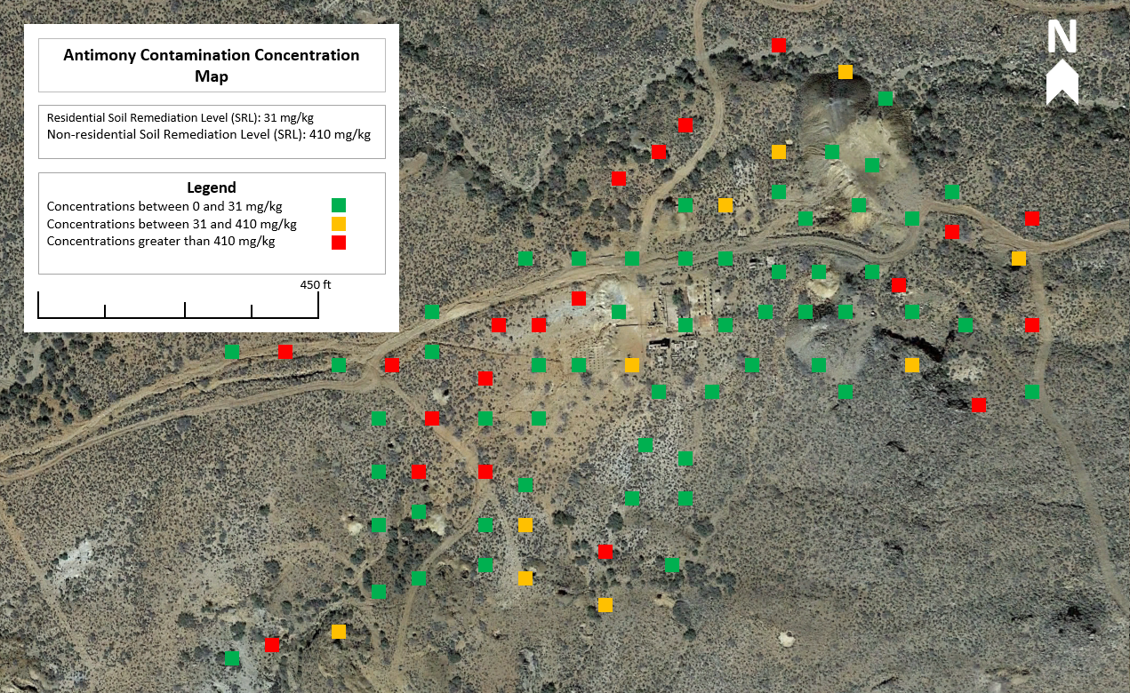
Notes:
spencer

Slide 19
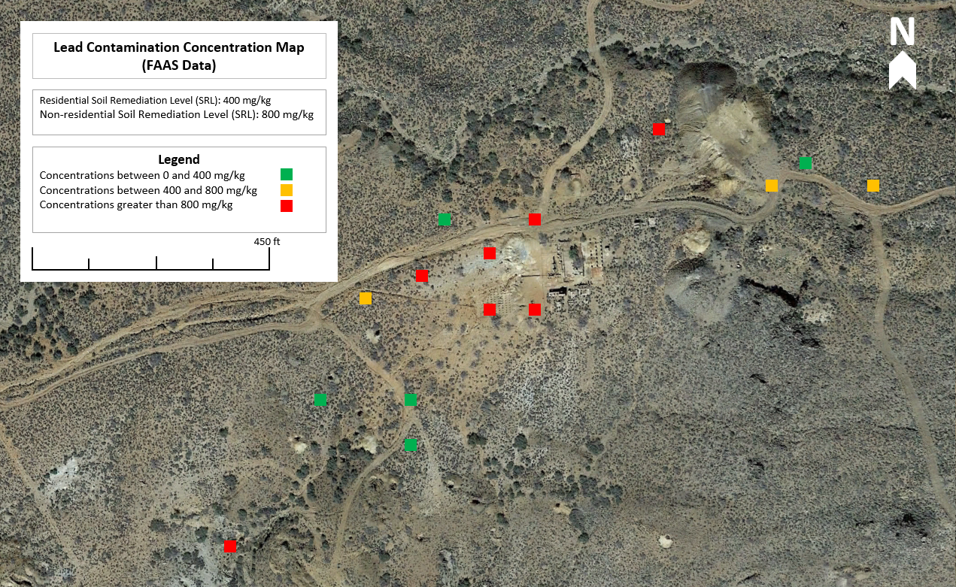
Notes:
spencer

Slide 20
Risk Assessment: Exposure Scenarios
Chronic Daily Intake (mg/kg-day): Carcinogenic and non-carcinogenic calculated.
Cancer Slope Factor for carcinogenic risk
Reference Dose for non-carcinogenic risk
Table 3: Exposure Scenarios Risk Summary for 50% Concentrations
 | Recreational Adult | Recreational Child | 1-Year Worker
Arsenic Non-Carcinogenic Risk Hazard Quotient | 0.03 | 0.07 | 0.54
Arsenic Carcinogenic Risk | 1.4E-4 | 9.3E-5 | 1.2E-4
Antimony Non-Carcinogenic Risk Hazard Quotient | 0.02 | 0.05 | 0.38
Antimony Carcinogenic Risk | N/A | N/A | N/A
Notes:
sarah
HQ not above 1

Slide 21
Risk Assessment: Exposure Scenarios
Chronic Daily Intake (mg/kg-day): Carcinogenic and non-carcinogenic calculated
Cancer Slope Factor for carcinogenic risk
Reference Dose for non-carcinogenic risk
Table 4: Exposure Scenarios Risk Summary for 95% Concentrations
 | Recreational Adult | Recreational Child | 1-Year Worker
Arsenic Non-Carcinogenic Risk Hazard Quotient | 0.20 | 0.41 | 3.13
Arsenic Carcinogenic Risk | 8.4E-4 | 5.3E-4 | 6.7E-4
Antimony Non-Carcinogenic Risk Hazard Quotient | 0.10 | 0.21 | 1.61
Antimony Carcinogenic Risk | N/A | N/A | N/A
Notes:
sarah
HQ not above 1

Slide 22
Risk Assessment: Adult Lead Model
US EPA Adult Lead Model (ALM): Analyzed adult lead blood levels (PbB) for recreationalists and workers [9]
Recommended Lead Blood Level (PbB): < 5 μg/dL
Table 5: Adult lead modeling exposure scenarios for recreational adult and 1-year worker
 | Recreational Adult | 1-Year Worker
Soil Ingestion Rate (g/day) | 0.1 | 0.1
Exposure Frequency (days/year) | 14 | 250
50% Adult PbB (ug/dL) | 1.5 | 11.6
95% Adult PbB (ug/dL) | 3.9 | 52.9
Notes:
sarah
Recreational adult: 14 day camping limit by blm
1-year worker: remediation scenario for site

Slide 23
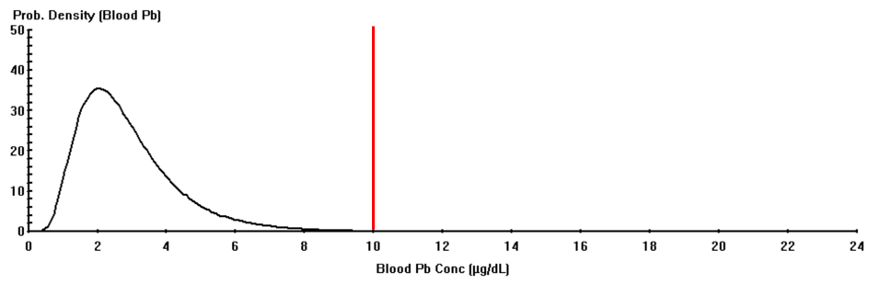
Risk Assessment: Child Lead Exposure
Integrated Exposure Uptake Biokinetic Model (IEUBK): Assesses blood level concentration in children under 7 years of age
Recommended Lead Blood Level: <10 μg/dL and < 5% probability [8]
50% Concentration: 0.24% above recommended level
95% Concentration: 6.4% above recommended level [8]
Figure 15: IEUBK Model Blood Lead Concentration for 50% lead Concentration
Notes:
laura
Mention different method for arsenic and antimony
Point out Red line
Not applicable for short term so it was corrected

Slide 24
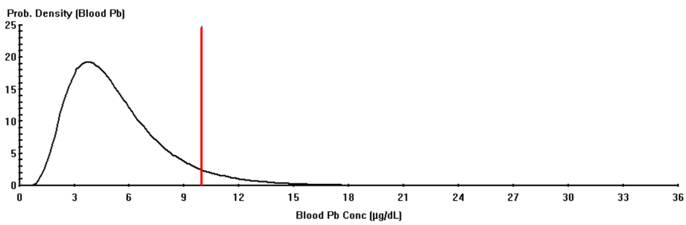
Risk Assessment: Child Lead Exposure
Integrated Exposure Uptake Biokinetic Model (IEUBK): Assesses blood level concentration in children under 7 years of age
Recommended Lead Blood Level: <10 μg/dL and < 5% probability [8]
50% Concentration: 0.24% above recommended level
95% Concentration: 6.4% above recommended level [8]
Figure 16:IEUBK model blood lead concentration for 95% lead concentration
Notes:
laura
Mention different method for arsenic and antimony

Slide 25
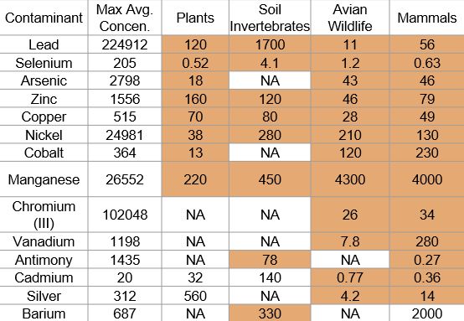
Risk Assessment: Ecological
Table 6: Copper Age Mine soil concentrations compared to the EPA soil screening levels (mg/kg) weight in soil).
EPA Risk Management Criteria [10]
Average XRF concentrations were compared to 15 elements and their respective Ecological Soil Screening Levels
All Copper Age Mine sample exceedances are highlighted
Notes:
laura

Slide 26
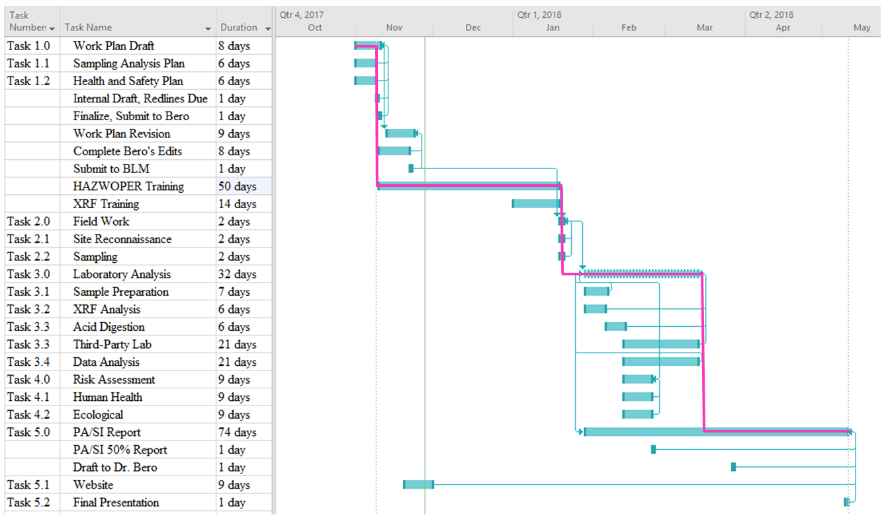
Notes:
laura
Project Management is

Slide 27
Staff Cost
Major Task | Senior Engineer | Engineer | Associate Engineer | Technician
Work Plan | 12 | 24 | 28 | 20
Field Work | 36 | 70 | 64 | 64
Lab Analysis | 10 | 24 | 75 | 92
Risk Assessment | 10 | 12 | 8 | 10
PA/SI Report | 30 | 28 | 46 | 44
Project Management | 30 | 42 | 26 | 26
Staff Total: | 128 | 200 | 247 | 256
Cost: | $16,000 | $16,000 | $9,880 | $8,960
The hourly rates cover overhead and benefits for each position.
Senior Engineer: $125/Hour
Total Hours: 128
Engineer: $80/Hour
Total Hours: 200
Associate Engineer: $40/Hour
Total Hours: 247
Technician: $35/Hour
Total Hours: 256
Total Staffing Cost: $50,840
Notes:
laura
Staff justifications/responsibilities
Senior Engineer is responsible for overseeing the entire process of the project, including critical decisions and overall approach
Engineering is responsible for more day-to-day operations, and overseeing other members of the team
The primary difference between the EIT and Tech is the Tech is more focused on lab work

Slide 28
Total Cost
The subtotal costs for each cost description with the total cost.
Personnel: Staffing costs.
Travel: Hotel, per diem, and van rental.
Materials: Sampling and lab work supplies.
Subcontractor: Colorado Plateau Analytical Lab services quote.
Training: XRF and 40-hour HAZWOPER.
Equipment: Includes the XRF instrument, GPS unit, and camera.
Total Cost: $59,017
Cost Description | Final Costs | Proposed Costs
Personnel | $50,840 | $61,730
Travel | $925 | $925
Material | $2,707 | $2,707
Subcontractor | $385 | $840
Training | $2,600 | $2,600
Equipment | $1,560 | $1,560
Total Costs: | $59,017 | $70,362
Notes:
laura
Staff justifications/responsibilities
Senior Engineer is responsible for overseeing the entire process of the project, including critical decisions and overall approach
Engineering is responsible for more day-to-day operations, and overseeing other members of the team
The primary difference between the EIT and Tech is the Tech is more focused on lab work

Slide 29
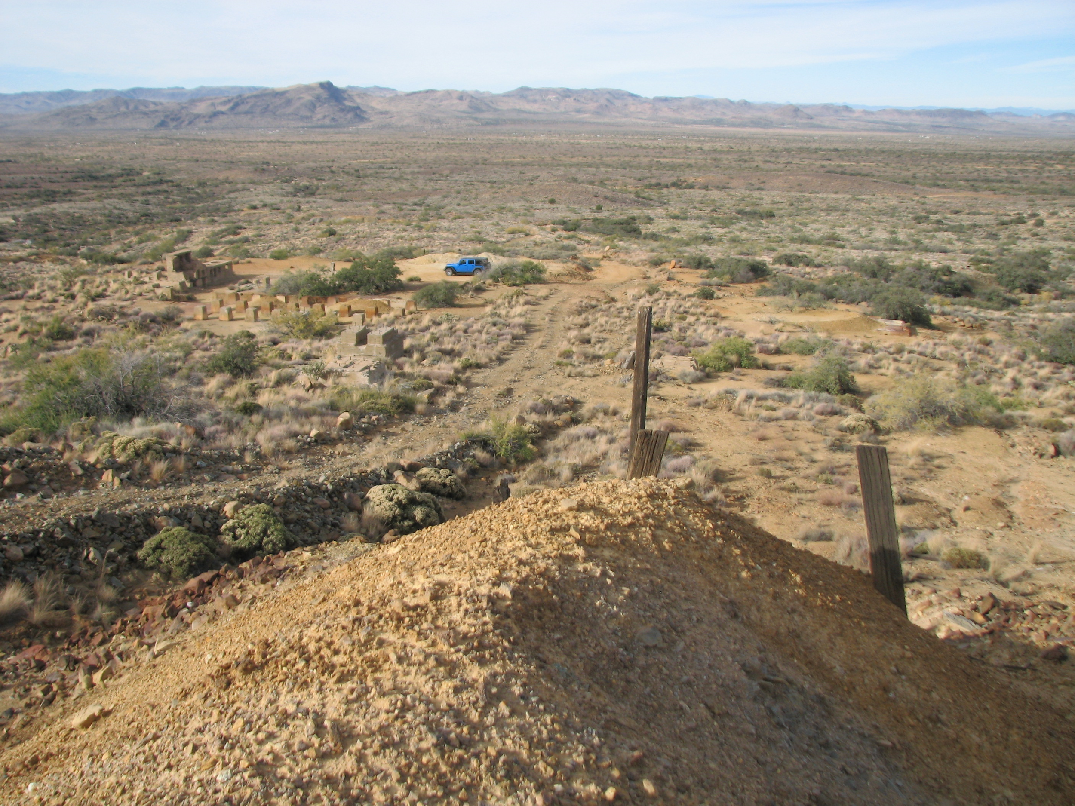
Acknowledgements
Eric Zielske, P.E., Client, Bureau of Land Management
Bridget Bero, Ph.D., P.E., Technical Advisor
Alarick Reiboldt, MEng, E.I.T., Grading Instructor, Advice Giver
Josue Juarez, Graduate Student Assistance
Adam Bringhurst, MEng, E.I.T., CENE Lab Manager
Jeffrey Propster and Bryden Baker, Colorado Plateau Analytical Lab
Marty Mihay, Instrumentation Specialist
Josh Froyum, Ingram Lab
Notes:
Travel includes: van rental, mileage, hotel, and per diems
Supplies:
Sampling Materials: ziplocs, tyvek suits, gloves, gps unit, shovels, etc. +20% fee
Analytical Materials and Lab Expendables: chemicals, safety glasses, lab coats, etc. +20% fee
Equipment: Field sampling/monitoring, safety, lab equipment
Training: XRF, HAZWOPER
Subcontracting: $35/sample, 20 samples. +20% fee

Slide 30
References
[1] "El Oro", Arizona Department of Mines and Mineral Resources File Data.
[2] Arizona State Parks and Trails, "Arizona State Parks," [Online]. Available: https://azstateparks.com/find-a-park/.
[Accessed 27-11-2017].
[3] Google Earth Pro 2017. 2017.
[4] "METHOD 6200 FIELD PORTABLE X-RAY FLUORESCENCE SPECTROMETRY FOR THE
DETERMINATION OF ELEMENTAL CONCENTRATIONS IN SOIL AND SEDIMENT", US EPA, 2007.
[5] Lachat method 13-115-01-B, Total P, Kjeldahl digests, Copper catalyst, Rev. 26-Oct-06.
[6] "Common Causes of Lead Interference Using XRF", XOS, 2013.
[7] M. Tighe, P. Lockwood, S. Wilson and L. Lisle, "Comparison of Digestion Methods for ICP-OES Analysis of a
Wide Range of Analytes in Heavy Metal Contaminated Soil Samples with Specific Reference to Arsenic and
Antimony", Communications in Soil Science and Plant Analysis, vol. 35, no. 9-10, pp. 1369-1385, 2004.
[8] TRW Lead Committee, “Training on the IEUBK Model”, US EPA. [Online]. Available:
https://semspub.epa.gov/work/11/176285.pdf
[9] "Lead at Superfund Sites: Software and Users' Manuals | US EPA", US EPA, 2017. [Online]. Available:
https://www.epa.gov/superfund/lead-superfund-sites-software-and-users-manuals.
[10] “Interim Ecological Soil Screening Level Documents”, US EPA. [Online]. Available:
https://www.epa.gov/chemical-research/interim-ecological-soil-screening-level-documents

